Slide 1
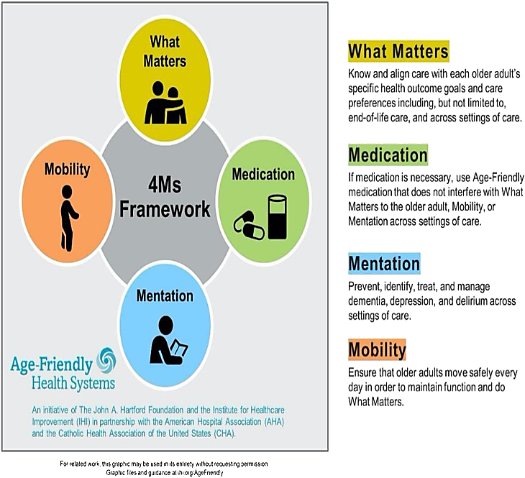
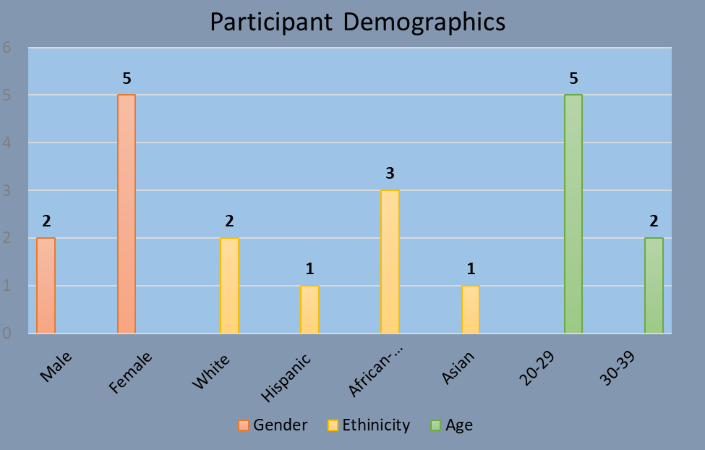
Nursing Students’ Response to the Age-Friendly Health Systems 4Ms Framework Curriculum
Timothy O’Connor, Ph.D.¹ Naushira Pandya, M.D.² Sweta Tewary, Ph.D.² Oksana Shnayder, B.S.² Elizabeth Campbell, DNP¹
¹Ron and Kathy Assaf College of Nursing
²Dr. Kiran C. Patel College of Osteopathic Medicine
Problem: There is a shortage of registered nurses, especially those choosing to work in long-term care. Providing interdisciplinary education on age-friendly health care to nursing students offers long-term care as a career option post-graduation. To evaluate the effectiveness of teaching nursing students about age-friendly health care, the students must provide adequate feedback on the educational content they receive. Purpose: This project is part of the Age-Friendly Health Systems 4Ms project and identified why nursing students did not complete a comprehensive survey after receiving an interdisciplinary educational session based on the Age-Friendly Health Systems 4Ms Framework. Research Design: A focus group design was used, and subjects were recruited from nursing students who received the educational session but did not complete the comprehensive survey. Questions for the focus group discussion were derived from the content received during the academic session and from the comprehensive survey. The focus group interview was audio-recorded, and the recordings were transcribed verbatim. Data Analysis: Focus group transcripts were analyzed using descriptive content analysis to determine themes. Results: The outcome of this study provided researchers with insight into why nursing students did not complete the comprehensive survey. The results of this study will help improve future comprehensive survey response rates for the remainder of the Age-Friendly Health Systems 4Ms project. Significance: The findings of this study enhances the validity and reliability of the comprehensive survey results and informs researchers across disciplines on how to avoid low survey response rates.
A focus group design is being used for this study. Participants were recruited from a group of students who received the educational training session but did not complete the comprehensive survey. Questions for the focus group discussion were derived from the content received during the educational session provided by the KPCOM and from the comprehensive survey. The focus group interview was audio-recorded, and the recordings were transcribed verbatim. Field notes were taken during the focus group to assist in coding the interview transcripts. Focus group transcripts were analyzed using descriptive content analysis to determine themes. Trustworthiness and rigor in the accuracy of coding the focus group transcripts was addressed by having the focus group moderator code 20 percent of the transcript the investigator also coded. The coded transcripts were compared, and coding was revised until an agreement was reached for the coding.
ABSTRACT
METHODS
FOCUS GROUP QUESTIONS
Question 1: Share with me what you can recall being discussed at the initial educational training session you received from the KPCOM faculty in November 2022?
Question 2: What comes to mind when you hear the term, Age-Friendly Health System care?
Question 3: What is one topic you recall being most relevant to you from the educational training session?
Question 4: What is one topic you recall as not being relevant to you from the educational training session?
Question 5: What are your thoughts about working in a nursing home after you graduate from the nursing program?
Question 6: Share with me reasons why you may not have completed the comprehensive survey after receiving the initial educational training session from the KPCOM faculty in November 2022.
Question 7: What could have been done differently so that you might have completed the comprehensive survey?
Question 8: Please take a few minutes to suggest how we might improve the educational training sessions?
Question 9: Please share any final thoughts you have about the educational training sessions and the comprehensive survey.
Through a process of selective reduction, the focus group transcript was read several times to identify the occurrence of terms related to the research question, why nursing students did not complete the comprehensive survey after receiving an interdisciplinary educational session based on the Age-Friendly Health Systems 4Ms Framework. Words, phrases, and terms related to the research question were extracted and coded based on frequency in occurrence. Coding rules were followed for translating the text into codes that were categorized based on their thematic relationship. Initially, seven categories were combined into three; pertaining to the interdisciplinary educational session, age-friendly care in long term care and completing the comprehensive survey. Three themes emerged from the codes and categories, impacting, and experiencing the educational session, providing and doing the comprehensive survey, and conditioning and impacting from age-friendly care. Students were more likely to complete the comprehensive survey when given the chance to interact and engage with faculty during the presentation. More students would have completed the comprehensive survey if given the time during class. Lastly, students have preconceived notions about older adults and working in long term care that may hinder participation in the project.
RESULTS
The South Florida Geriatric Workforce Enhancement Program (SFGWEP), located within Nova Southeastern University's Dr. Kiran C. Patel College of Osteopathic Medicine (KPCOM), has partnered with Nova Southeastern University’s Ron and Kathy Assaf College of Nursing (ACON) to provide an evidence-based practice curriculum on nursing home care of older adults within the context of the Age-Friendly Health Systems 4Ms framework. The 4Ms is an evidence-based geriatric model consisting of four core features that lay the foundation of age-friendly care (Hartford Institute for Geriatric Nursing, 2021), including health outcomes that matter, maintaining mobility, eliminating medication interference and addressing mentation issues such as depression, dementia, and delirium (Institute for Healthcare Improvement, 2023).
INTRODUCTION
This study set out to gain a greater understanding of why a group of nursing students did not complete the comprehensive survey after receiving the interdisciplinary educational training session on the 4Ms. The results emphasize the need to engage students during the training session by providing opportunities for students to interact with the faculty and peers. Students are more likely to complete the comprehensive survey if given time in class following the educational session. An unexpected finding from the study was that students have negative perceptions about older adults and working in long term care based on past personal experiences. Faculty will need to consider a student’s presumptions about aging and providing age-friendly care. The results from this study will assist in improving student response rate for SFGWEP’s Age-Friendly Health Systems 4Ms.
American Geriatric Society. (n.d.). GWEP coordinating center. https://www.americangeriatrics.org/programs/gwep-coordinating-center.
Hartford Institute for Geriatric Nursing. (n.d.). Age-friendly health systems: The 4M’s. https://www.johnahartford.org/grants-strategy/current-strategies/age-friendly/age-friendly-care.
Health Resources & Services Administration. (n.d.). Geriatrics workforce enhancement program competing supplement. https://www.hrsa.gov/grants/find-funding/HRSA-21-111.
Institute for Healthcare Improvement. (n.d.). Age-friendly health systems. https://www.ihi.org/Engage/Initiatives/Age-Friendly-Health-Systems/Pages/default.aspx.
DISCUSSION
REFERENCES

