Slide 1
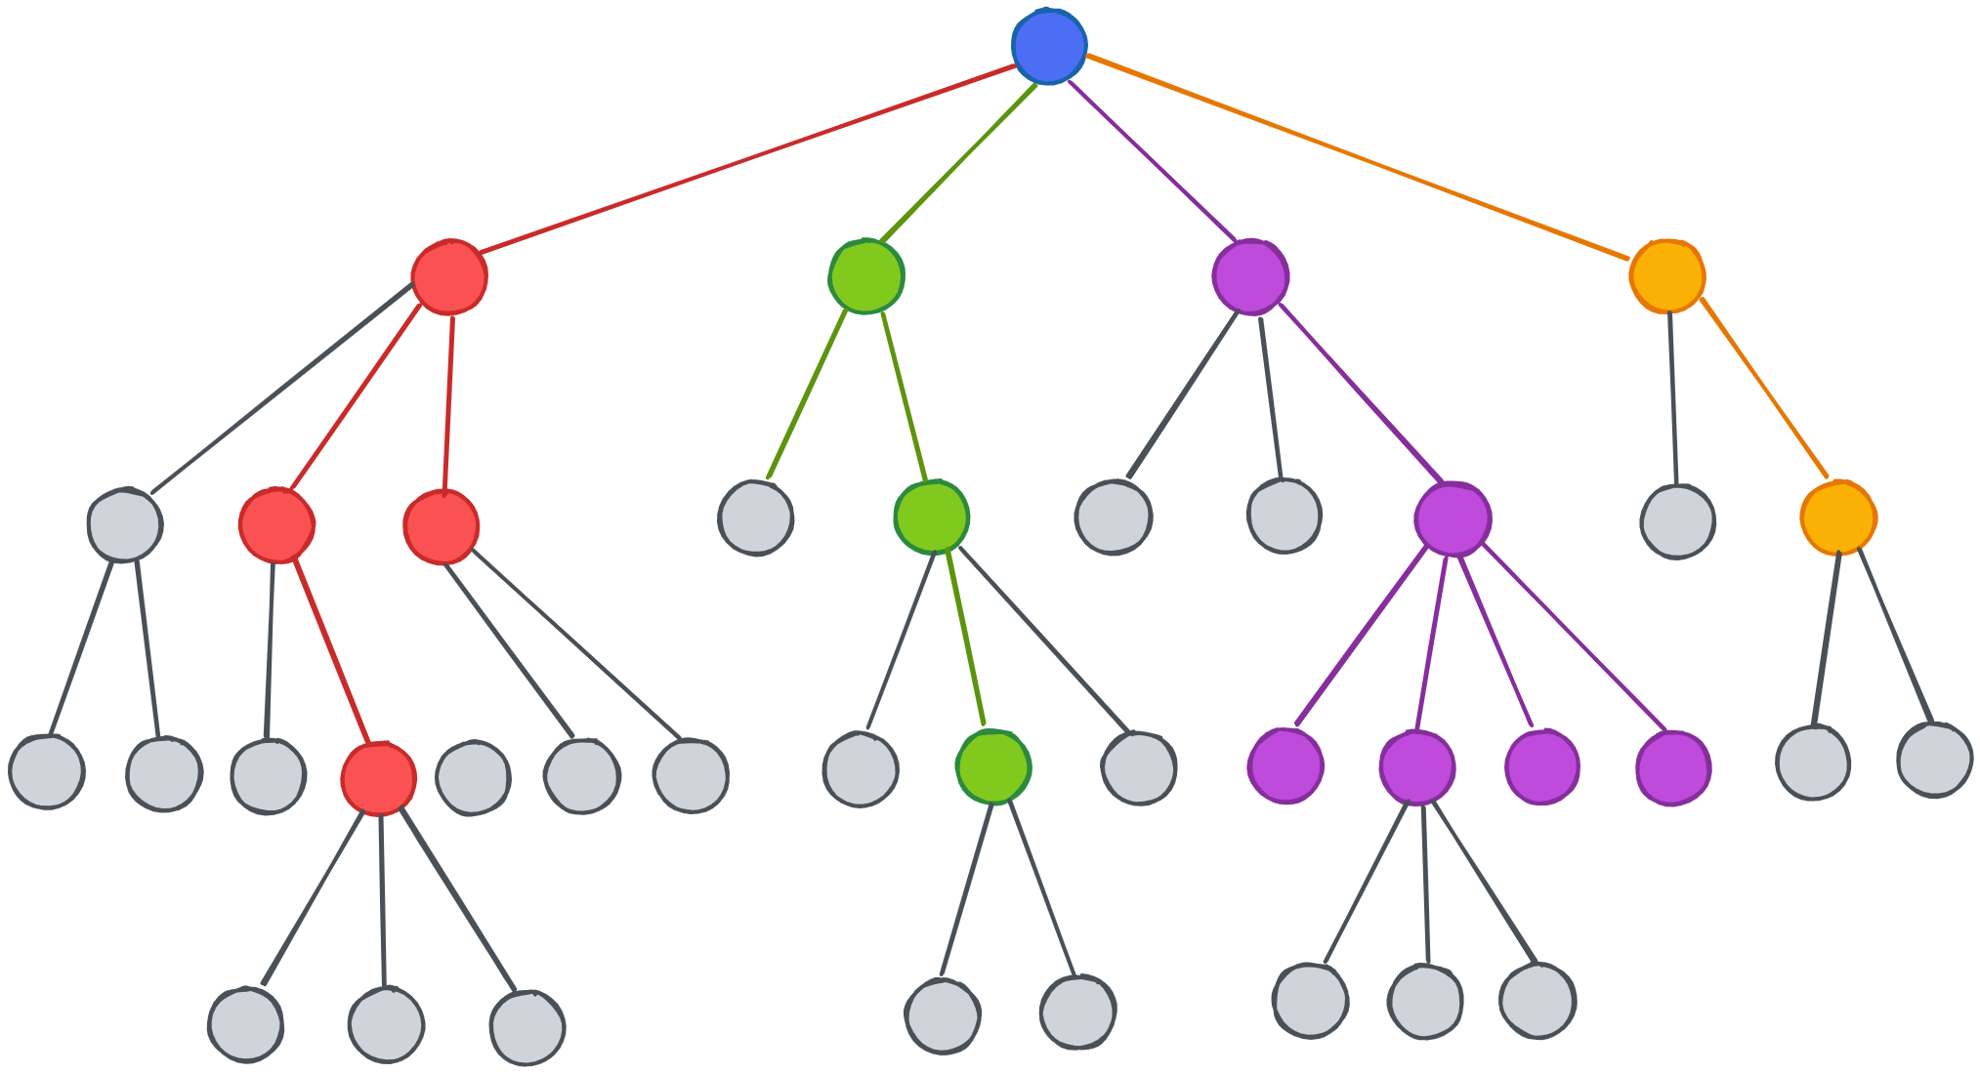
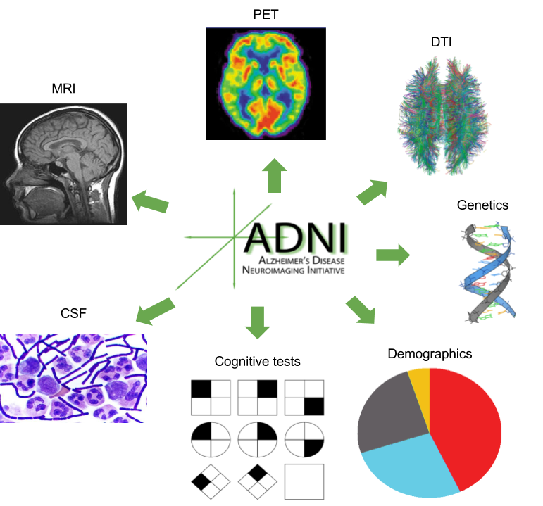
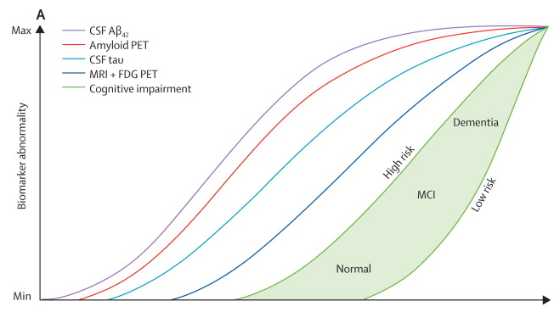
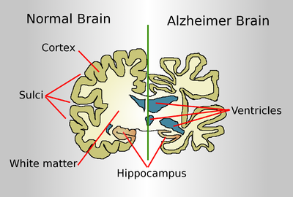
Development of models of Alzheimer's disease progression using longitudinal patient data
Tara Ghafourian, Vivek Patel, Benedict Albensi
Barry & Judy Silverman College of Pharmacy
Introduction
Objectives
Proposed Methods
To develop new models of Alzheimer’s disease progression by using various machine learning algorithms. The models should be able to predict future key outcomes:
Clinical diagnosis
Cognitive test results
Imaging results such as total volume of the ventricles.
2. Identify patient factors that impact the future diagnosis of AD or disease progression: lifestyle attributes, existing comorbidities (and biochemical features of comorbidities such as inflammation biomarkers), medications used for these comorbidities, and pharmacological interventions for AD on the disease progression by interpreting the models obtained in objective 1.
We propose to develop models of Alzheimer’s disease progression using variants of decision tree algorithms and ensembles. We also propose Constructed Temporal Features (CTFs) for the supervised machine learning problem of longitudinal classification.
Alzheimer’s Disease is a key challenge for healthcare. Longitudinal (observational) databases document heterogeneous patient experiences over time and provide the unique potential for mining important information from the data. ADNI is a multicenter longitudinal study collated from patients at different stages of the disease and from healthy volunteers. Disease progression is tracked using neuroimaging methods, biochemical biomarkers, and cognitive test scores. Genetics and demographic data are also collated. data archive hosted at the Laboratory of NeuroImaging (LONI) at the University of Southern California [1].
Diffusion tensor imaging, a new MRI technique to analyze the anatomy of neuronal network: AD shows progressive disruption of the brain connectome.
Previous Models and Data-Driven Methods
Conclusion
differences in glucose metabolism, amyloid plagues and tau tangles
Previous models indicate a complicated relationship between various biomarkers of the disease and the clinical measures of cognitive decline. Decision tree algorithms may improve prediction accuracy given the non-linearity of the data as they do not postulate any particular type of data distribution or model structure, with the ability to cope with complex relationships. In addition, by using CTF, time indexes of the biomarkers will be considered in the modeling to account for temporal patterns. This is the second novelty of the proposed method that has the potential to improve the algorithms’ predictive performance when applied to longitudinal data.
The focus is to identify patient factors that may be modifiable lifestyle options or comorbidities that may be managed/treated by various interventions. Hence, identifying such factors will impact the patients’ health outcomes.
model of dynamic biomarkers of the Alzheimer's disease pathological cascade [2]
APOE ε4 and whole genome sequencing
Tau-weighted distance
(Model 1), tau-weighted functional connectivity (Model 2), and tau- & distance-weighted functional connectivity (Model 3) models of group-mean annual tau-PET change in 53 Aβ+ ADNI [3]
Overall health and history, education, etc.
Previous literature has reported computational models and data analysis to identify and/or validate disease progression scores from various biomarkers. Some previous models assume constant disease progression rates [4-5] or use logistic curves to describe the non-linearity in data [6-7].
References
CSF proteins: Tau and β-amyloid
Synaptic biomarkers
[1] https://ida.loni.usc.edu/login.jsp
[2] Jack CR et al, 2013, Tracking pathophysiological processes in Alzheimer’s disease: an updated hypothetical model of dynamic biomarkers. Lancet Neurol. 2013;12:207-216
[3] Franzmeier N, et al. Functional brain architecture is associated with the rate of tau accumulation in Alzheimer’s disease. Nat Commun. 2020;11:347.
[4] Beheshti et al 2022, J Alzheimers Dis. 89, 1493-1502, https://doi.org/10.3233/JAD-220585
[5] Jedynak et al 2015, Neurobiology of Aging, Suppl 1, Pages S178-S184, https://doi.org/10.1016/j.neurobiolaging.2014.03.043
[6] Delor et al 2013, CPT: Pharmacometrics & Systems Pharmacology, 2: 1-10 78, https://doi.org/10.1038/psp.2013.54
Galasko et al 2019, Alzheimers Dement (N Y) 5, 871-882. https://doi.org/10.1016/j.trci.2019.11.002
[7] Samtani et al 2013, Br. J. Clin. Pharmacol. 75, 146–161, https://doi.org/10.1111/j.1365-2125.2012.04308.x
ADAS-cog and CDR-SOB
Research Team
neuropsychological tests of brain function: memory, executive function, and the ability for daily living activities
The interdisciplinary team includes a Cheminformatician and pharmacologist with expertise in Machine Learning and mathematical modeling applied to pharmaceuticals and drug properties (Tara Ghafourian), who is collaborating with a neuroscientist focused on the biological basis of Alzheimer's disease (Dr Albensi), supervise a Pharm.D. student.
AD pathology is already present in people without signs of memory loss: subtle brain atrophy with characteristic pattern

