Slide 1
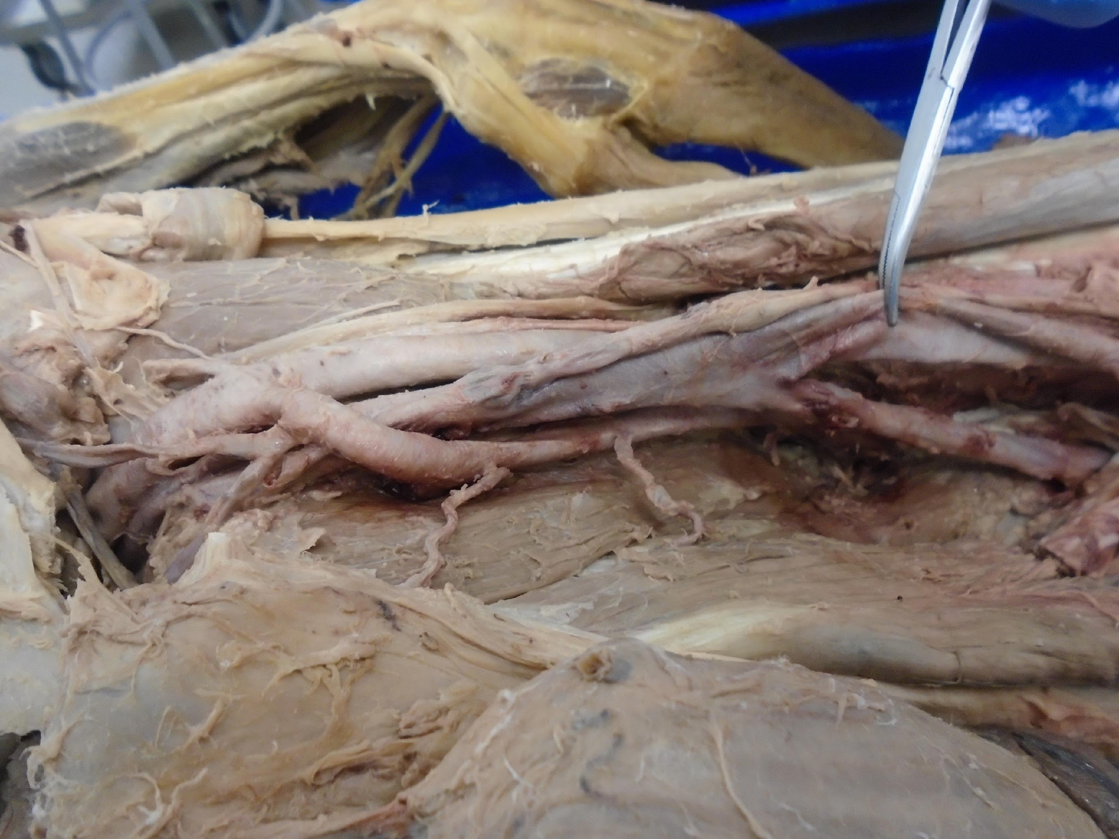
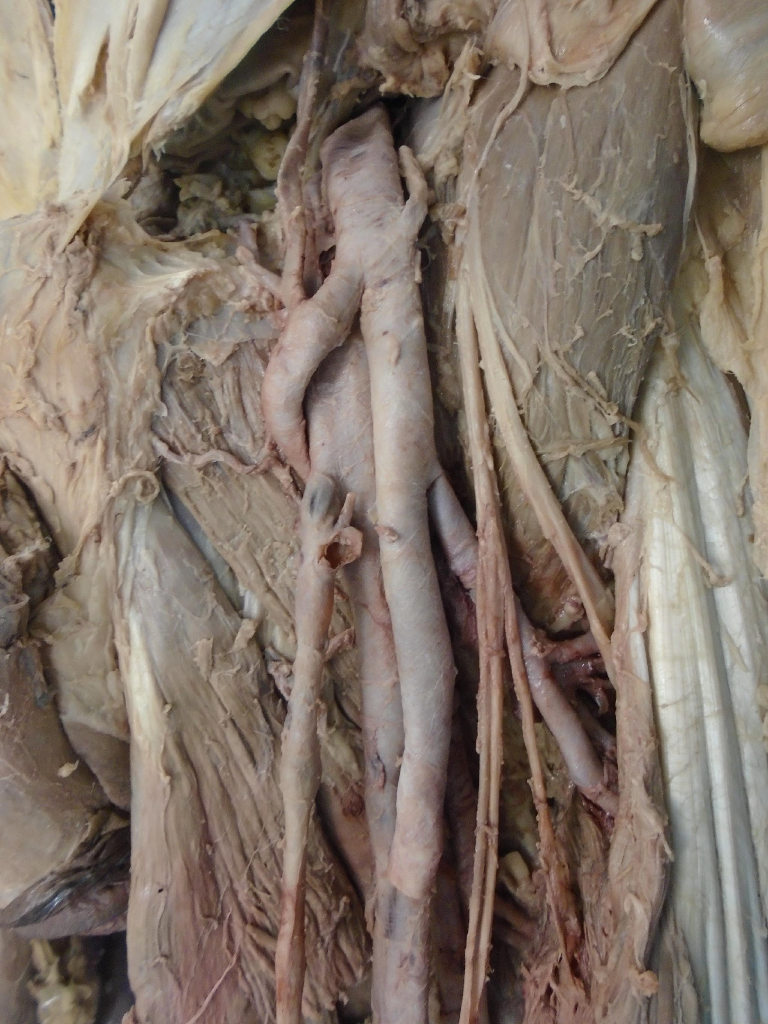
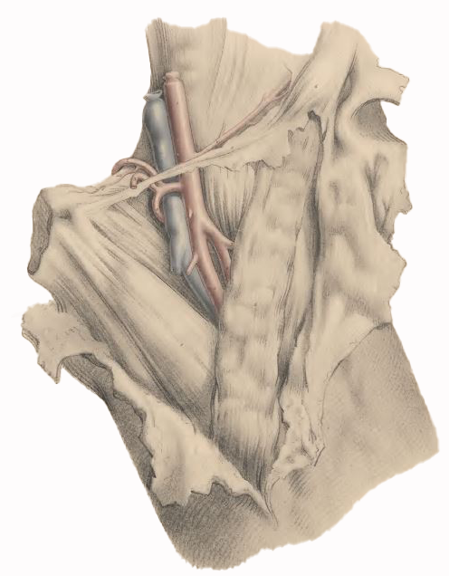
A Variant Deep Femoral Artery Passing Anterior to Femoral Vein: Implications in Femoral Vein Cannulation
Jay Sheth, OMS- II¹; Sana Padival, OMS-II¹; Mohammadali M. Shoja, MD²; Gary B. Schwartz, MD²; Maria-Teresa De Leon, MS²
¹Dr. Kiran C. Patel College of Osteopathic Medicine, ²Dr. Kiran C. Patel College of Allopathic Medicine
Introduction
Results
Conclusion
The common femoral artery (CFA) naturally branches into its superficial and deep branches. The deep femoral artery (DFA) is the largest and thickest branch of the CFA, which forms the principal blood supply to the adductor, extensor, and flexor muscles of the thigh.
We report a rare variation of DFA that showed a unique branching pattern and relationship with the femoral vein in the subinguinal region of a male cadaver.
Objectives: The exact anatomical knowledge of the DFA to the femoral vein is crucial for various clinical procedures such as arteriographies, hemodialysis, and venous interventional procedures in patients requiring emergency hemodynamic intervention.
Fig. 1
Fig. 2
This case represents only the second known variation of DFA, after Adachi’s special case (1928), in which the malpositioned DFA gave origin to the inferior epigastric and obturator arteries as well as MFCA.
This rare origin and course of DFA has serious implications due to origin and path affecting the femoral vein access, especially in patients requiring emergency hemodynamic intervention and prone to cardiac or peripheral occlusive artery disease.
DFA is located deeply and in close proximity to the femoral shaft and is prone to injury due to femoral shaft fractures and surgical screws in orthopedic surgery.
The femoral vein in the subinguinal region remains a reliable access site under emergency circumstances and during pediatric emergencies due to its high success rate.
This unusual vascular relationship in the subinguinal region may potentially result in arterial injury during femoral vein cannulation or formation of arteriovenous fistula after the procedure.
DFA
SFA
FV
LCFA
Figure 1 & 2:
The left CFA (star) bifurcated into two equal-sized branches cm below the inguinal ligament. The lateral branch descended into the adductor canal and represented the SFA as usual.
Methods
Research Team
Dissections were performed on 24 lower extremities of 12 embalmed cadavers.
Dissection was started with skin incisions followed by superficial fascia and separating the fascia lata from deeper structures exposing the roof of the femoral triangle. The distance from the midpoint of the inguinal canals were divided into three equal parts: (1) proximal one-third, (2) middle one-third, and (3) distal third. The femoral origins of the medial circumflex and lateral circumflex femoral arteries were also observed.
Previously documented variations by frontier anatomists were also reviewed to ensure anatomical rarity if this variation.
The DFA variant reported here has several unique features:
It arose as the medial trunk of a premature bifurcation of the CFA
It gave rise to inferior epigastric, obturator, MFCA and external pudendal arteries
It passed anterior to the femoral vein above the saphenofemoral junction, took a spiral path, wrapping itself around the medial aspect of the femoral vein
It was overdeveloped as its terminal potion (the fourth perforating branch) was of considerable caliber piercing the adductor magnus at the lower third of the thigh in above the adductor hiatus.
The interprofessional team that worked on this case study included graduate students, clinicians, and lab technicians from two colleges. This project has taken an interdisciplinary approach incorporating anatomical and medical sciences. The team performed comprehensive dissections on all body parts and used their respective skills to successfully find this rare anatomical variation with real world clinical significance.
References
Adachi B (1928) Das Arteriensystem der Japaner, vol. II, pp. 111-196. Kyoto: Verlag der Kaiserlich Japanischen Universitat.
Chitra R. A rare variational anatomy of the profunda femoris artery. Folia Morphol (Warsz). 2008 May;67(2):157-8.
Burns A. Observations on Some of the Most Frequent and Important Diseases of the Heart, Edinburgh, 1809.
Quain R (1844) Anatomy of the Arteries of the Human Body and its Application to Pathology and Operative Surgery. London: Taylor and Walton.
Sahin B, Uzun A, Emirzeoglu M, Kosif R, Bilgic S (2003) A deep femoral artery passing in front of the femoral vein. Folia Morphol, 62: 143–146.
Young AH. Abnormal Arrangement of the Branches of the Femoral Artery. Note on the Absence of the Profunda Femoris. J Anat Physiol. 1879 Jan;13(Pt 2):154-6.
Falkoff M, Heinle RA, Ong LS, Barold SS (1978) Inapparent double puncture of the femoral artery and vein an important complication of temporary cardiac pacing by the transfemoral approach. Pacing Clin Electrophysiol, 1: 49–51.
Siddharth P, Smith NL, Mason RA, Giron F (1985) Variational anatomy of the deep femoral artery. Anat Rec, 212: 206–209.
Figure 3:
From Quain (1844). Note the origin of the inferior epigastric, obturator and medial femoral circumflex arteries from the convex side of the malpositioned DFA passing in front of femoral vein.

