Slide 1
Sex differences in the physiological and cognitive-behavioral effects of high fat and ketogenic diets in mice
Lisa S. Robison, Ph.D.
Assistant Professor of Neuroscience
Department of Psychology & Neuroscience
Nova Southeastern University

Slide 2
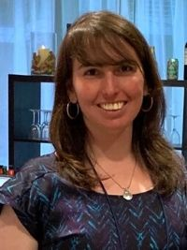
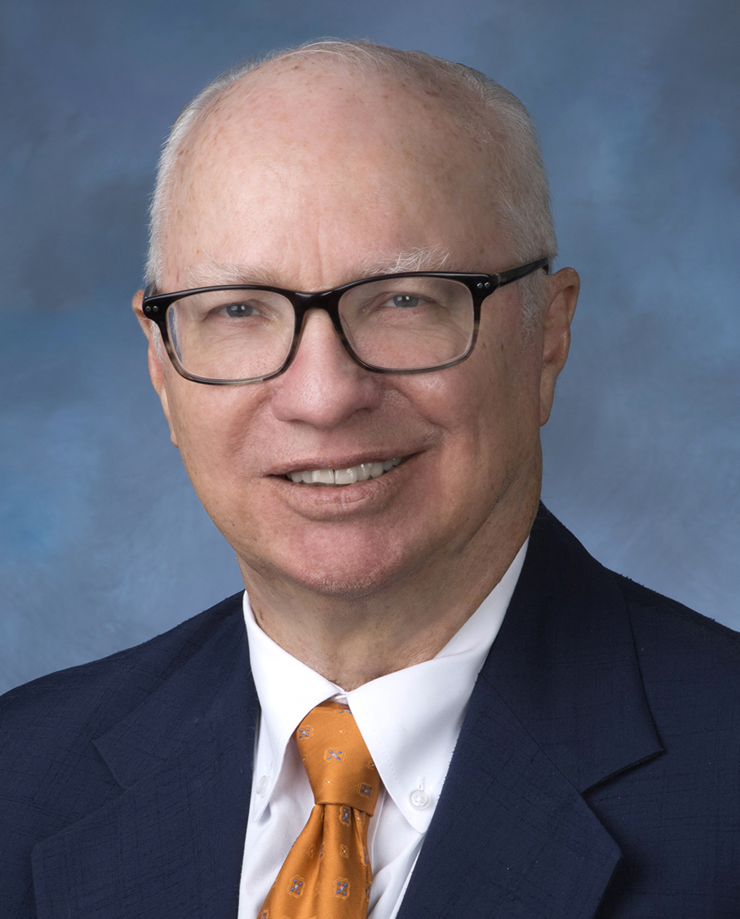
OUR TEAM
Microbiology
Microbial cooperation
Antibiotic resistance
Pathogenesis
Cardiovascular Science
Cardiac diseases
Epigenetics
Autophagy
Naras
Rob
Lisa
Bob
Ben
Dr. Narasimman Gurusamy
College of Pharmacy
UP
NEXT!
Dr. Robert Smith
KPCOM (NSU MD)
Neuroscience, Pharmacology, Cardiovascular
Renin-angiotensin system
Neurodegenerative diseases
Neuroscience
Inflammation & mitochondrial dysfunction in Alzheimer’s
Diet & nutritional supplements
Sex differences
Behavioral Neuroscience
Lifestyle factors + repurposing drugs for dementia
Sex differences
Dr. Lisa Robison
College of Psychology
Dr. Robert Speth
College of Pharmacy
Dr. Benedict Albensi
College of Pharmacy

Slide 3
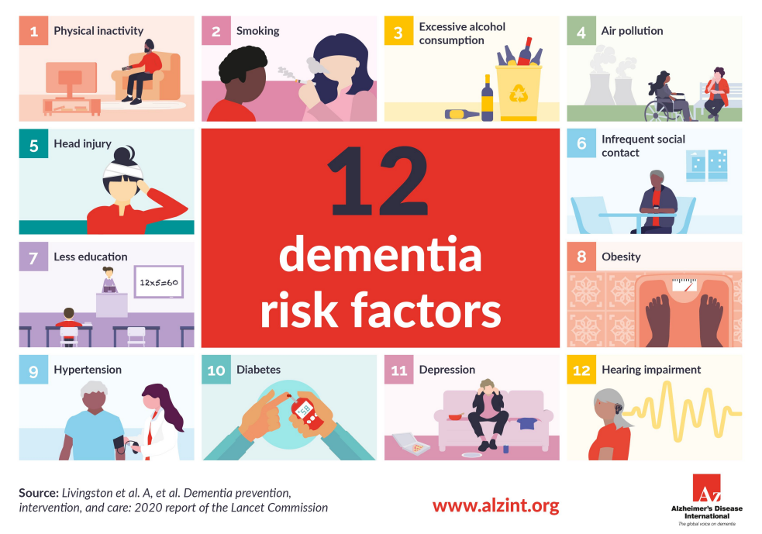
Dementia risk factors

Slide 4
~2/3 of AD patients are women
Importance of sex as a biological variable in dementia
Men
↑ risk factors
Incidence
vs. Influence*
Women
¹Alzheimer's disease Facts and Figures 2018, ²Brun et al (1986) Annals of Neurology, ³Fernando et al (2004) J of Neurological Sciences, ⁴Beam, et al (2018) Journal of Alzheimer's disease, ⁵Nebel et al (2018) Alzheimer’s & Dementia
Notes:
but it may be especially important for diseases with a clear sex/gender bias – for example, diseases like dementia (particularly AD) for which women represent 2/3 of patients. Despite this, animal studies often lack representation of both sexes, and even when they do, sex is often not analyzed as a biological variable.
---This gender bias for dementia remains even when controlling for the fact that women live longer than men. One possible explanation is that there’s either a higher incidence or greater contribution of risk factors for these diseases in women.

Slide 5
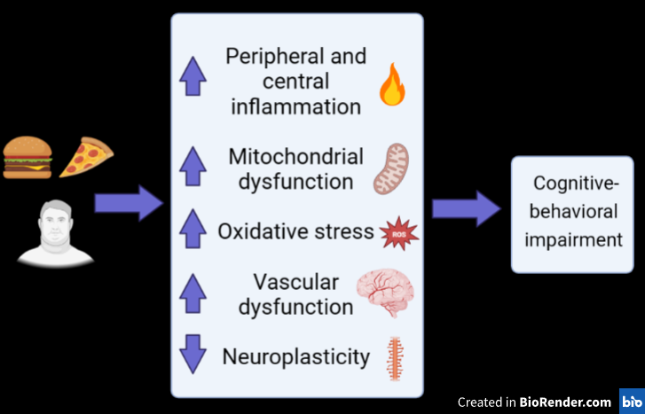
HF diet/ metabolic disease impairs the brain and behavior

Slide 6
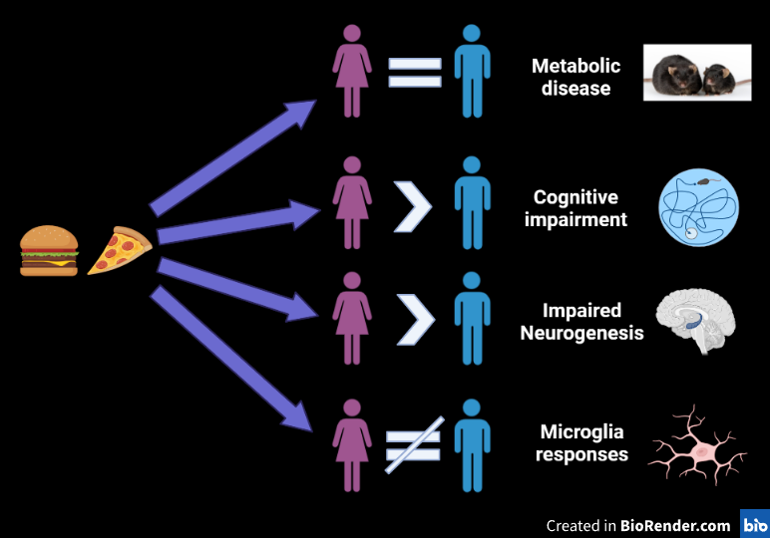
Sex differences in response to HF diet
(Robison et al., 2019)
(Robison et al., 2022)
(Robison et al., 2019)
(Robison et al., 2019)
(unpublished data)

Slide 7
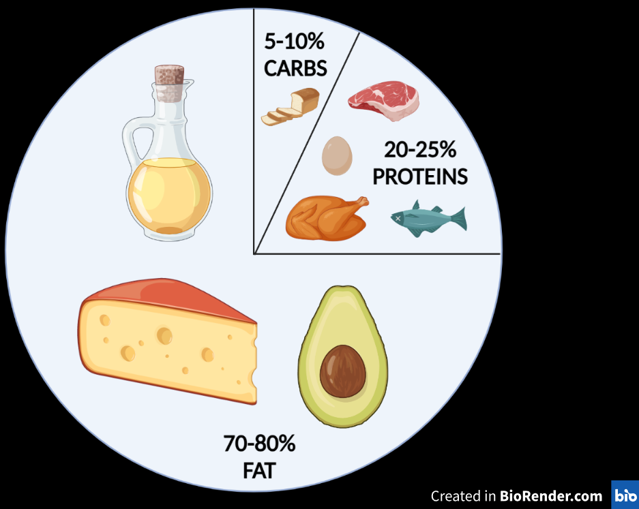
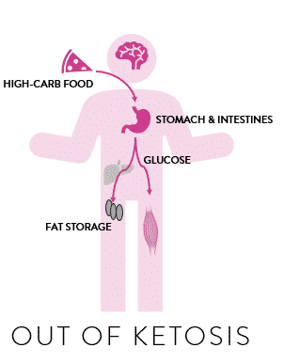
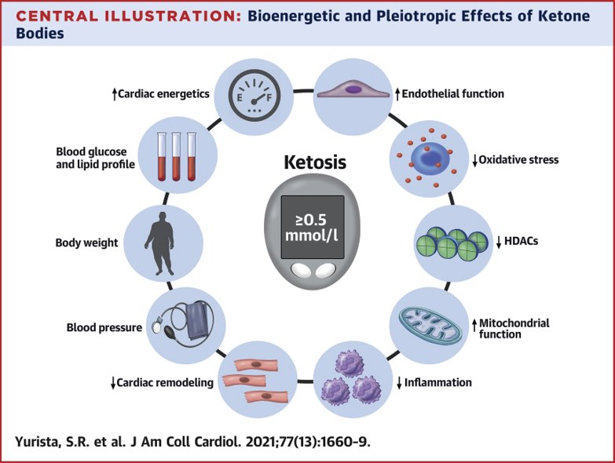
Ketogenic diet
Metabolic disease

Slide 8
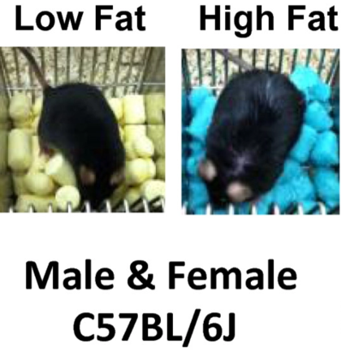
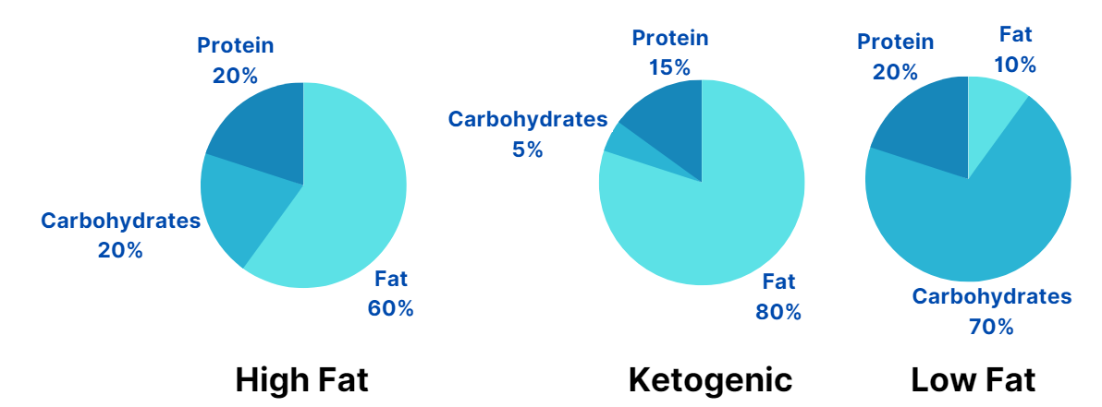
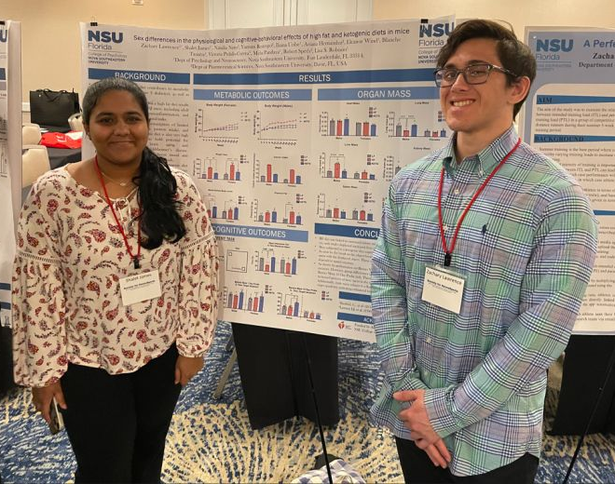
Experiment overview + timeline
Objective: To compare the effects of long-term consumption of a high-fat and translationally relevant ketogenic diet to a low-fat control diet in adult male and female mice.
Shalet James & Zachary Lawrence
Honors thesis students

Slide 9
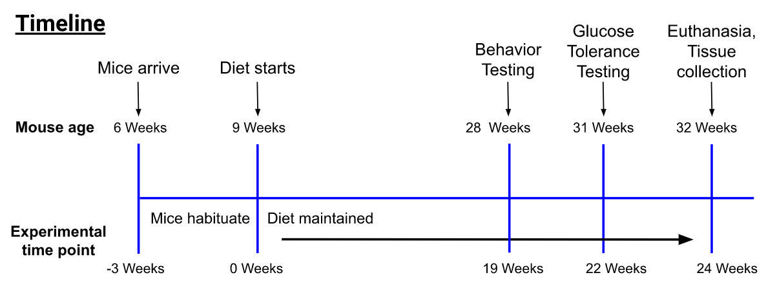
Experiment overview + timeline
Objective: To compare the effects of long-term consumption of a high-fat and translationally relevant ketogenic diet to a low-fat control diet in adult male and female mice.
Shalet James & Zachary Lawrence
Honors thesis students

Slide 10
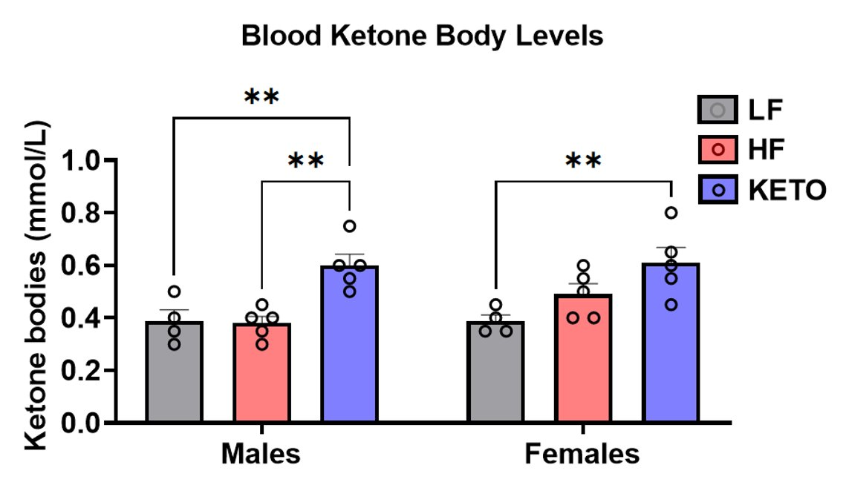
Ketogenic diet induces mild ketosis

Slide 11
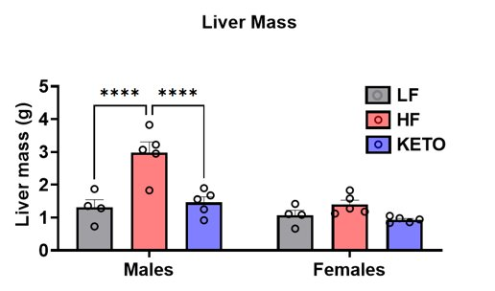
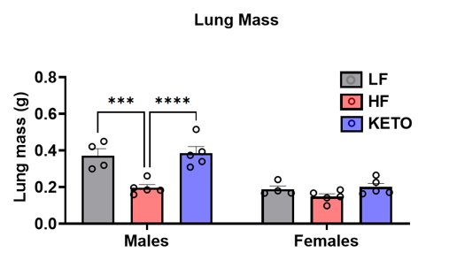
Physiological data
- Liver – histology for NAFLD
- Heart – inflamm/ox stress/mito fxn/autophagy (Gurusamy)
- Gut microbiome (Smith)

Slide 12
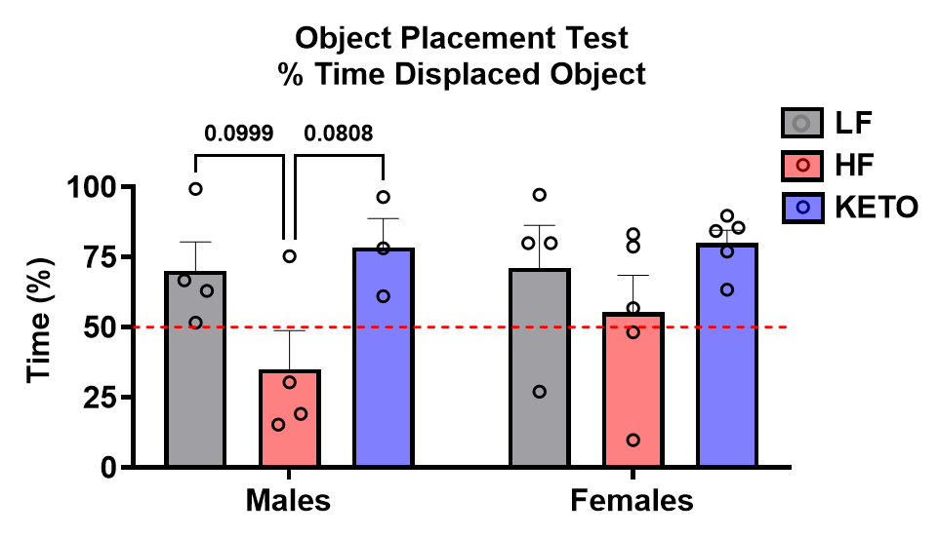
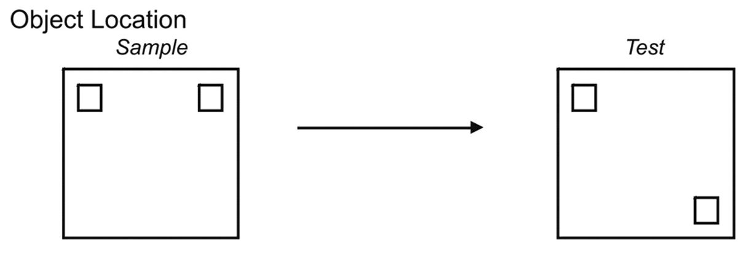
OBJECT PLACE TEST (SPATIAL MEMORY)
HF diet impairs spatial memory
(In progress…)

Slide 13
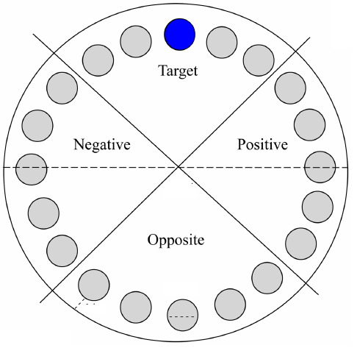
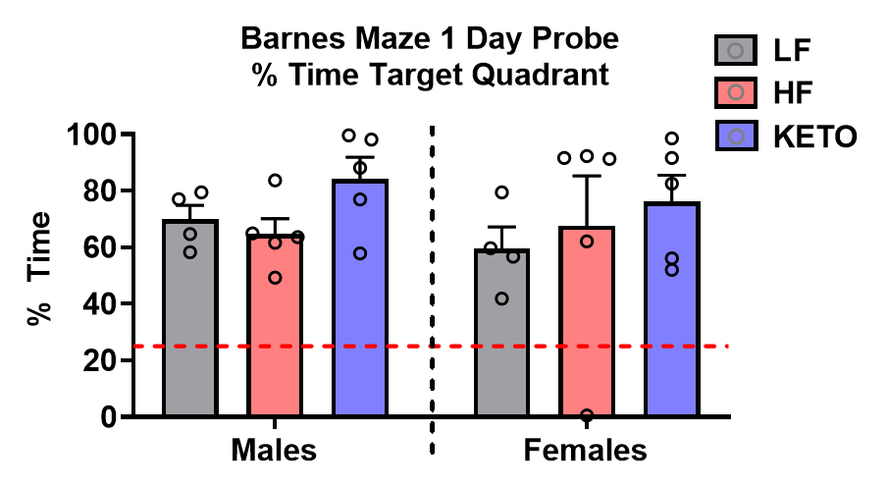
BARNES MAZE (SPATIAL MEMORY)
No diet effect on intermediate-term spatial memory
(In progress…)

Slide 14
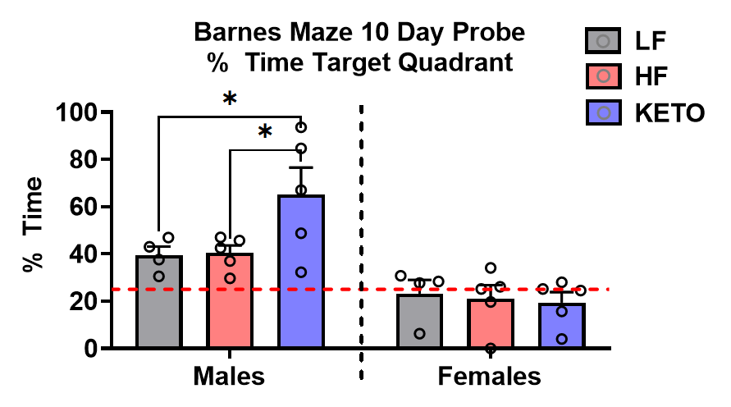
BARNES MAZE (SPATIAL MEMORY)
Keto diet improves long-term spatial memory
(In progress…)

Slide 15
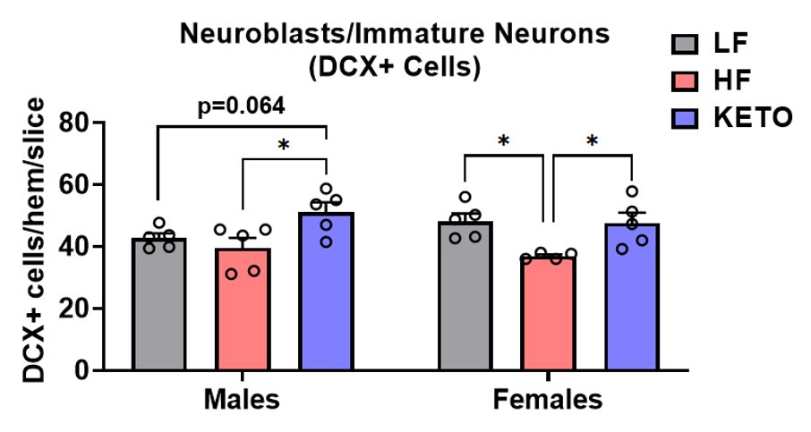
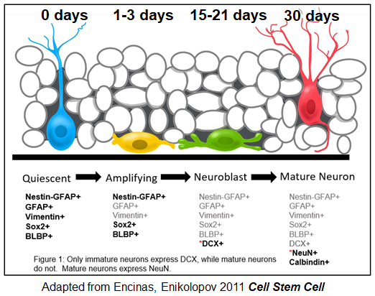
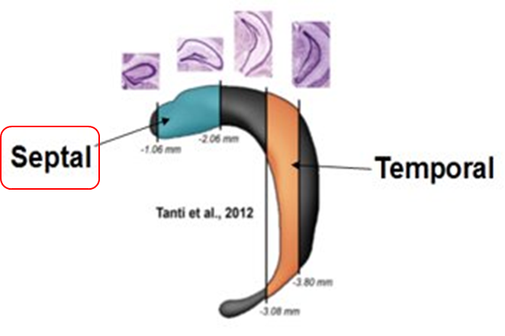
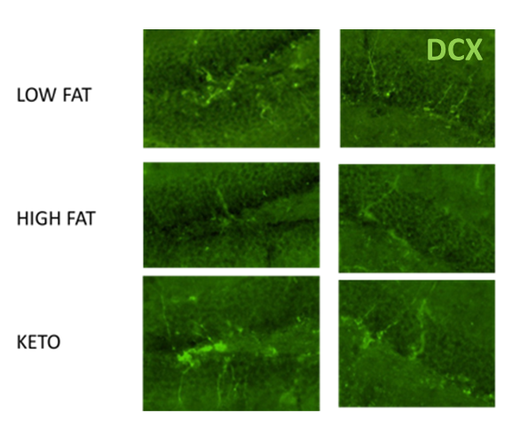
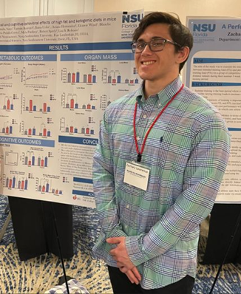
Effects of HF vs. keto diet on neurogenesis varies by sex
*Analysis of neurogenesis was performed in a separate cohort of mice (n=5/group)
-- Neuroinflammation
- Brain mito fxn/ox stress/NF-kB (Albensi)
- Brain RAS (Speth)
-Keto diet in CAA model
DORSAL
VENTRAL
Zachary Lawrence
Honors thesis student

Slide 16
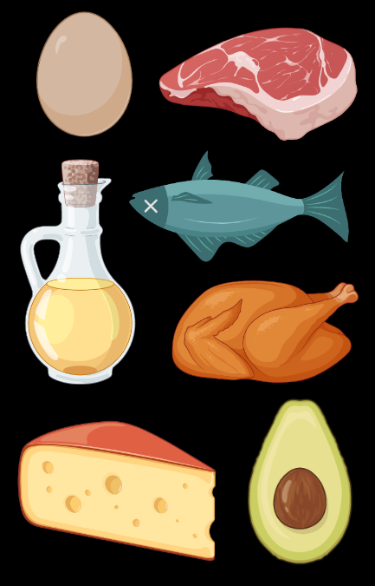
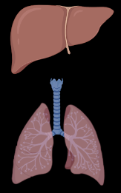
Conclusions
High fat diet
Ketogenic diet
Metabolic outcomes
Improved cognition
Increased Neurogenesis
?
Organ mass changes
?
No organ mass changes

Slide 17
Acknowledgments
Speth Lab
Natalia Noto (PhD Student)
Yazmin Restropo (Technician)
Collaborators
Robert Speth
Benedict Albensi
Narasimman Gurusamy
Robert Smith
NSU Vivarium staff
Dominique Ouimet
Sophia Gallus
Alexia Hilber
Robison Lab
Zachary Lawrence
Shalet James
Anshika Motiani
Divya Komandooru
Divya Papaiya
Ellie Wind
Maheen Khan
Nitish Dundigalla
Priyanka Prasanna
Smrithi Mukund
Meha Pandaya
Robison Lab (contd)
Chanal Vogel
Aishwarya Muppoor
Blanche Tamiya
Kenania Tisselin
Melanie Rojas
Victoria Pulido-Correa
Roshini Bodicherla
Ariana Hernandez
Iliana Uribe
Nikhila Paleati
Valeria Cohen
Follow Me!!!:
@LisaRobison86
Email:
lrobiso1@nsu.edu
Funding
NSU – Startup Funds
NSU – PFRDG
NSU – COP Faculty Development Award
American Heart Association

Slide 18
Questions?

