Slide 1
Predictors Of HPV Vaccination Status Among College Students in the U.S
Jesús Sánchez, PhD
Fahad Alsulami, PharmD, MS
Department of Sociobehavioral and Administrative Pharmacy
Barry & Judy Silverman College of Pharmacy

Slide 2
Human papillomavirus (HPV)
HPV is a small DNA virus that infects sexual organs, anus, and/or the oral cavity (CDC, 2019).
HPV spreads by sexual contact of infected persons' skin and/or mucous membranes to their sexual partners (CDC, 2019).
HPV can be transmitted even if there are no symptoms in an infected person.
Symptoms may take years to develop among infected people.
Low vs High-Risk HPVs

Slide 3
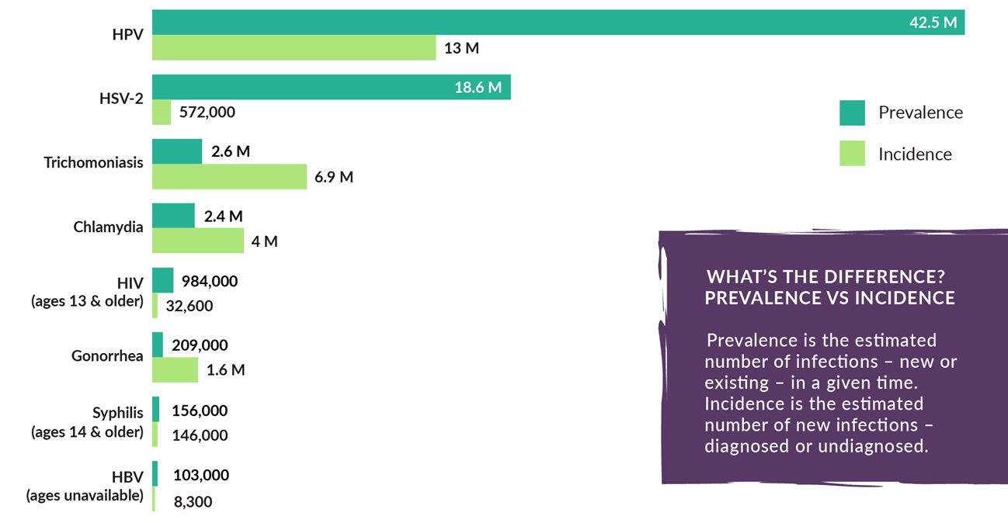
Prevalence and Incidence of Sexual Transmitted Diseases in The U.S.A, 2018

Slide 4
Protection Strategies
The use of a condom lowers the probability of getting HPV, but it does not provide complete protection.
Receiving the HPV vaccine is the most effective way of protecting against the transmission of HPV.
In 2006, the U.S. FDA approved the first HPV vaccine (Gardasil ®) in the U.S. (HPV types 6, 11, 16, and 18).
Today, Gardasil 9 ® is the only HPV vaccine distributed in the U.S.

Slide 5
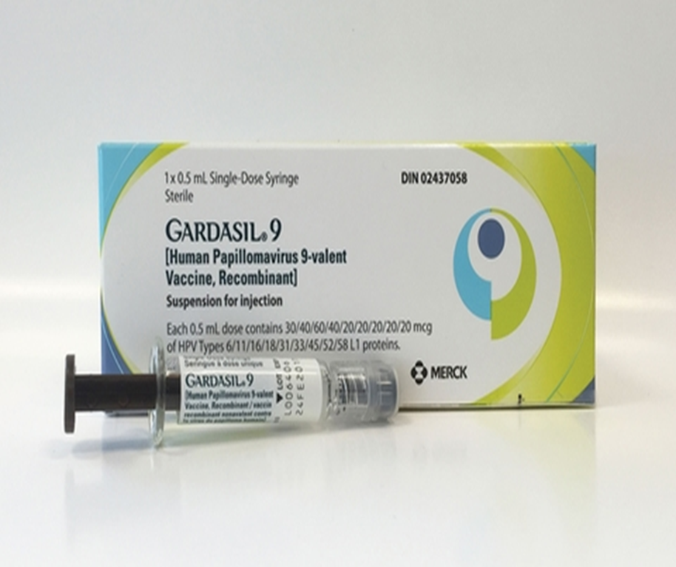
Dosage and Administration for Gardasil 9 ®
9-14 years old:
2 doses (6-12 months after the first dose).
3 doses (0, 2 months, and 6 months).
15-45 years old:
3 doses (0, 2 months, and 6 months).

Slide 6
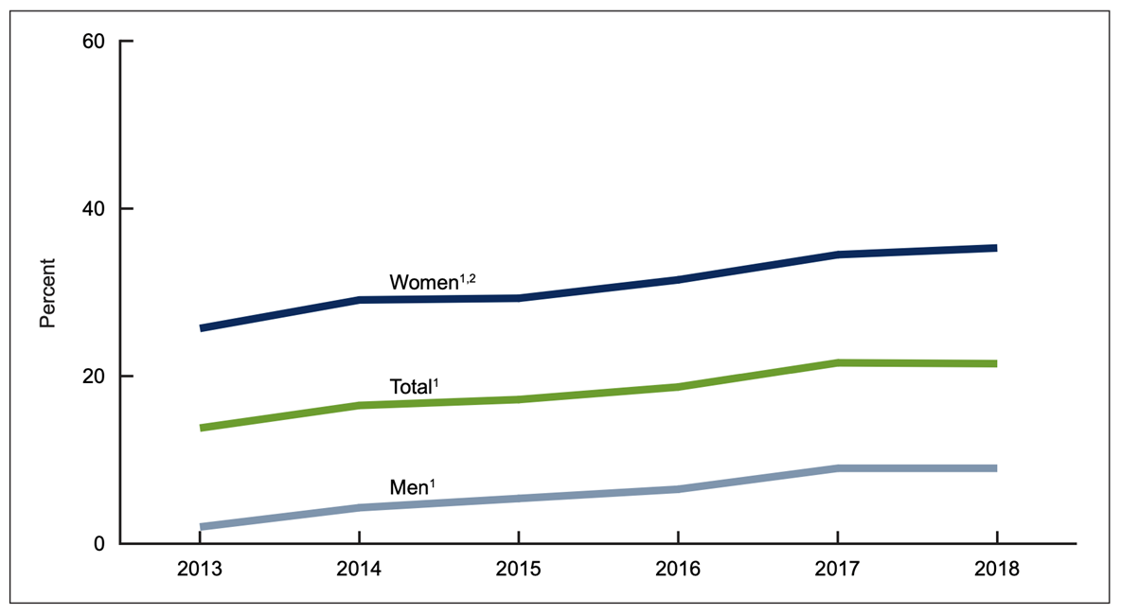
The Percentage of Adults Aged 18−26 Who Received The Recommended Number of Doses of HPV Vaccine, 2013-2018
Notes:
This Data from the National Health Interview Survey (NHIS).
The percentage of adults aged 18−26 who received the recommended number of doses of HPV vaccine increased from 13.8% in 2013 to 21.5% in 2018.
The percentage of women who received the recommended number of doses of HPV vaccine increased from 25.7% in 2013 to 35.3% in 2018, and the percentage of men increased from 2.0% in 2013 to 9.0% in 2018.
The coverage with the recommended number of doses against HPV is below the Healthy People 2020 target of 80% (ODPHP, 2014).
As the FDA expanded the coverage of HPV vaccination to include individuals over 26 years old in 2018, little is known about the HPV vaccination rate among people at age 26-45 years old.

Slide 7
NSU Student Population

Slide 8
Study Methodology
Cross-sectional design.
Convenience sample of NSU students.
Electronic survey via REDCap.
Institutional Review Board (IRB) approval was obtained.
Students were recruited by receiving an email invitation with the survey link.
First 400 student participants received a $15 gift card.
The inclusion criteria were:
18 years old or older.
Proficient in English.
Able to provide informed consent.

Slide 9
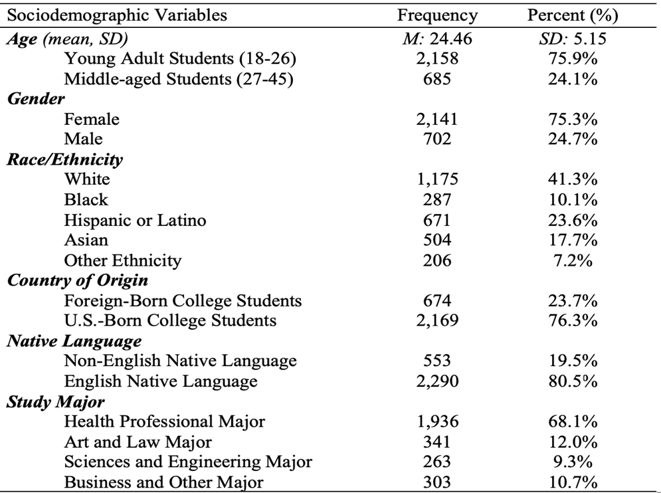
Sociodemographic Characteristics of Study Participants (N = 2,843)

Slide 10
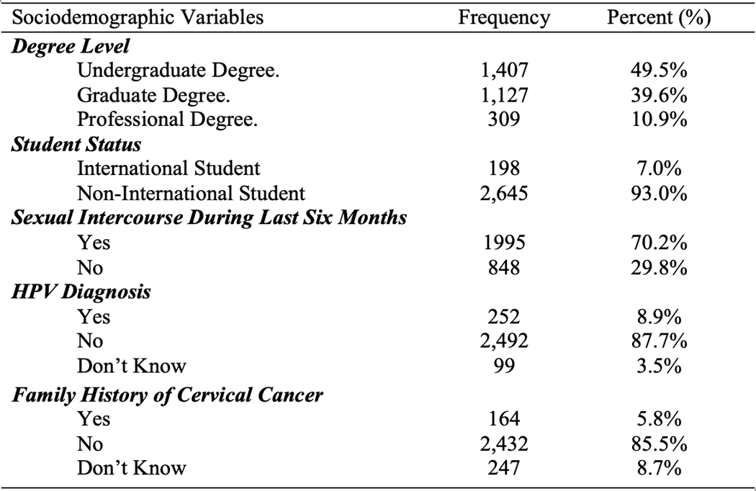
Sociodemographic Characteristics of Study Participants (N = 2,843)

Slide 11
Vaccination Rates and Willingness to Get Vaccinated

Slide 12
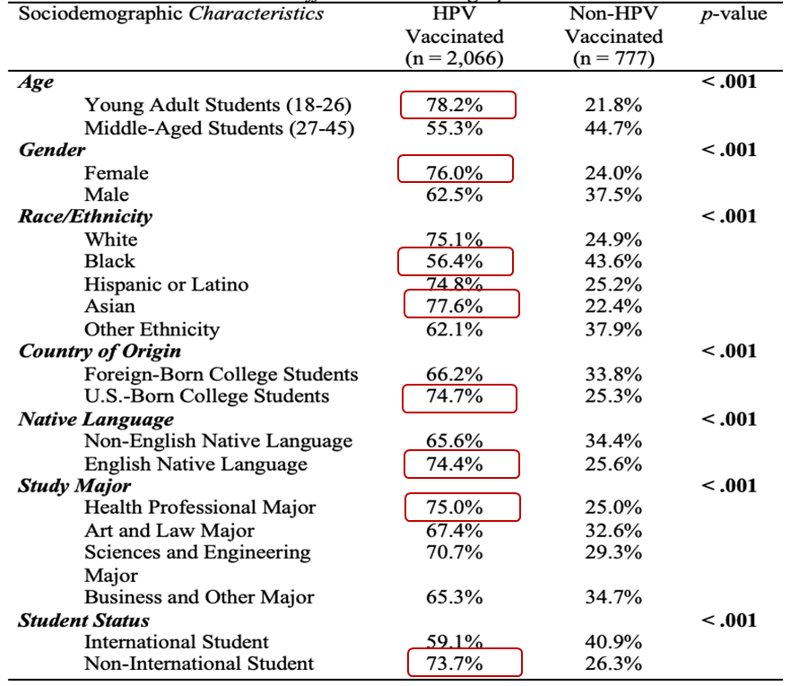
HPV Vaccination Rates Across Different Sociodemographic Characteristics
Notes:
A Chi-square test was conducted to determine if there are significant differences in the HPV vaccination rates among college students across different Sociodemographic Characteristics.
young adult college students had higher HPV vaccination rates than middle-aged college students.
Also, Female college students had higher HPV vaccination rates than male college students.
Asian college students had the highest HPV vaccination rates, followed by White and Hispanic or Latino college students. On the other hand, Black college students had the lowest HPV vaccination rates compared to all different races/ethnicities.
Among students with different native languages, college students with an English native language had higher HPV vaccination rates than those with a non-English native language.
Also, international students had lower HPV vaccination rates than non-international college students.
Lastly, college students in health professional majors had higher HPV vaccination rates, followed by those in sciences and engineering majors, art and law majors, and business and other majors.

Slide 13
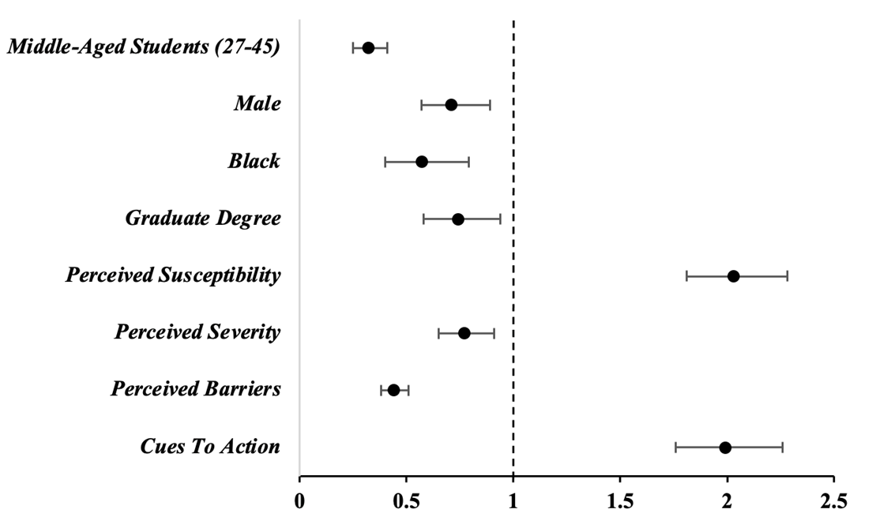
Significant Predictors Associated With HPV vaccine Uptake

Slide 14
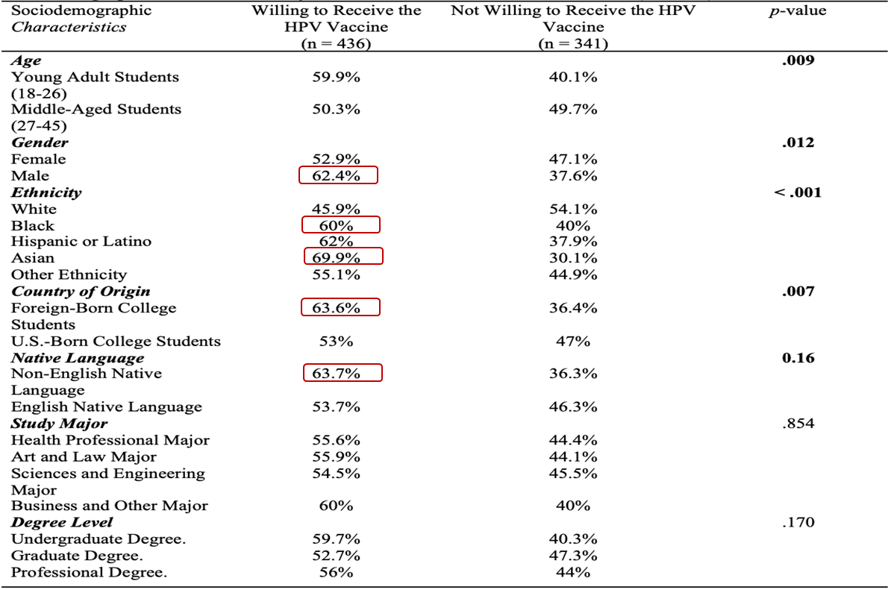
Sociodemographic Characteristics of Non-HPV Vaccinated College Students (n = 777)

Slide 15
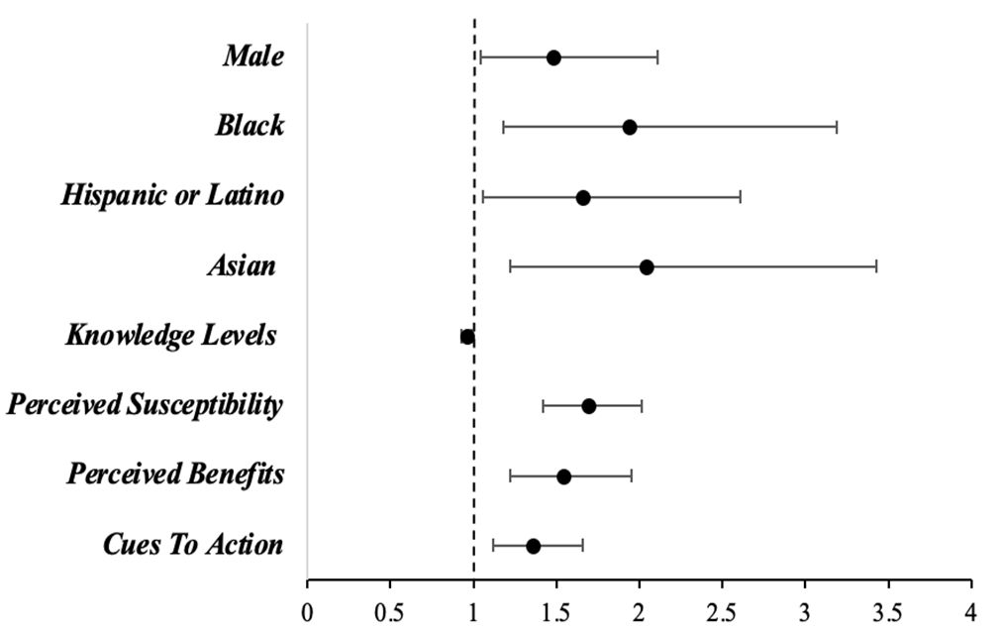
Significant Predictors Associated With Willingness to Receive The HPV vaccine

Slide 16
Significance of the Study
The Healthy People 2030 initiative, led by the U.S. Department of Health and Human Services, sets a goal of achieving a vaccination rate of 80% for the human papillomavirus (HPV) vaccine among adolescents aged 13-15 years.
College students are a population that can benefit from the HPV vaccine, as they may be at increased risk for HPV infection due to behaviors such as sexual activity and sharing living spaces.
The Centers for Disease Control and Prevention (CDC) recommends that young adults through age 26 who have not completed the HPV vaccine series receive catch-up vaccination.

Slide 17
Significance of the Study
This study is one of a limited number of studies that measured HPV vaccination rates and knowledge of the HPV and the HPV vaccine among college students in the U.S.
Also, this study looks into willingness to vaccinate among students that have not received the HPV vaccine.
More vaccination campaigns targeting college students are needed to increase HPV vaccine knowledge among college students with the ultimate goal of increasing vaccine uptake.

Slide 18
Implications of the Study
Healthcare providers must be aware that:
Male, Black, and over 26 years old college students are less likely to be vaccinated with the HPV vaccine.
Foreign-born college students, international students, and college students with a non-English native language are less likely to be vaccinated with the HPV vaccine.
Male, Black, and foreign-born college students are less likely to receive recommendations for receiving the HPV vaccine.

Slide 19
NSU as an agent of public health
NSU can play a significant role as an agent of public health in several ways:
Providing Health Education
Offering Healthcare Services
Conducting Research
Engaging in Community Outreach
Creating Healthy Environments
Notes:
Providing Health Education: Colleges can educate their students about the importance of maintaining a healthy lifestyle, including regular exercise, healthy eating habits, and proper hygiene. They can also provide information about how to prevent and manage common health issues such as stress, anxiety, and sexually transmitted infections.
Offering Healthcare Services: Many colleges offer healthcare services such as counseling, mental health services, and medical care to their students. This can help students access healthcare services easily and help them manage their health concerns.
Conducting Research: Colleges can conduct research on various health-related topics such as disease prevention, health promotion, and the impact of social determinants on health outcomes. This research can help inform public health policies and interventions.
Engaging in Community Outreach: Colleges can engage in community outreach activities, such as health fairs and health education programs, to promote healthy behaviors and raise awareness about health issues in the community.
Creating Healthy Environments: Colleges can create healthy environments by providing healthy food options, creating smoke-free campuses, and promoting physical activity through campus facilities and programs.

Slide 20
The Role of Interdisciplinary Collaboration
The role of NSU as an agent of public health promotion will benefit from an environment that fosters interdisciplinary and interprofessional collaboration.
Interdisciplinary collaboration is essential in promoting public health because it allows for a comprehensive approach to care, improves the quality and efficiency of care delivery, promotes innovation and creativity, and facilitates advocacy efforts.
This study combined the expertise of scholars from different disciplines that include the behavioral sciences, economy, pharmacy, and education.

Slide 21
Study Limitations
Convenience sampling method.
College students were recruited from one university.
Cross-sectional design.
Self-report survey.
Lack of standardization for the health belief model instrument.

Slide 22
Thank you!

