Slide 1
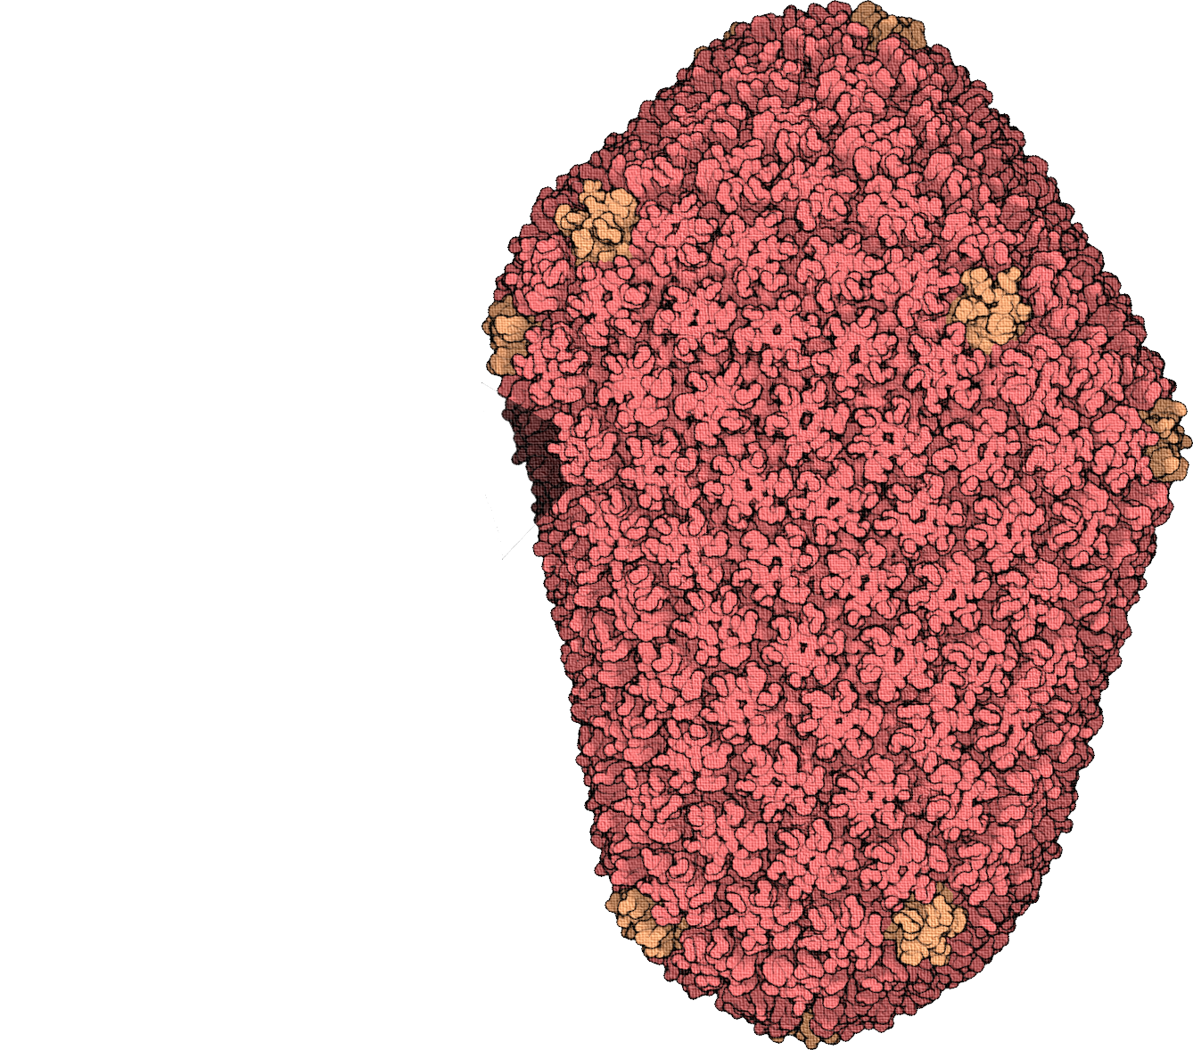
Highly antigenic novel soluble HIV-1 clade C 1086.c ENV trimer vaccine candidate
Highly antigenic novel soluble HIV-1 clade C 1086.c ENV trimer vaccine candidate
The HIV capsid
Mohammad Sabbir, Ph.D. ¹ (Presenter)
Alexander Bontempo, Ph.D. ², and Mark Cayabyab Ph.D. ²
¹NSU’s Barry and Judy Silverman College of Pharmacy
²NSU’s College of Dental Medicine

Slide 2
This interdisciplinary study involves a team of scientists from:
Dr. M.G. Sabbir
Dr. A Bontempo Dr. Mark Cayabyab
Barry and Judy Silverman College of Pharmacy &
2. College of Dental medicine
with skills in immunology, crystallography and Structural bi0logy, and cell and molecular biology.

Slide 3
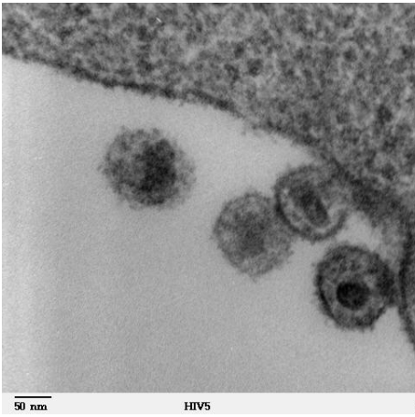
HIV: Human Immunodeficiency Virus
Attacks the body’s immune system.
Lead to AIDS (Acquired Immunodeficiency Syndrome).
No effective cure.
HIV can be controlled by antiretroviral therapy (ART)
Successful ART requires lifelong adherence
ART carries risks of long-term side effects and drug resistance.
Cell: Cytosol
HIV
HIV infected cell

Slide 4
Is There a Vaccine to Prevent HIV?
After 40+ years of trying, there is currently no vaccine available.
Developing safe, effective, and affordable vaccines is the highest HIV research priority given its game-changing potential for controlling and ultimately ending the HIV/AIDS pandemic.
Scientists are working to develop one and WE ARE A PART OF THAT INITIATIVE.

Slide 5
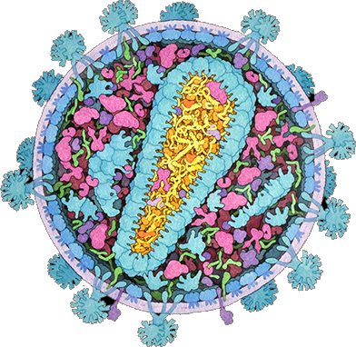
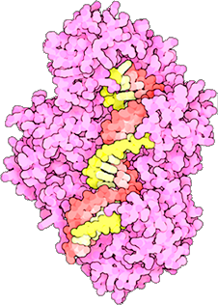
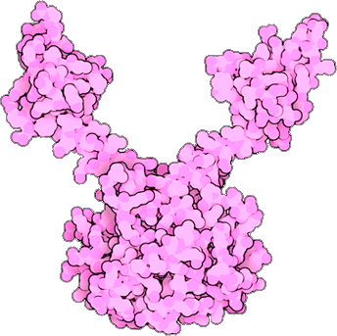
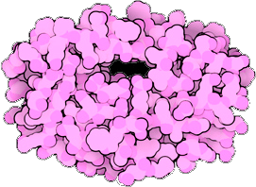
HIV is composed of:
two strands of RNA,
15 types of viral proteins,
a few proteins from the last host cell it infected,
all surrounded by a lipid bilayer membrane.
Integrase Reverse Transcriptase Protease

Slide 6
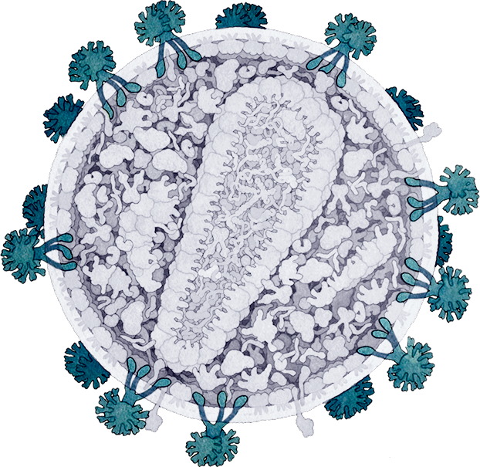
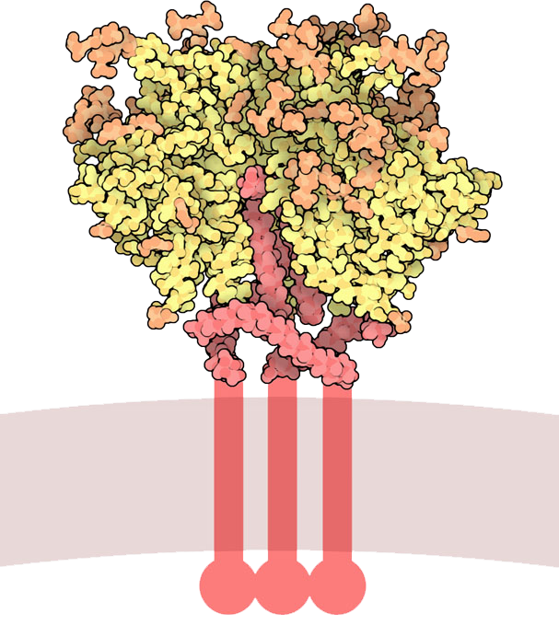
Envelope proteins gp120 and gp41
bind to receptors on the surface of cells that HIV infects, and then penetrate the surface to infect it with the viral RNA.
The spikes formed by these proteins are highly decorated with carbohydrates, making them difficult to recognize by antibodies.
HIV envelope glycoprotein, with the membrane-spanning portion

Slide 7
HIV hide itself from the immune cells in many ways.
HIV surface glycoproteins, synthesized in infected cells, provides an effective camouflage.
The conserved functional sites of the viral protein are hidden deep in a pocket surrounded by these sugars, difficult for antibodies to reach.
Error-prone replication machinery creates a great diversity in the viral glycoproteins. So unfortunately, once the immune system has found antibodies to recognize the infecting virus, other viruses rapidly mutate to change the site that is recognized.
HIV envelope glycoprotein, with the membrane-spanning portion

Slide 8
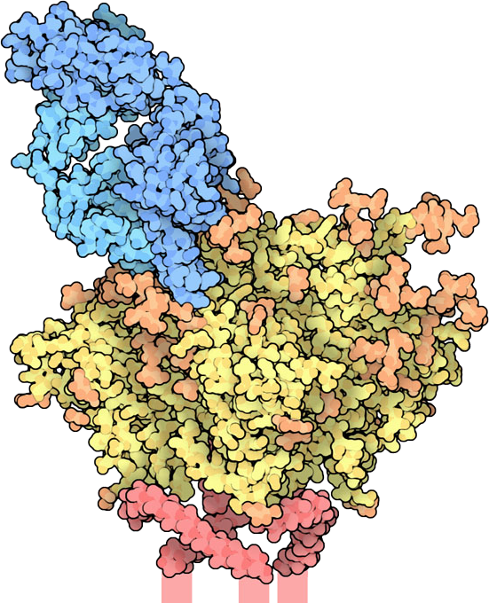
Broadly Neutralizing Antibodies (bnABs)
After several years of battle with the infection, some people develop broadly neutralizing antibodies. “Broadly" because they attack many strains of the virus, and "neutralizing" because they attack key functional sites in the virus and block infection.
We are studying these broadly neutralizing antibodies and trying to find ways to spur the immune system into creating them quickly with a vaccine.
Antibody

Slide 9
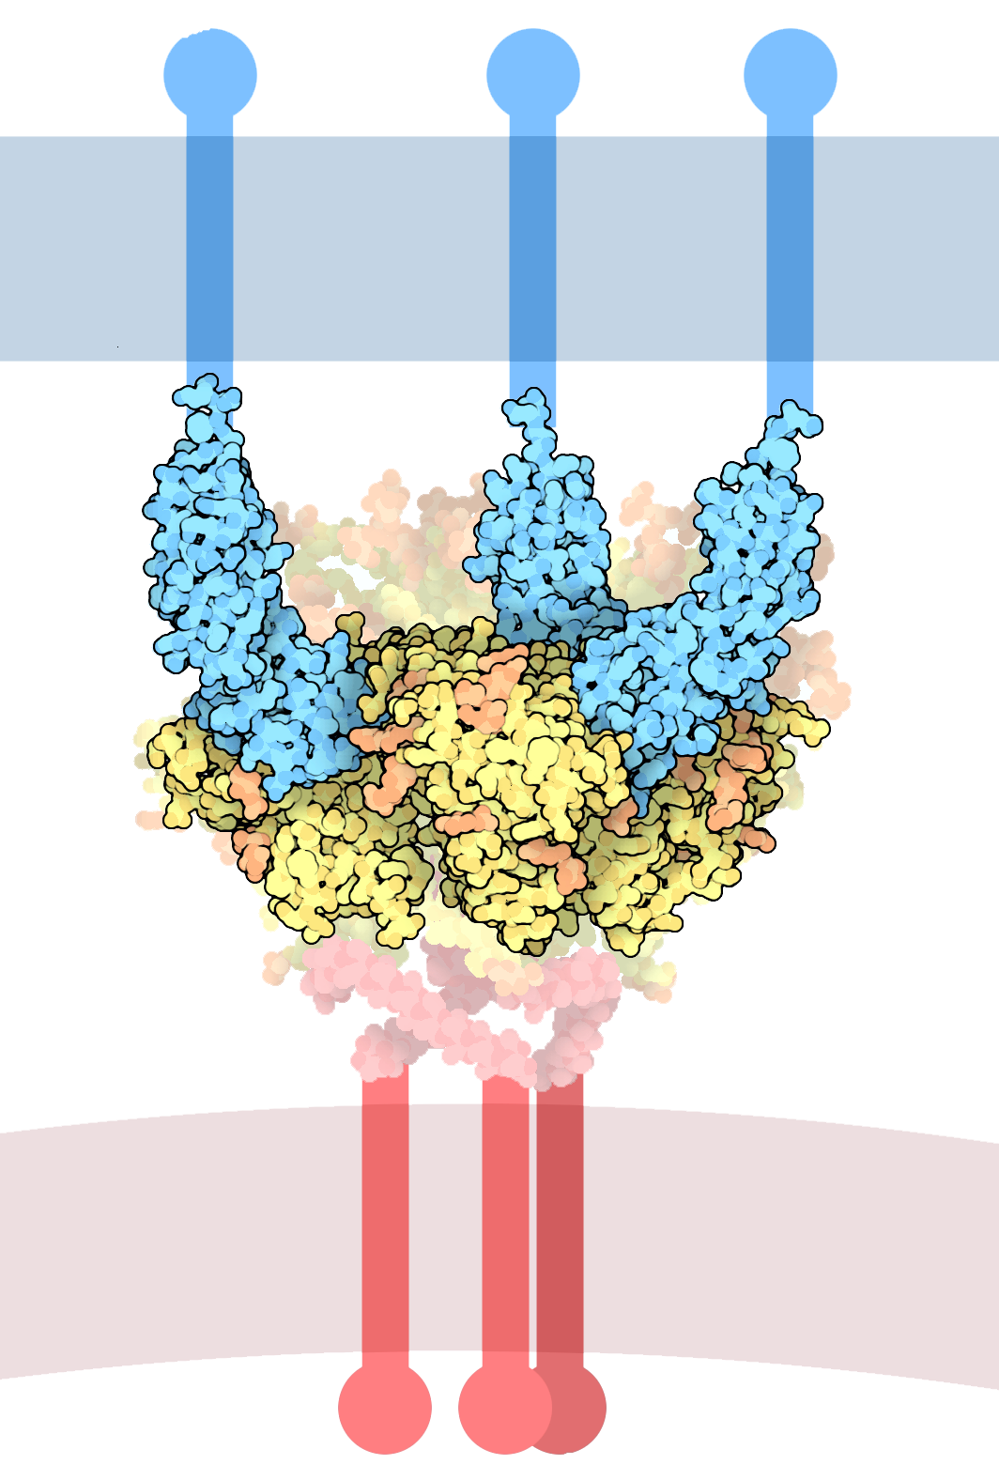
Our Research?
HIV-1 entry into CD4+ target cells is mediated by cleaved envelope glycoprotein (Env) trimers that have been challenging to characterize structurally.
We generated a novel HIV-1 Env trimer (1086.c ENV SOSIP gp140) that was recognized by many bnAbs specific to conserved regions of Env protein including CD4 binding site.
Next, we characterized monoclonal antibodies isolated from RV144 trial vaccines for their binding to 1086.c ENV SOSIP
Host cell membrane
CD4+
Env
HIV membrane
SOSIP: a disulfide bond termed SOS , an Ile to Pro change

Slide 10
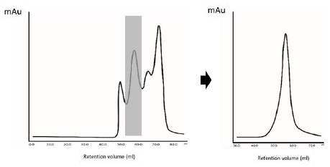
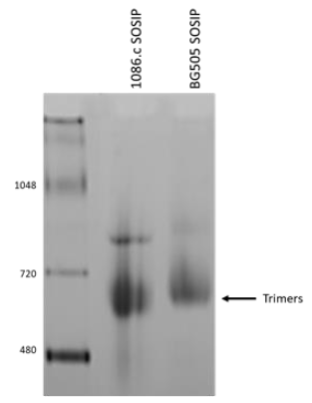
Biochemical and structural analysis of the 1086.c SOSIP trimer
Elution profile of 1086.c SOSIP trimer after SEC/DEAE chromatography
Blue Native PAGE Analysis
A. Bontempo and M Cayabyab

Slide 11
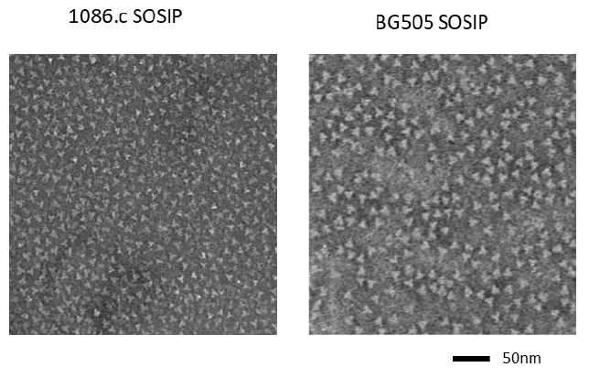
Negative Stain Electron Microscopy
A. Bontempo and M Cayabyab

Slide 12
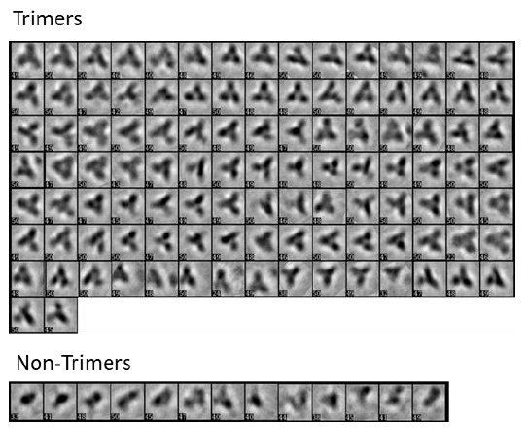
Analysis of 2D averages of the 1086.c SOSIP trimer.
5680 single trimer particles were automatically picked with crYOLO and clustered in 120 average stacks using ISAC software
A. Bontempo and M Cayabyab

Slide 13
Antigenicity study of 1086.c SOSIP trimer
Twenty-two anti-HIV-1 envelope glycoprotein antibodies were tested for assessing the antigenicity of 1086.c SOSIP trimer compared to BG505 SOSIP trimer construct.
NB: No binding
A. Bontempo and M Cayabyab

Slide 14
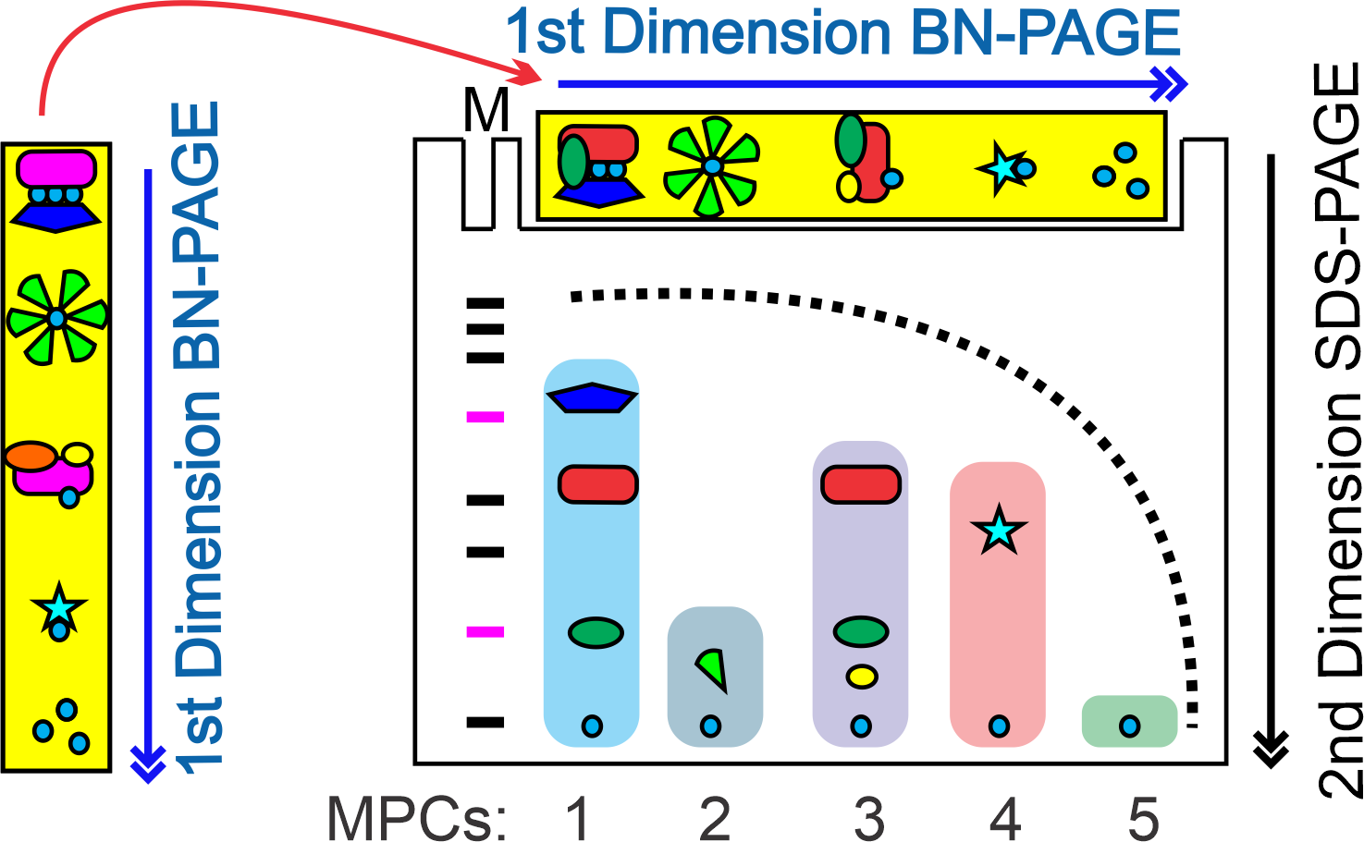
My role:
Addressing the question: does CH58 specifically bind 1086.c SOSIP trimer or monomers?
M. Sabbir

Slide 15
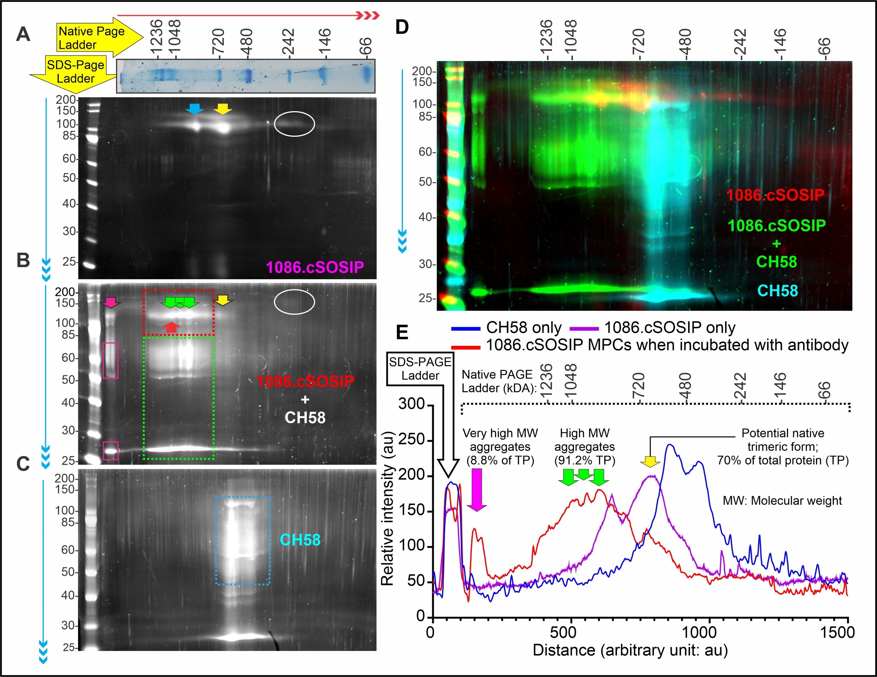
Addressing the question: does CH58 selectively binds 1086.c SOSIP trimer or monomeric forms?

Slide 16
Future Studies:
Preclinical studies to assess whether 1086.c SOSIP trimer immunogen is capable of eliciting protective epitope family V2p antibodies with broad antibody-dependent cellular cytotoxic activity
Acknowledgement: David S. Goodsell, RCSB Protein Data Bank and Scripps Research

Slide 17
Acknowledgments:
NIH/NIDCR grant R01 DE027249 (to M.J.C).
M.J.C. and A.B. are American Association of Immunologist Careers in Immunology fellowship recipients.
Zachary Edwards, Naylene Rivera, Alexandra Chirino, and Anthony Kushta for their technical support.
Dr. Kelly Arnett, Director of the Center for Macromolecular Interaction, Harvard Medical School, Boston for BLI and nanoDSF technical support and analysis.
Dr. Maria Ericsson, Director of the Electron Microscopy Facility, Department of Cell Biology, Harvard Medical School, Boston for technical assistance with electron microscopy. The
Dr. Benedict C Albensi, Bary and Judy Silverman College of Pharmacy, NSU for providing laboratory space for Dr. Sabbir
All authors declare no financial or other conflicts of interest

