Slide 1
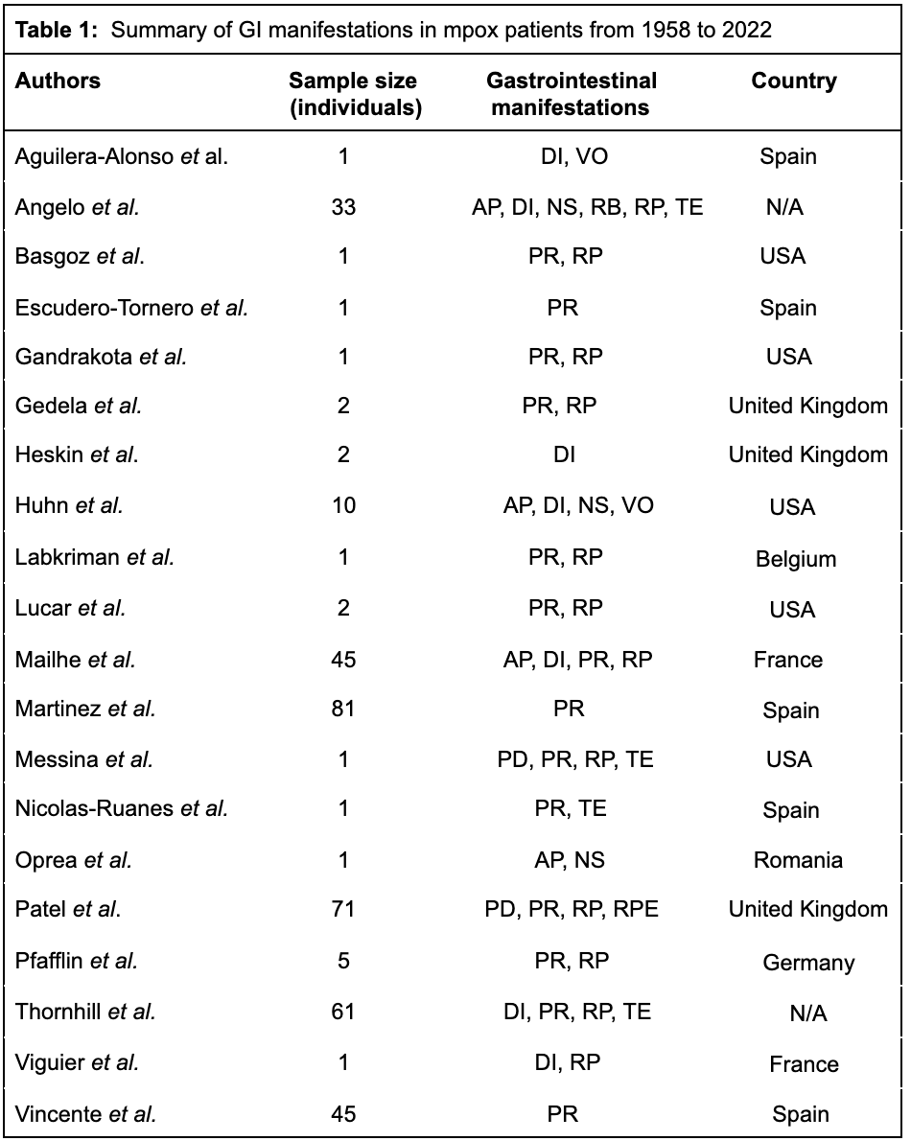
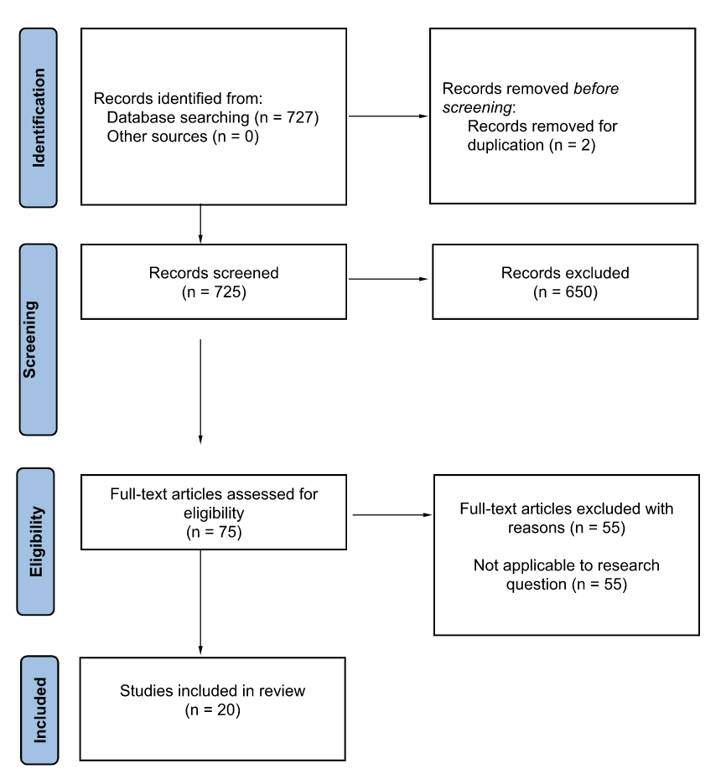
A Public Health and Gastrointestinal Perspective on the 2022 Mpox (Monkeypox) Outbreak
Rahul Ramakrishnan¹, Atira Shenoy², Dr. Ranganathan Madhavan M.D. MPH³
¹Nova Southeastern University Dr. Kiran C. Patel College of Allopathic Medicine, ²Nova Southeastern University Dr. Kiran C. Patel College of Osteopathic Medicine, ³Department of Hospital Medicine, Sutter Medical Group
Introduction
Results
Discussion/conclusion
Mpox (monkeypox) is a viral infection caused by the monkeypox virus, a member of the Poxviridae family and Orthopoxvirus genus. Other well-known viruses of the Orthopoxvirus genus include the variola virus (smallpox), cowpox virus, and vaccinia virus. The first human mpox infection was reported in 1970 in the Democratic Republic of Congo when an infant presented with smallpox-like blisters. In May 2022, cases of mpox infections were reported in non-endemic countries, and a global outbreak was declared.
In November 2022, the World Health Organization (WHO) suggested to rename “monkeypox” to “mpox.” For one year, as “monkeypox” is phased out, both names will be used interchangeably. Although there is a plethora of research regarding dermatological and upper respiratory symptoms of mpox, particularly following the 2022 mpox outbreak, more research is needed on the gastrointestinal effects. The objective of this systematic review is to outline the gastrointestinal manifestations of mpox and the importance of public health tools in approaching future outbreaks.
20 papers involving 366 patients were selected for this review. The gastrointestinal manifestations in mpox patients are proctitis, vomiting, diarrhea, rectal pain, nausea, tenesmus, and abdominal pain. The reviewed papers did not identify a relation between the severity of upper respiratory symptoms and the gastrointestinal manifestations. The current evidence indicates Black, Hispanic, and LGBTQIA+ persons are disproportionately affected.
Proctitis, rectal pain, diarrhea, and tenesmus were present in the majority of mpox patients that had a GI complication. 99.7% of patients had at least one of the aforementioned manifestations present. In contrast, the rarer gastrointestinal complications were rectal perforation (0.2%) and vomiting (3%).
Virus may invade cells in the gastrointestinal system utilizing cell-surface receptors such as chondroitin sulfate or heparan sulfate.
Gastrointestinal symptoms of mpox are crucial for gastroenterologists and other healthcare professionals to recognize in order to address patient discomfort and further understand the pathophysiology of the virus.
Public health measures are crucial to controlling future outbreaks while also educating the public to prevent stigmatization of underserved groups.
Methodology
Acknowledgements
The authors of this review would like to thank Dr. Rana Shenoy, Chief of Infectious Diseases of Southern California Permanente Medical Group - Antelope Valley, for her clinical guidance regarding the mpox outbreak.
References
AP, abdominal pain; DI, diarrhea; GI, gastrointestinal; NS, nausea; PD, painful defecation; PR, proctitis; RB, rectal bleeding; RP, rectal pain; RPE, rectal perforation; TE, tenesmus; VO, vomit; N/A, not applicable.

