Slide 1
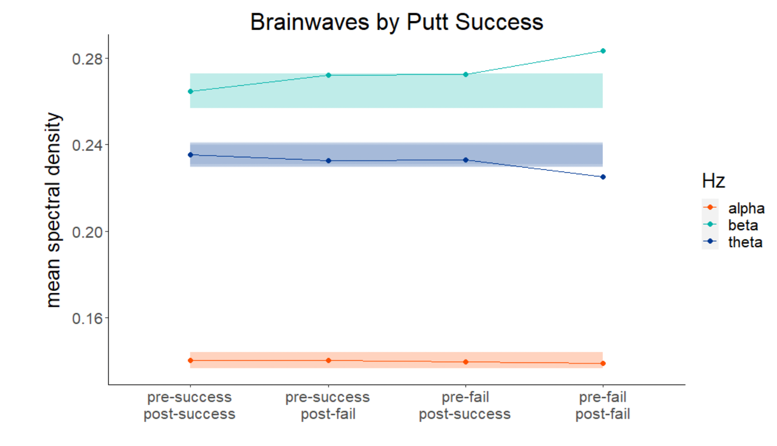
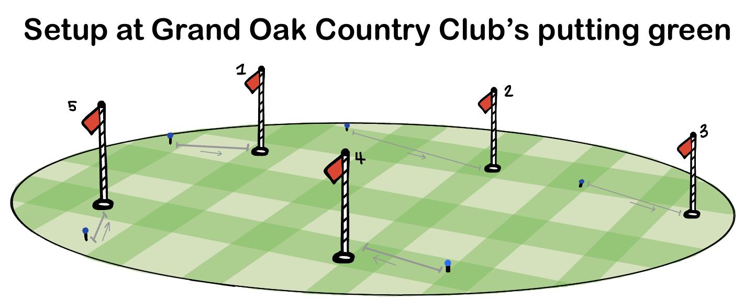
Assessment of Brain Function and Putting Performance of
Collegiate Golfers
Marissa Bonsangue, Pradeep Vanguri, PhD, LAT, ATC, Amani Khan, Valerie G. Starratt, PhD
Pallavi Patel College of Health Care Sciences
Exercise and Sports Science
This study identifies the brain waves via electroencephalography (EEG) of collegiate golfers while putting and the possible correlation between brain wave patterns and putting success.
Introduction:
Electroencephalography (EEG) is a noninvasive method for assessing brain activity.
Previous research indicated significant correlation between performance outcome and different amplitudes of alpha, beta, and theta brain waves. The lower the amplitude of alpha waves, the higher rate of success for the putt.
Alpha waves are present when the brain is in a state of wakeful rest, beta waves are present while completing high- processing tasks, and theta waves are present during deep focus activities.
Results can be indicative of the focus of the player and how the player mentally and physically adjusts from a previous failure.
Design
Subjects: 11 male (n= 7) and female (n= 4) National Collegiate Athletic Association (NCAA) Division II Golfers
Measures:
Electroencephalography (EEG)
Heart rate (HR)
Procedure:
Each golfer was fit with “Enchanted Wave Wave-1 brainwave-sensing headband” across the temporal surface and a heartrate monitoring watch
Golfers completed 10 putts at 5 varied hole distances (total- 50 putts) on an outdoor putting surface (Depicted)
EEG was recorded in 4-second epochs labeled pre-success/post-success, pre-success/post-failure, pre-failure/post-success, pre-failure/post-failure.
Hierarchical linear modeling assessed the extent to which power spectral density (PSD) in alpha, beta, and theta waves were associated with putting success/failure.
hierarchical linear models (HLM) to examine the differences in spectral density at three wavelengths (alpha, beta, theta) recorded across four different epoch categories: pre-success/post-success, pre-success/post-fail, pre-fail/post-success, and pre-fail/post-fail.
Figure 2:
Results:
Epochs preceding and/or following a failed putt were compared to epochs preceding and following successful putts. HLM analyses controlled for inter-golfer individual differences. Statistics are depicted in Table 2:
This study identifies NCAA golfers’ brain waves via electroencephalography (EEG) while putting and the possible correlation between brain wave patterns and putting success.
Competition Simulation
External factors (weather, noise)
Varied putting distances
Outdoor putting surface
Introduction:
Electroencephalography (EEG) is a noninvasive method for assessing brain activity.
Previous research indicated significant correlation between performance outcome and different amplitudes of alpha, beta, and theta brain waves. The lower the amplitude of alpha waves, the higher rate of success for the putt (Babiloni et al., 2008).
Alpha waves are present when the brain is in a state of wakeful rest, beta waves are present while completing high-processing tasks, and theta waves are present during deep focus activities (Abhang et al., 2016).
Results can be indicative of the focus of the player and how the player mentally and physically adjusts from a previous failure.
Design:
Subjects: 11 male (n= 7) and female (n= 4) National Collegiate Athletic Association (NCAA) Division II Golfers
Measures:
Electroencephalography (EEG)
Heart rate (HR)
Procedure:
Each golfer was fit with “Enchanted Wave Wave-1 brainwave-sensing headband” across the temporal surface and a heartrate monitoring watch
Golfers completed 10 putts at 5 varied hole distances (total- 50 putts) on an outdoor putting surface (Depicted)
EEG was recorded in 4-second epochs labeled pre-success/post-success, pre-success/post-failure, pre-failure/post-success, pre-failure/post-failure.
Hierarchical linear modeling assessed the extent to which power spectral density (PSD) in alpha, beta, and theta waves were associated with putting success/failure.
Table 2:
Figure 2: Discusses three reasons why our experiment is different from similar research. This experiment includes external factors, uses varied putting distances, and uses an outdoor putting surface.
 | B | t | df | p
Alpha
pre-fail/post-success | -44.6e-4 | -1.79 | 2225 | .073
pre-success/post-fail | -36.1e-4 | -1.51 | 2225 | .131
pre-fail/post-fail | -21.9e-4 | -0.97 | 2225 | .333
Beta
pre-fail/post-success | 2.0e-4 | 0.04 | 2225 | .971
pre-success/post-fail | -0.2e-4 | -0.00 | 2225 | .996
pre-fail/post-fail | 104.8e-4 | 2.10 | 2225 | .036*
Theta
pre-fail/post-success | -23.5e-4 | -0.59 | 2225 | .557
pre-success/post-fail | -25.6e-4 | -0.67 | 2225 | .506
pre-fail/post-fail | -89.6e-4 | -2.47 | 2225 | .014*
Figure 3:
Conclusion:
Hierarchial linear model depicted no change in alpha wave spectral density, thus indicating beta and theta waves play a higher role in post-failure success.
”Choking” in sport (defined as when athletes fail to meet performance goals, usually during high-pressure situations) can be the result of theta and beta wave ranges straying from the accepted ranges for success.
Performing the research on live putting green, as opposed to the lab, simulates the most accurate environment golfers experience during competition.
Reference:
Babiloni, C., Del Percio, C., Iacoboni, M., Infarinato, F., Lizio, R., Marzano, N., Crespi, G., Dassù, F., Pirritano, M., Gallamini, M., Eusebi, F., 2008. Golf putt outcomes are predicted by sensorimotor cerebral EEG rhythms. The Journal of Physiology 586 (1), 131–139 (Jan 1).
Abhang, Priyanka A., et al. “Technological Basics of EEG Recording and Operation of Apparatus.” Introduction to EEG- and Speech-Based Emotion Recognition, 2016, pp. 19–50., https://doi.org/10.1016/b978-0-12-804490-2.00002-6.
Figure 3: Hierarchical linear models (HLM) to examine the differences in spectral density at three wavelengths (alpha, beta, theta) recorded across four different epoch categories: pre-success/post-success, pre-success/post-fail, pre-fail/post-success, and pre-fail/post-fail.
Table 1:
Type of brain wave | Function
Alpha (8-12 Hz) | state of relaxation, passive attention.
Beta (12-35 Hz) | state of alertness and mental activity; anxiety dominant
Theta (4-8 Hz) | state of deep relaxation and inward focus; can help reduce stress
Figure 1:
Figure 1: Setup at Grand Oaks Country Club. Each golfer started at a different hole than predecessor.
Table 1: Types of brain waves tested, the frequencies of each wave, and the function of each wave.
Notes:
1” margins outside and between columns; 14”, 16”, 14” columns; internal box margins = 0.25”; 1” from section title to section text

