Slide 1
Alterations of DNA Methylation Profile in Multiple Myeloma Patients Experiencing Chemotherapy-Induced Peripheral Neuropathy
Umamaheswari Natarajan¹, Sultan E. Ahmed⁴, Steve Weinstein³, and Appu Rathinavelu^{1,2}
¹Rumbaugh-Goodwin Institute for Cancer Research; ²B & J Silverman College of Pharmacy; ³Multiple Myeloma Support Group leader; & ⁴JAS Medical Management LLC.

Slide 2
Research team
This interdisciplinary research initiative, focused on analyzing the DNA Methylation Status of chemotherapy-induced peripheral neuropathy (CIPN) in Multiple Myeloma Patients, was performed with the team of Physicians, Nurses and Scientists

Slide 3
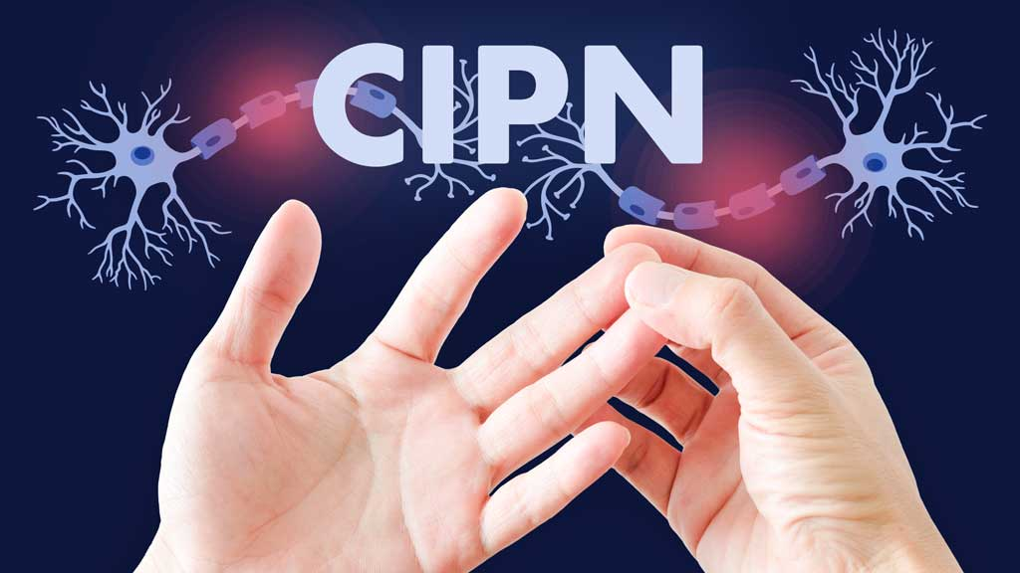

Slide 4
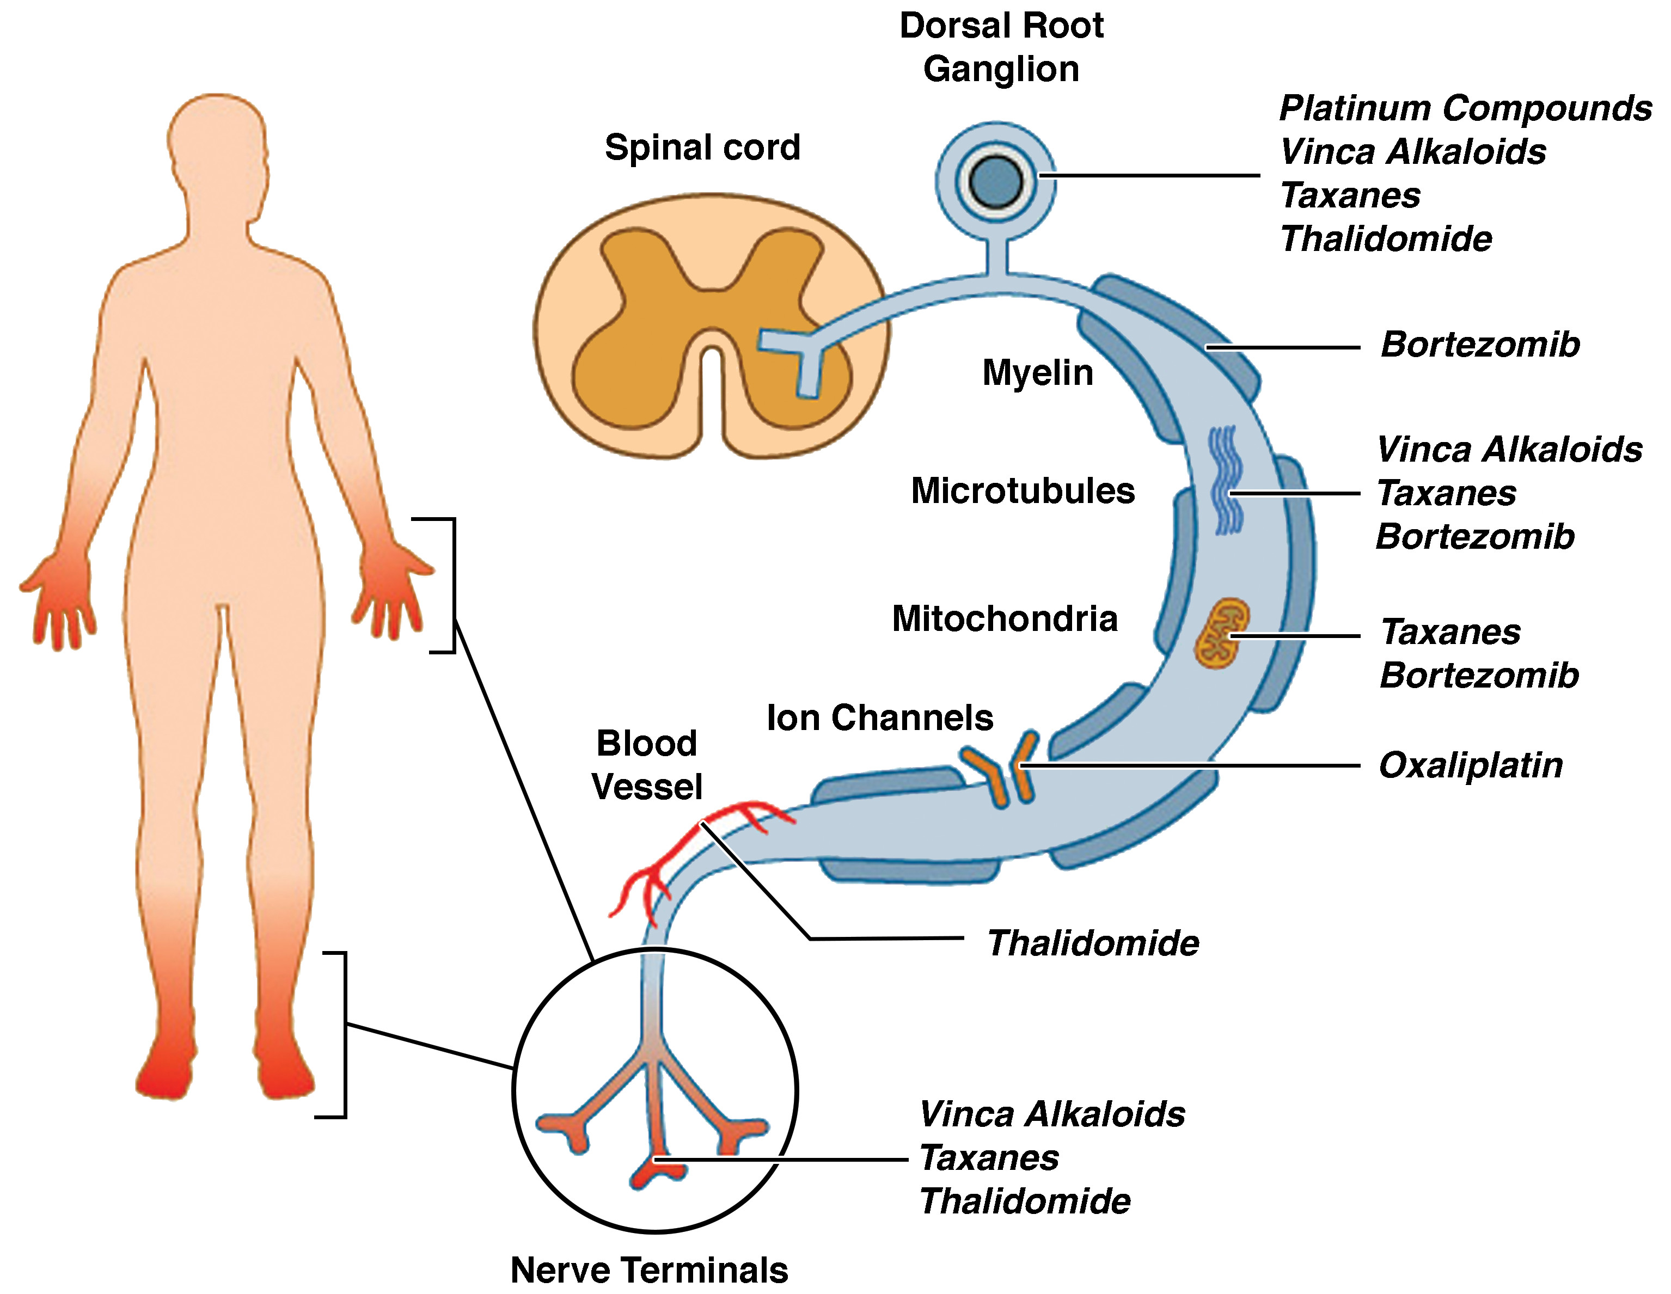
Causes for Peripheral Neuropathy

Slide 5
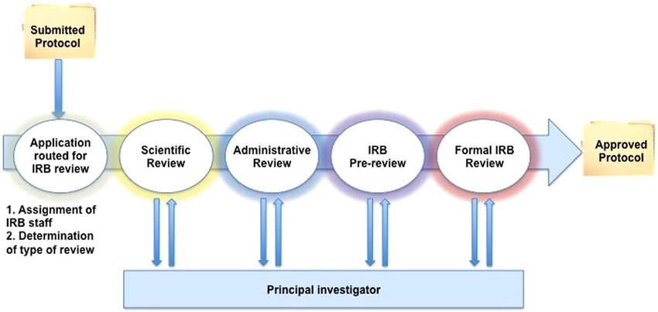
Sample Collection

Slide 6
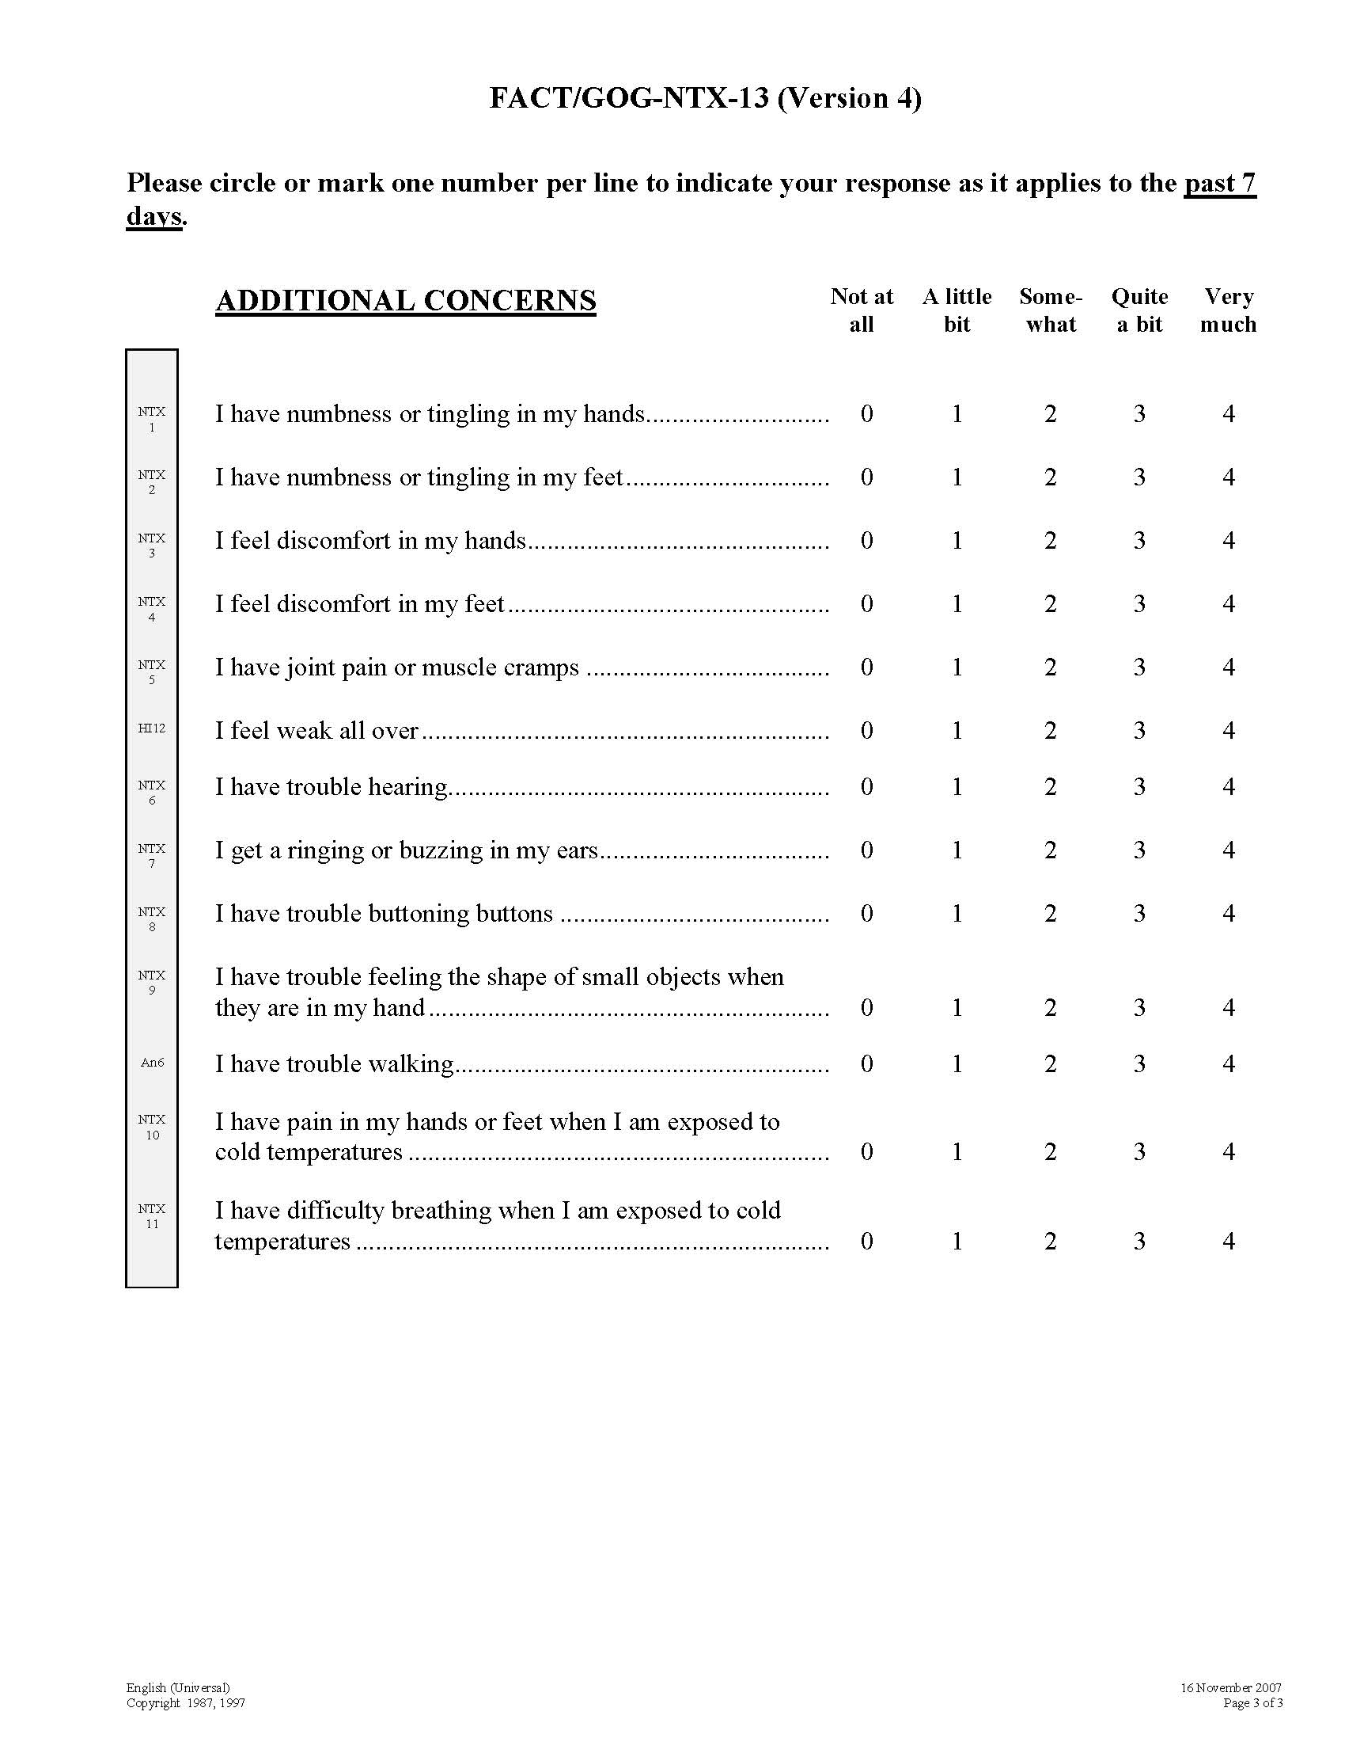
CIPN Assessment
FACT/GOG-NTX-13 Version 4
Encompassing Objective Tests,
Clinician-rated scales,
Patient-reported outcome (PRO) measures

Slide 7
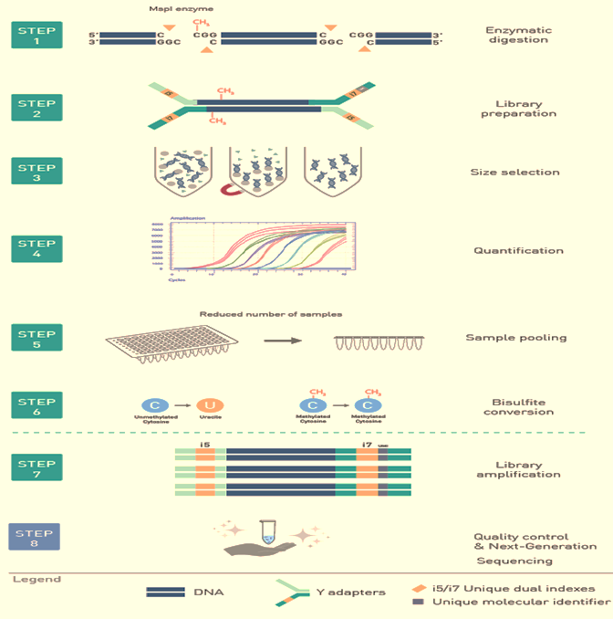
RRBS Protocol
Enzymatic Digestion
End Repair & Adapter Ligation
Size Selection, quantification, and sample pooling
Bisulfite Conversion
PCR Amplification
Quality Control and NGS

Slide 8
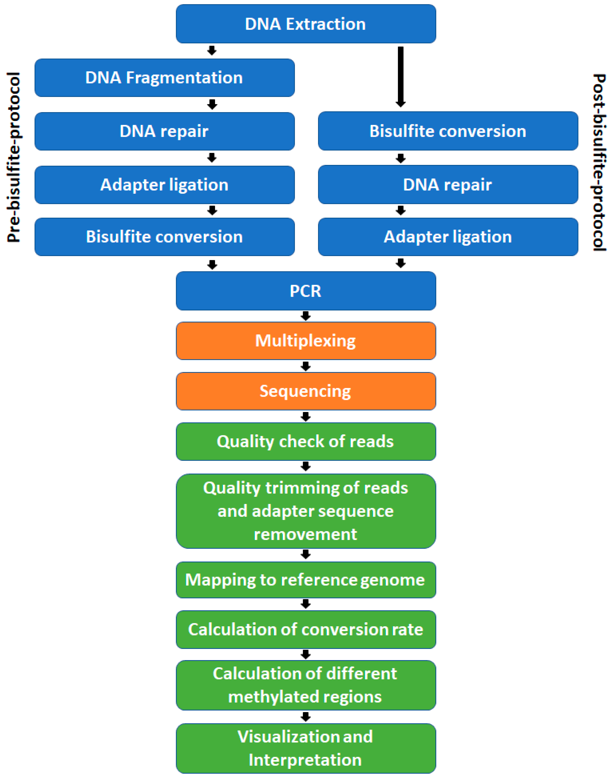
Bioinformatic Analysis
Sequence Alignment and Methylation Identification

Slide 9
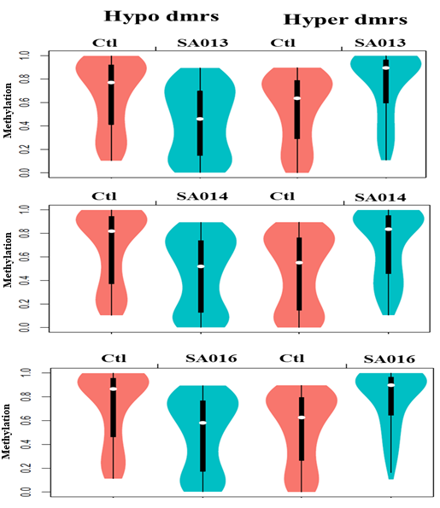
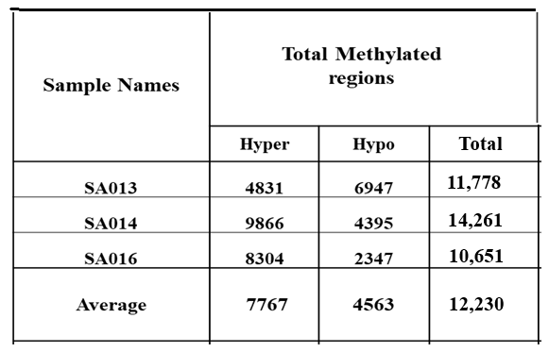
Distribution of Methylation Level of DMR

Slide 10
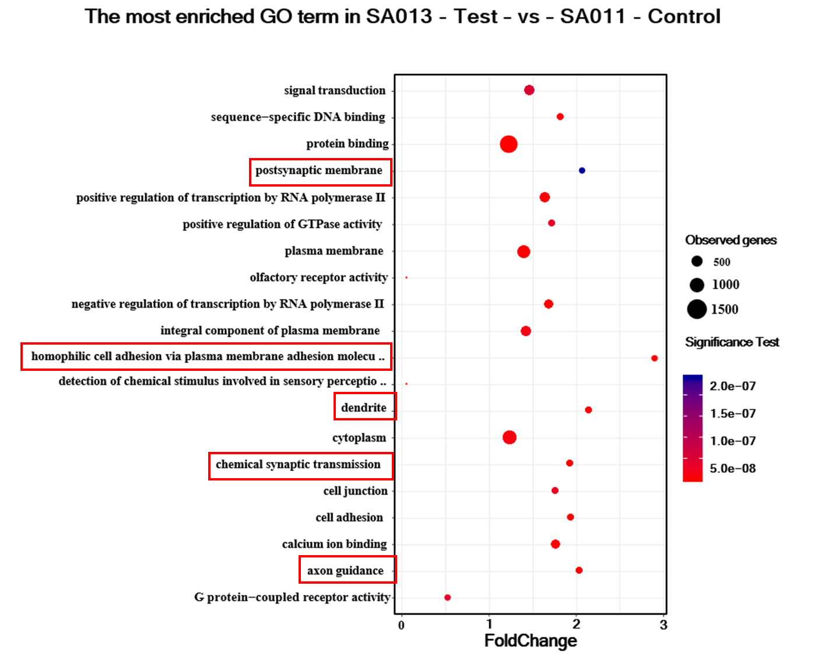
Most Enriched GO (MEGO) terms

Slide 11
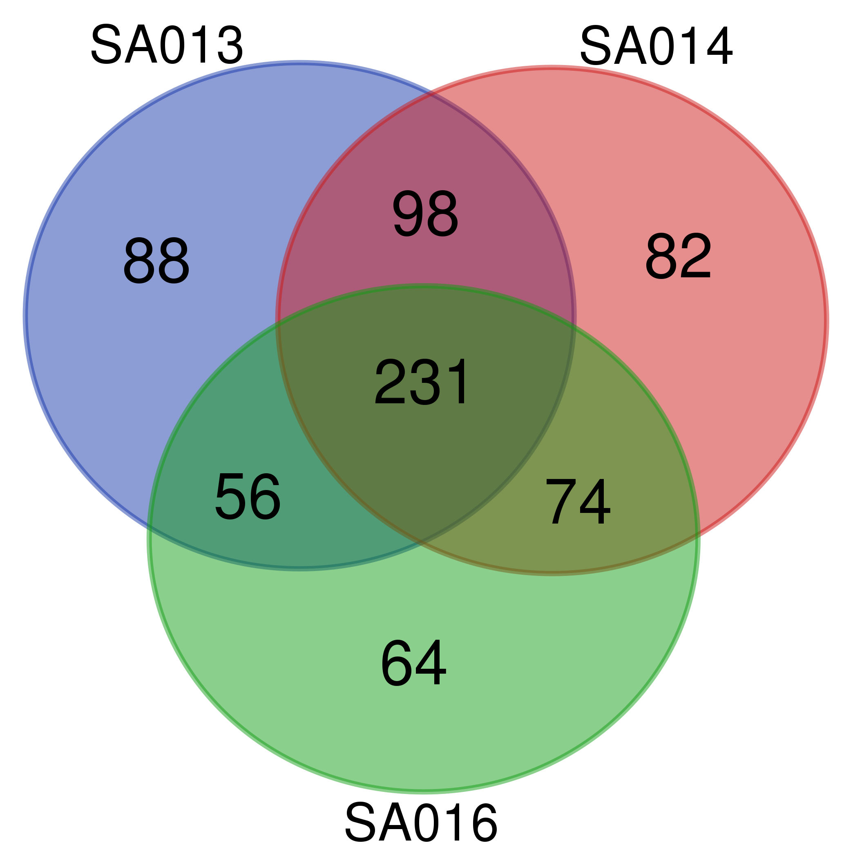
Both Hyper and Hypo genes from
Top 5 Most Enriched GO Items
List names | Number of elements | Number of unique elements
SA013_HDPAC | 585 | 473
SA014_HDPAC | 601 | 485
SA016_HDPAC | 533 | 425
Overall number of unique elements |  | 693
Overall number of Common unique elements |  | 231

Slide 12
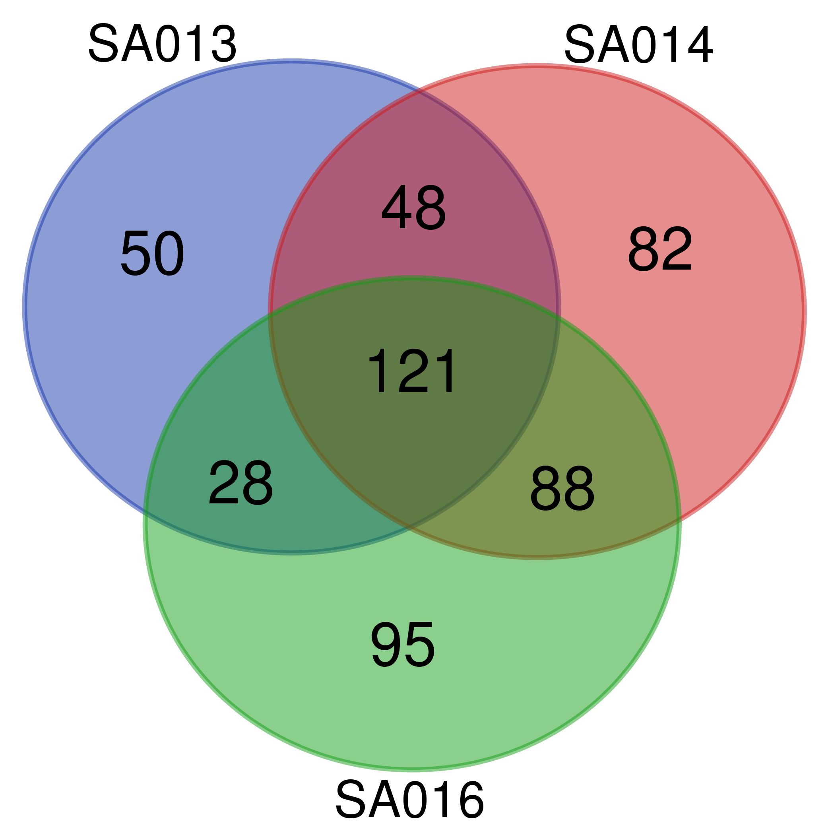
Top5 - MEGO terms
Hyper Methylated Genes Hypo Methylated genes

Slide 13
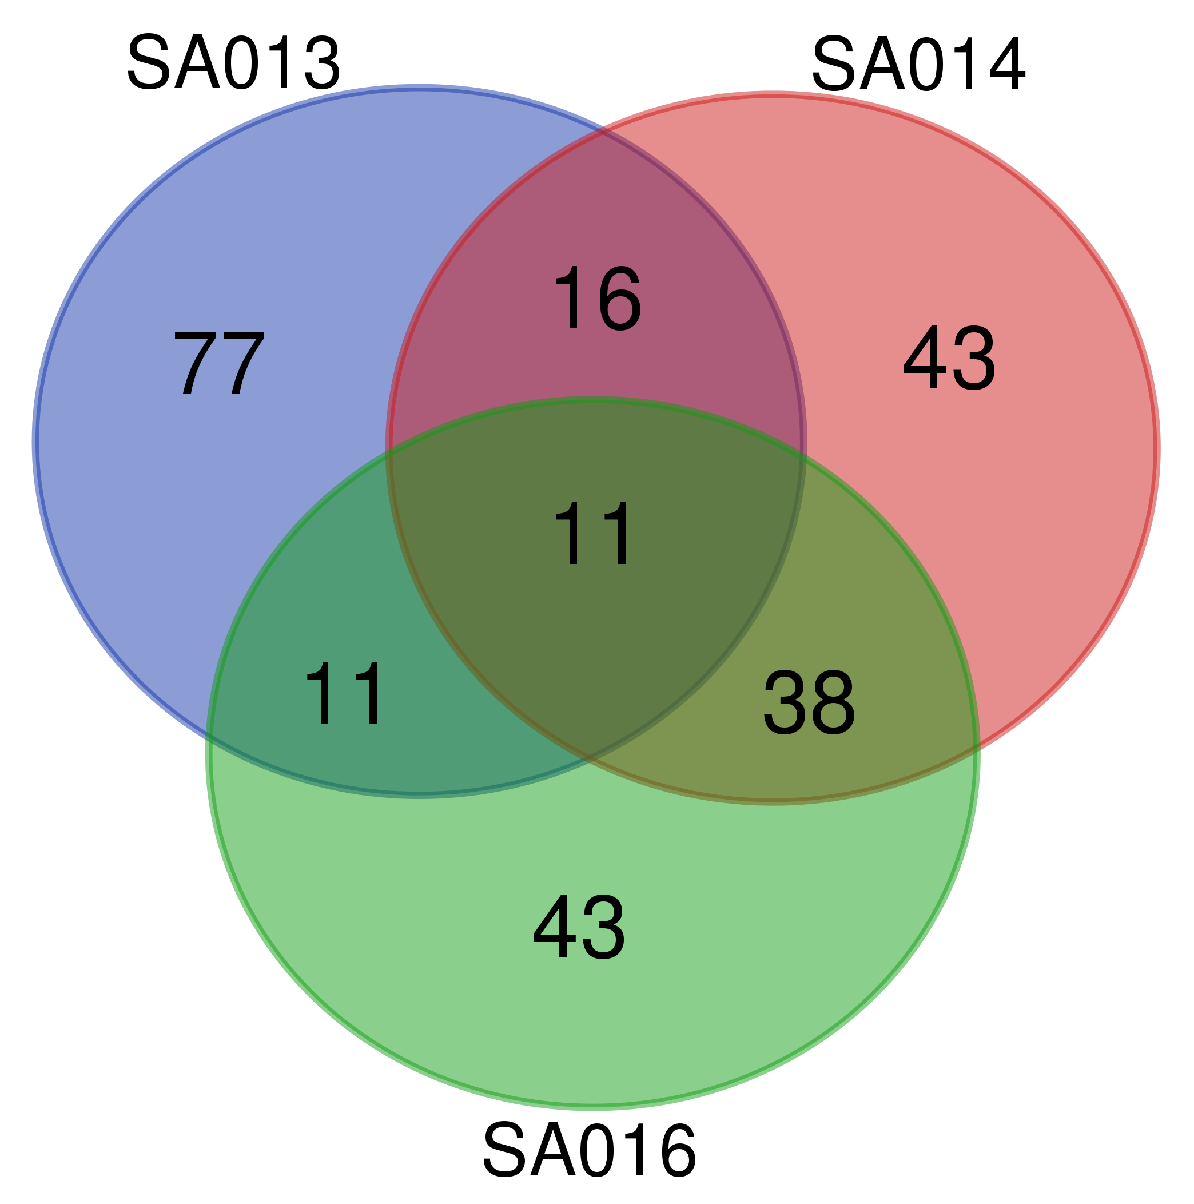
Promotor Region
Hyper Methylated Genes Hypo Methylated genes

Slide 14
Significantly methylated genes in the Promoter Regions
that belong to different GO Terms
S.No | Names | Abbreviation used for GO Term | GO TERMS | Methylation Status
1 | GABRB3 | PSM | GO:0045211 | Hypo
 |  | CST | GO:0007268 | Hypo
2 | EPHA6 | AG | GO:0007411 | Hypo
3 | CDH11 | HCA | GO:0007156 | Hypo
4 | MYCBPAP | CST | GO:0007268 | Hypo
5 | SLC6A1 | CST | GO:0007268 | Hypo
6 | HRAS (LRRC56) | …... | …... | Hypo
7 | ARRB2 | PSM | GO:0045211 | Hyper
8 | KCNQ1OT1 | …... | …... | Hyper
9 | GNAS (LOC101927932) | …... | …... | Hyper
10 | GNAS (GNAS-AS1) | …... | …... | Hyper
11 | PCDHA7 | HCA | GO:0007156 | Hyper
12 | ANK1 | PSM | GO:0045211 | Hyper
 |  | AG | GO:0007411 | Hyper
13 | DRD4 | CST | GO:0007268 | Hyper
14 | GNAS | DEND | GO:0030425 | Hyper
15 | NLGN2 | PSM | GO:0045211 | Hyper
16 | SGCE | DEND | GO:0030425 | Hyper
17 | CRMP1 | DEND | GO:0030425 | Hypo & Hyper
18 | CRMP1 | AG | GO:0007411 | Hypo & Hyper

Slide 15
INDRA GO CURATED
Signor: Glutamatergic synapse
WikiPathways: WP4875 - Disruption of postsynaptic signaling by CNV - Homo sapiens
Signor: GABAergic synapse
Signor: Dopaminergic Synapse
WikiPathways: WP2636 - Common pathways underlying drug addiction - Homo sapiens
WikiPathways: WP5083 - Neuroinflammation and glutamatergic signaling - Homo sapiens
WikiPathways: WP2380 - Brain-derived neurotrophic factor (BDNF) signaling pathway - Homo sapiens
Signor: Neurotransmitters release
Signor: Oxytocin signaling
WikiPathways: WP4159 - GABA receptor signaling - Homo sapiens
INDRA GO: GO:0007156 (homophilic cell adhesion via plasma membrane adhesion molecules)
INDRA GO: GO:0007215 (glutamate receptor signaling pathway)
INDRA GO: GO:0035235 (ionotropic glutamate receptor signaling pathway)
INDRA GO: GO:0035249 (synaptic transmission, glutamatergic)
INDRA GO: GO:0060078 (regulation of postsynaptic membrane potential)
INDRA GO: GO:0048013 (ephrin receptor signaling pathway)
INDRA GO: GO:0097120 (receptor localization to synapse)
INDRA GO: GO:2001257 (regulation of cation channel activity)
INDRA GO: GO:0007269 (neurotransmitter secretion)
INDRA GO: GO:0007612 (learning)

Slide 16
Conclusion
Differential methylation of DNA occurs in Multiple Myeloma patients who experienced CIPN
An average of 12,230 regions were differentially methylated in the patients
Analysis of Differentially Methylated Regions of the Promoters revealed 18 elements that are related Neuro Transmission / Neurodegenerative pathways
Analysis of more samples are necessary to validate these preliminary findings

Slide 17
References & Acknowledgments
References
Pancheri, E.; Guglielmi, V.;Wilczynski, G.M.; Malatesta, M.; Tonin, P.; Tomelleri, G.; Nowis, D.; Vattemi, G. Non-Hematologic Toxicity of BTZ in Multiple Myeloma: The Neuromuscular and Cardiovascular Adverse Effects. Cancers 2020, 12, 2540
Kober, K.M.; Lee, M.C.; Olshen, A.; Conley, Y.P.; Sirota, M.; Keiser, M.; Hammer, M.J.; Abrams, G.; Schumacher, M.; Levine, J.D.; et al. Differential methylation and expression of genes in the hypoxia-inducible factor 1 signaling pathway are associated with paclitaxel-induced peripheral neuropathy in breast cancer survivors and with preclinical models of chemotherapy-induced neuropathic pain. Mol. Pain 2020, 16, 1744806920936502
Kai Guo, Sarah Elzinga, , Stephanie Eid, Claudia Figueroa-Romero, Lucy M. Hinder, Crystal Pacut (2019), Genome-wide DNA methylation profiling of human diabetic peripheral neuropathy in subjects with type 2 diabetes mellitus, Epigenetics, Vol 14, No.8, Pages 766-779 https://doi.org/10.1080/15592294.2019.1615352
Farkhonde Hasannejad, Malek Moein Ansar, Mohammad Rostampour, Edris Mahdavi Fikijivar, Behrooz Khakpour Taleghani, (2019), Improvement of pyridoxine‑induced peripheral neuropathy by Cichorium intybus hydroalcoholic extract through GABAergic system, The Journal of Physiological Sciences (2019) 69:465–476
Guo, K.; Elzinga, S.; Eid, S.; Figueroa-Romero, C.; Hinder, L.M.; Pacut, C.; Feldman, E.L.; Hur, J. Genome-wide DNA methylation profiling of human diabetic peripheral neuropathy in subjects with type 2 diabetes mellitus. Epigenetics 2019, 14, 766–779
Chen Z, Miao F, Paterson AD, et al. Epigenomic profiling reveals an association between persistence of DNA methylation and metabolic memory in the DCCT/EDIC type 1 diabetes cohort. Proc Nat Acad Sci. 2016;May 24;113(21):E3002–11
Acknowledgments
This research was supported by the Community Foundation of Broward and the Royal Dames of Cancer Research Inc. of Ft. Lauderdale, Florida

