Slide 1
Iron deficiency in incident peritoneal dialysis Higher prevalence in absence of anemia and association with mortality
Brianna Hartley*, Vladimir Rigodon*, John W. Larkin, Yue Jiao, Len A. Usvyat, Franklin W. Maddux, Peter Kotanko, Roberto Pecoits-Filho, Thyago P. Moraes, Murilo H. Guedes
1. Pontificia Universidade Catolica do Parana, Curitiba, PR, Brazil; 2. Fresenius Medical Care, Global Medical Office, Waltham, MA, United States; 3. Fresenius Medical Care AG & Co KGaA, Bad Homburg, Hessen, Germany; 4. Renal Research Institute, New York, NY, United States; 5. Nova Southeastern University College of Osteopathic Medicine, Clearwater, FL, United States

Slide 2
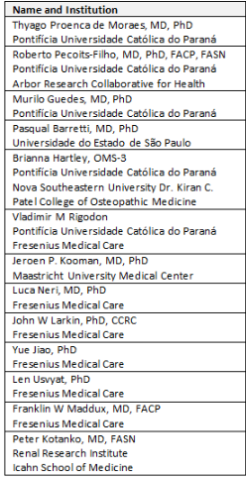
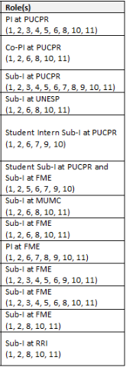
Interdisciplinary Research Team

Slide 3
Background
KDIGO and KDOQI guidelines recommend IV iron therapy to be considered in CKD patients with anemia characterized by low hemoglobin (Hgb) levels^{1, 2}
Guidelines recommend IV iron medications are managed considering:^{1, 2}
Effectiveness of IV iron as seen by increases in Hgb or decreases in ESA dose
Maintenance of transferrin saturation (TSAT) ≤30% and ferritin ≤500 ng/ml
If CKD patients have iron deficiency in the absence of a low Hgb level, they may be at risk of being under treated or untreated, irrespective of ESA use
DOPPS has identified CKD patients with indications for receiving IV iron therapy have often been found to remain untreated³
Recent studies investigated the role of iron deficiency and outcomes, independent of Hgb levels characterizing anemia
KDIGO clinical practice guideline for anemia in chronic kidney disease. Kidney Int Suppl 2: 279–335, 2012. Available at: https://kdigo.org/wp-content/uploads/2016/10/KDIGO-2012-Anemia-Guideline-English.pdf.
Kliger, Alan S. et al. KDOQI US Commentary on the 2012 KDIGO Clinical Practice Guideline for Anemia in CKD. American Journal of Kidney Diseases, Volume 62, Issue 5, 849 – 859.
Wong MMY, et al. Anemia and iron deficiency among chronic kidney disease Stages 3-5ND patients in the Chronic Kidney Disease Outcomes and Practice Patterns Study: Often unmeasured, variably treated. Clin Kidney J 13: 613–624, 2019
Notes:
KDIGO clinical practice guideline for anemia in chronic kidney disease. Kidney Int Suppl 2: 279–335, 2012. Available at: https://kdigo.org/wp-content/uploads/2016/10/KDIGO-2012-Anemia-Guideline-English.pdf.
Kliger, Alan S. et al. KDOQI US Commentary on the 2012 KDIGO Clinical Practice Guideline for Anemia in CKD. American Journal of Kidney Diseases, Volume 62, Issue 5, 849 – 859.
Wong MMY, et al. Anemia and iron deficiency among chronic kidney disease Stages 3-5ND patients in the Chronic Kidney Disease Outcomes and Practice Patterns Study: Often unmeasured, variably treated. Clin Kidney J 13: 613–624, 2019

Slide 4
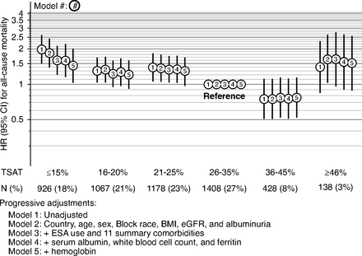
TSAT and Mortality in CKD
Guedes M, et al. JASN 2021; DOI: https://doi.org/10.1681/ASN.2020101531

Slide 5
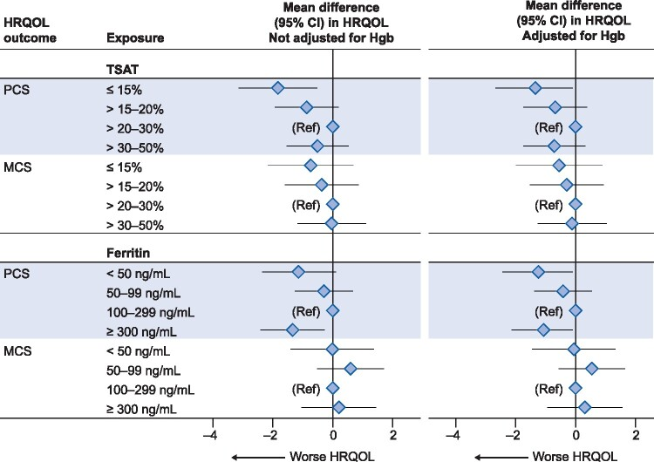
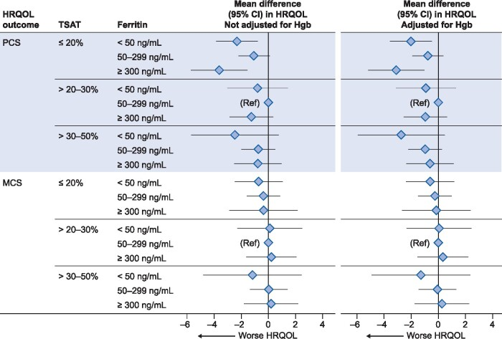
TSAT, Ferritin, and QOL in CKD
Guedes M, et al. NDT 2022; DOI: 10.1093/ndt/gfab050

Slide 6
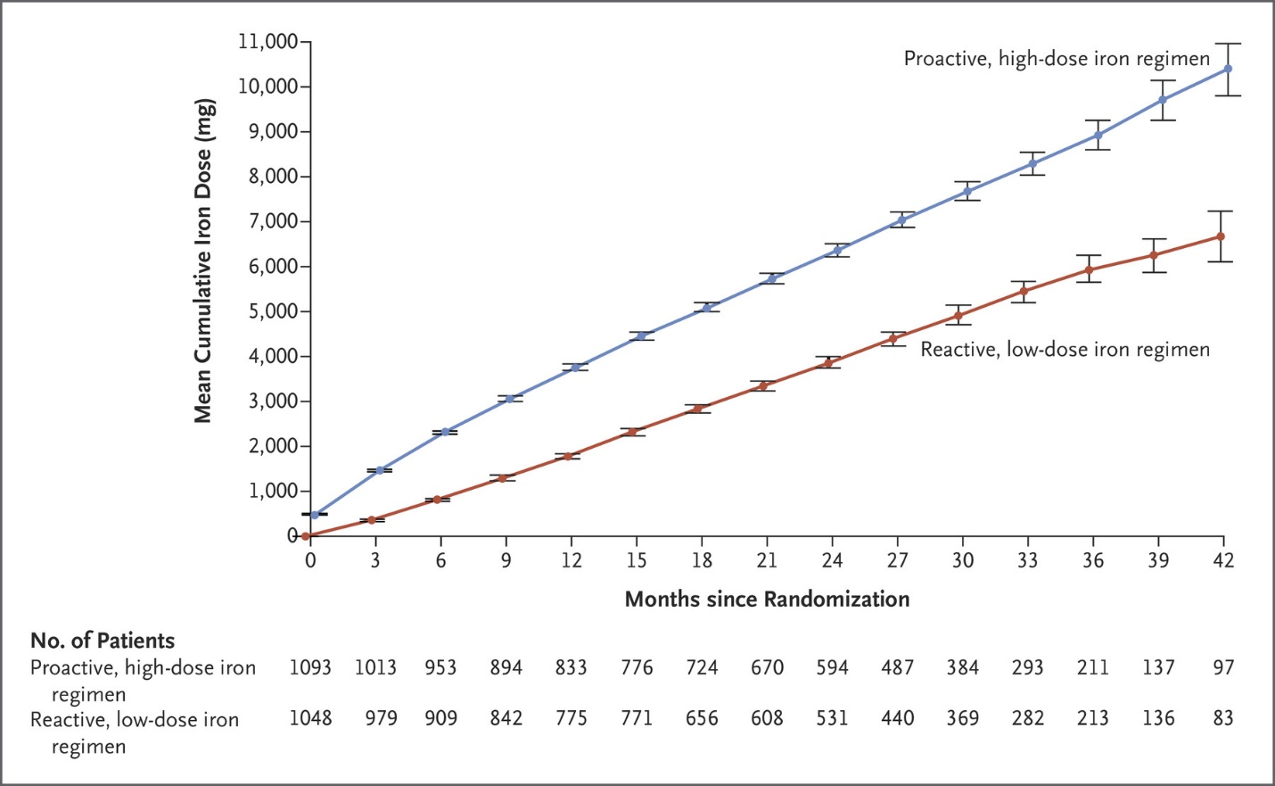
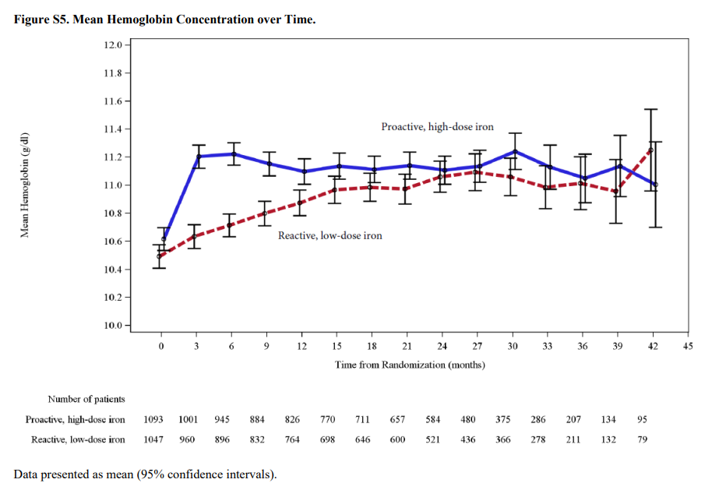
Hgb in high vs low dose IV iron in PIVIOTL trial
Macdougall IC, et al. NEJM 2019. DOI: 10.1056/NEJMoa1810742

Slide 7
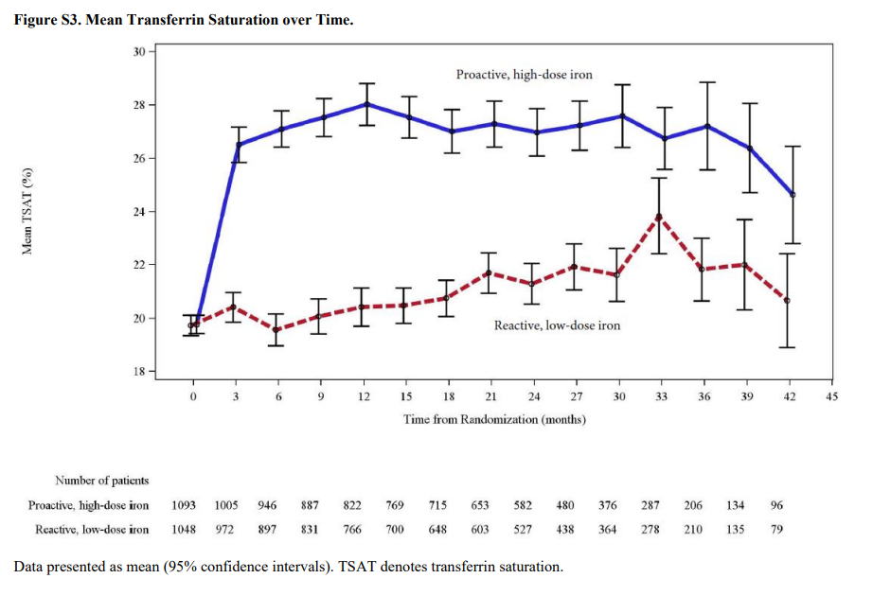
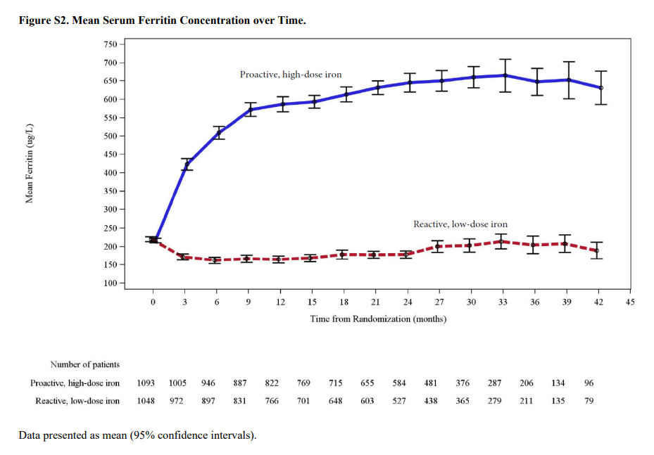
TSAT & ferritin in high vs low dose IV iron in PIVIOTL trial
Macdougall IC, et al. NEJM 2019. DOI: 10.1056/NEJMoa1810742

Slide 8
Iron stores: importance beyond erythropoiesis?
In CKD, iron deficiency associates with higher mortality rates, higher incidence of CVD events, and poorer QOL related to physical function
In kidney failure patients treated by hemodialysis, high dose IV iron has been demonstrated to associate with better hard outcomes and the same Hgb target achievement as low dose IV iron
Appears iron therapy may be delayed using current recommendations for IV iron therapy in CKD and kidney failure
Studies are needed to characterize outcomes for dialysis populations with iron deficiency
As a preliminary feasibility assessment, we characterized iron deficiency states in incident PD patients in the BrazPD dataset

Slide 9
BrazPD Patient Population
122 clinics PD clinics from 01 Dec 2004 to 31 Jan 2011
n=9905
Incident to PD
n=7007
Excluded from analysis:
Prevalent PD at BrazPD start (n=2,898)
On PD <180 days (n=4,256)
Had <1 Hgb, TSAT, or ferritin (n=1,386)
On PD ≥180 days
N=2,751
Had ≥1 Hgb, TSAT, and ferritin value in first 180 days of PD
N=1365
PD: Peritoneal dialysis
TSAT: Transferring saturation
Hgb: Hemoglobin

Slide 10
Categories of Iron Deficiency
≥10
≥10
<10
<10
≥10
≥10
<10
Hgb (g/dL)
<20
<20
<20
<20
<20
<20
<20
TSAT (%)
≥200
≥200
≥200
≥200
<200
<200
<200
Ferritin (ng/mL)
Functional ID without anemia
Functional ID with anemia
Absolute ID without anemia
Absolute ID with anemia

Slide 11
Baseline Characteristics
Parameter | Overall | Functional ID without anemia | Functional ID with anemia | Absolute ID without anemia | Absolute ID with anemia
Patients | 1365 | 71 | 21 | 86 | 25
Age (years) | 59.8 | 61.5 | 58.7 | 57.3 | 58.9
Male (%) | 46.4 | 53.5 | 47.6 | 37.2 | 24.0
Race white (%) | 61.1 | 56.3 | 61.9 | 73.3 | 48.0
BMI (kg/m²) | 24.8 | 24.6 | 24.1 | 25.0 | 24.9
Diabetes (%) | 49.1 | 54.9 | 61.9 | 50.0 | 44.0
Previous HD (%) | 41.2 | 35.2 | 23.8 | 29.1 | 32.0
Albumin (g/dL) | 3.5 | 3.4 | 3.6 | 3.5 | 3.4
Hgb (g/dL) | 11.3 | 11.6 | 9.1 | 11.8 | 9.1
TSAT (%) | 44.1 | 15.3 | 16.2 | 15.5 | 14.6
Ferritin (ng/mL) | 424.2 | 489.5 | 582.5 | 91.6 | 100.2

Slide 12
Prevalence of Iron Deficiency in Patients Incident to PD
14.9%
Overall
Prevalence of ID in Incident PD

Slide 13
Three Year Mortality Rates by Incident Iron Deficiency State

Slide 14
Conclusions
Iron deficiency appeared more frequent in the absence of anemia during the first 6 months after starting PD
Finding was consistent for functional and absolute iron deficiency states
Presence of functional iron deficiency without anemia in incident PD was associated with the highest all-cause mortality rate
Screening for, and characterization of, iron deficiency states may be important among patients with and without anemia
Further evaluations with larger sample sizes are warranted to determine if the treatment of functional iron deficiency in patients without anemia should be recommended

Slide 15
Next Steps
Investigate further within MONDO among PD and HD populations:​
Two manuscripts lead by co-first authors
Four models to estimate the association between iron deficiency states and all-cause mortality
Cox proportional hazard model
Fine and Grey competitive risk model (accounting for technique failure, discharge, …)
Multilevel survival analysis (accounting for clinic-level values in a mixed model)
Multivariate regression model (treating TSAT as a continuous measure)

Slide 16
Acknowledgments
Vladimir Rigodon
Murilo Guedes
Roberto Pecoits-Filho
John Larkin

Slide 17
References
Serum Biomarkers of Iron Stores Are Associated with Increased Risk of All-Cause Mortality and Cardiovascular Events in Nondialysis CKD Patients, with or without Anemia. https://jasn.asnjournals.org/content/32/8/2020
Kuo, KL., Liu, JS., Lin, MH. et al. Association of anemia and iron parameters with mortality among prevalent peritoneal dialysis patients in Taiwan: the AIM-PD study. Sci Rep 12, 1269 (2022). https://doi.org/10.1038/s41598-022-05200-3
Prevalence, correlates and outcomes of absolute and functional iron deficiency anemia in nondialysis-dependent chronic kidney disease, Nephrology Dialysis Transplantation, Volume 36, Issue 1, January 2021, Pages 129–136, https://doi.org/10.1093/ndt/gfz192
Iron Deficiency Anemia in Chronic Kidney Disease. Acta Haematol 2019;142:44-50. doi: 10.1159/000496492
Management of Anemia in Nondialysis Chronic Kidney Disease: Current Recommendations, Real-World Practice, and Patient Perspectives. Murilo Guedes, Bruce M. Robinson, Gregorio Obrador, Allison Tong, Ronald L. Pisoni, Roberto Pecoits-Filho. Kidney360 Aug 2020, 1 (8)855-862; DOI: 10.34067/KID.000144202

