Slide 1
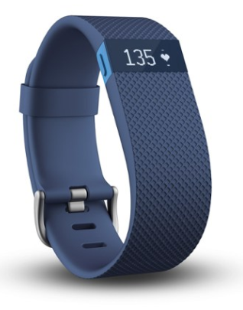
The Impact of Exercise Motives on Adolescents’ Sustained Use of Wearable Technology
Kimberly Deranek, Ph. D. ¹; Arvind Gudi, Ph. D.²; Barbara Hewitt, Ph. D.³; Alex McLeod, Ph. D.⁴
^{1, 2} Huizenga College of Business and Entrepreneurship, Nova Southeastern University,
³ Department of Health Information Management, Texas State University
⁴ Department of IS and Analytics, Texas State University
Introduction
Results
Conclusion
High rate of obesity amongst adolescents.
Growing use of wearable technology
Enables health information tracking - steps, distance traveled, etc.
Belief that use of wearable technology can lead to increased health and wellness.
Stats: New users of wearables (50%) and health apps (74%) stop using them within 2 weeks
Does adolescents’ inclination towards exercise motives influence their “commitment to the sustained use of wearable technology”?
Does “compliance” towards the use of wearable technology differ across exercise motives?
Correlation between EM and technology use
Positive influence on device use
Affiliation (β = .42, p<.002)
Health Pressures (β = .33, p<.002)
Negative effect on device use
Revitalization (β = -.51, p<.001)
Three constructs predict 26% of
adolescents’ compliance behavior!
MGA between group differences
Affiliation
Compliant group average Likert score lower than Non-compliant group
Less motivated by affiliation
Revitalization
Compliant group average Likert score higher than Non-compliant group
More motivated by revitalization
Compliant Participants:
May choose to exercise for reasons beyond peer-to-peer interaction or “Affiliation”
Prominent motivating factors such as “Revitalization” appear to influence behavior:
“It makes me feel good”
“I find exercise invigorating”
Non-compliant participants need to leverage social components of device…to foster “Affiliation”
Development of a predictive model to identify “Non-Compliant” individuals if wearables are leveraged
Use of wearables for reduced health insurance rates
Employers would need to be aware if members were predisposed to non-compliance
Research Question
Methods
Research Team
Response Variables
Independent Variable
Exercise Motives EMI-2
Forces that drive engagement/withdrawal from physical activity
14 Exercise Motives
Dependent Variable
Compliance: Charged/Wore device 30% or more during study duration
Non-compliance: Charged/Wore Fitbit <30% during study duration
Statistical Tests
Smart PLS
Tested relationship between exercise motives and compliance
Multi-group Analysis (MGA)
Measures significance of between group differences across constructs
The interdisciplinary research team included faculty members from multiple departments and institutions in:
Decision Sciences
Health Information Management
Information Systems and Analytics
 | p-Values (Comp30) | p-Values (Noncomp30)
Affiliation -> Compliance | 0.011 | 0.708
Revitalization -> Compliance | 0.012 | 0.61
References
Deranek, K., Hewitt, B., Gudi, A., & McLeod, A. (2021). The impact of exercise motives on adolescents’ sustained use of wearable technology. Behaviour & Information Technology, 40(7), 691-705.
Ingledew, D.K., Markland, D., & Medley, A.R. (1998). Exercise motives and stages of change. Journal of Health Psychology, 3(4), 477-489.
Markland, D. & Ingledew, D. K. (1997). The measurement of exercise motives: Factorial validity and invariance across gender of a revised Exercise Motivations Inventory. British Journal of Health Psychology, 2, 361-376.
Markland, D. Ingledew, D. K, Hardy, L. & Grant, L. (1992). A comparison of the exercise motivations of participants in aerobics and weight watcher exercisers. Journal of Sports Sciences, 10, 609-610.
Research funded under NSU Quality of Life Grant: 2016-2017

