Slide 1
Impact of Clinically Centered Microbiology and Immunology Coursework on Student Perceptions and Learning Outcomes
Michelle Demory Beckler, PhD, Beata I. Lewandowska OD, MS, Pranati Movva, MS, and Joshua M. Costin, PhD

Slide 2
Disclosures
I have no financial disclosures

Slide 3
Lots of reasons for Optometrists to study Microbiology & Immunology
Infections by microorganisms a common etiology of eye diseases
Optometrists must recognize the symptoms and signs of ocular infections
Optometrists may need to collect specimens from the ocular surface and deliver to a lab for analysis
Optometrists develop care plans to eradicate the offending microorganisms, promote tissue healing by taking into account the patient’s immunological status, educate the patients and their families, and effectively communicate with other members of the healthcare team.
Optometric clinics, as outpatient settings, must comply with infection prevention guidelines to minimize the spread of infectious agents.
The study of medical microbiology and immunology allows optometry students in their pre-clinical preparation to appreciate the various pathogens responsible for ocular infections as well as to understand the body’s immune responses against the infectious processes.
From: The Big Picture Medical Microbiology by Neal R. Chamberlain; McGraw Hill Companies, Ic., 2009.

Slide 4
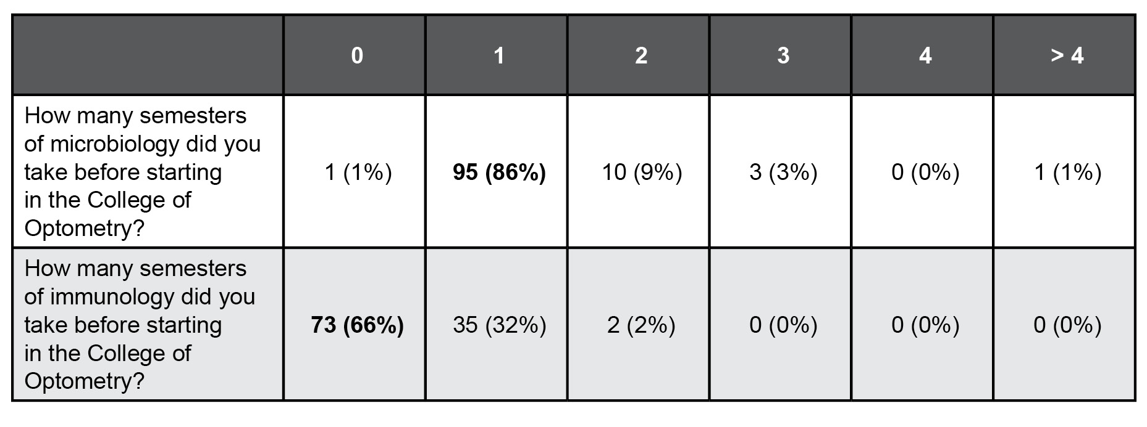
Students’ previous experience with Microbiology & Immunology

Slide 5
Problem
AY2019-2020
Optometry Microbiology & Immunology reduced from 3 credits to 2 credits
Can we do more with less?!?
A
B
A
B

Slide 6
Interdisciplinary & Interprofessional Collaboration!
Joshua Costin
Assistant Professor of Education, NSU MD
Course director
Virology and Mycology content expert
Michelle Demory Beckler
Associate Professor, NSU MD
Immunology content expert
Beata Lewandowska
Associate Professor of Optometry
Optometrist
Pranati Movva
Masters of Biomedical Sciences (MBS) student

Slide 7
Review of Optometry Education Literature

Slide 8
Vertical integration of optometry Microbiology & Immunology
Medical schools have realized the importance of including clinical tasks early in the curriculum
the mixing of basic and clinical sciences is termed vertical integration.
In a similar fashion, some optometry programs have moved toward interlinking the clinical and basic sciences within the curriculum.

Slide 9
Questions
Are clinical co-lectures in Microbiology & Immunology correlated with increased performance on summative assessments in an Optometry course?
Do Optometry students perceive clinical co-lectures in Microbiology & Immunology as helpful and relevant?
?
?

Slide 10
Study Setup

Slide 11
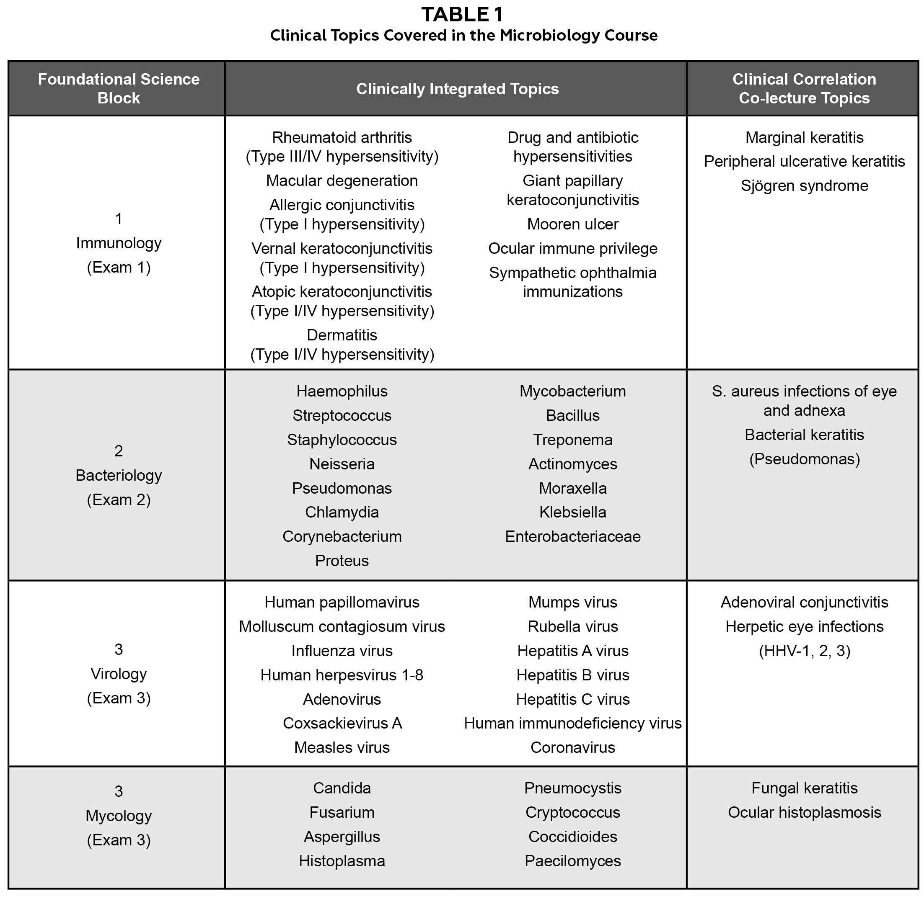
Assessments
3 exams in course
40 questions each
Exam 1 - Immunology
Immunology
6 case-based questions,
2 directly from the CCLs
Exam 2 - Bacteriology
11 case-based questions
2 directly from the CCLs
Exam 3 - Virology and Mycology
12 case-based questions
2 directly from the CCLs

Slide 12
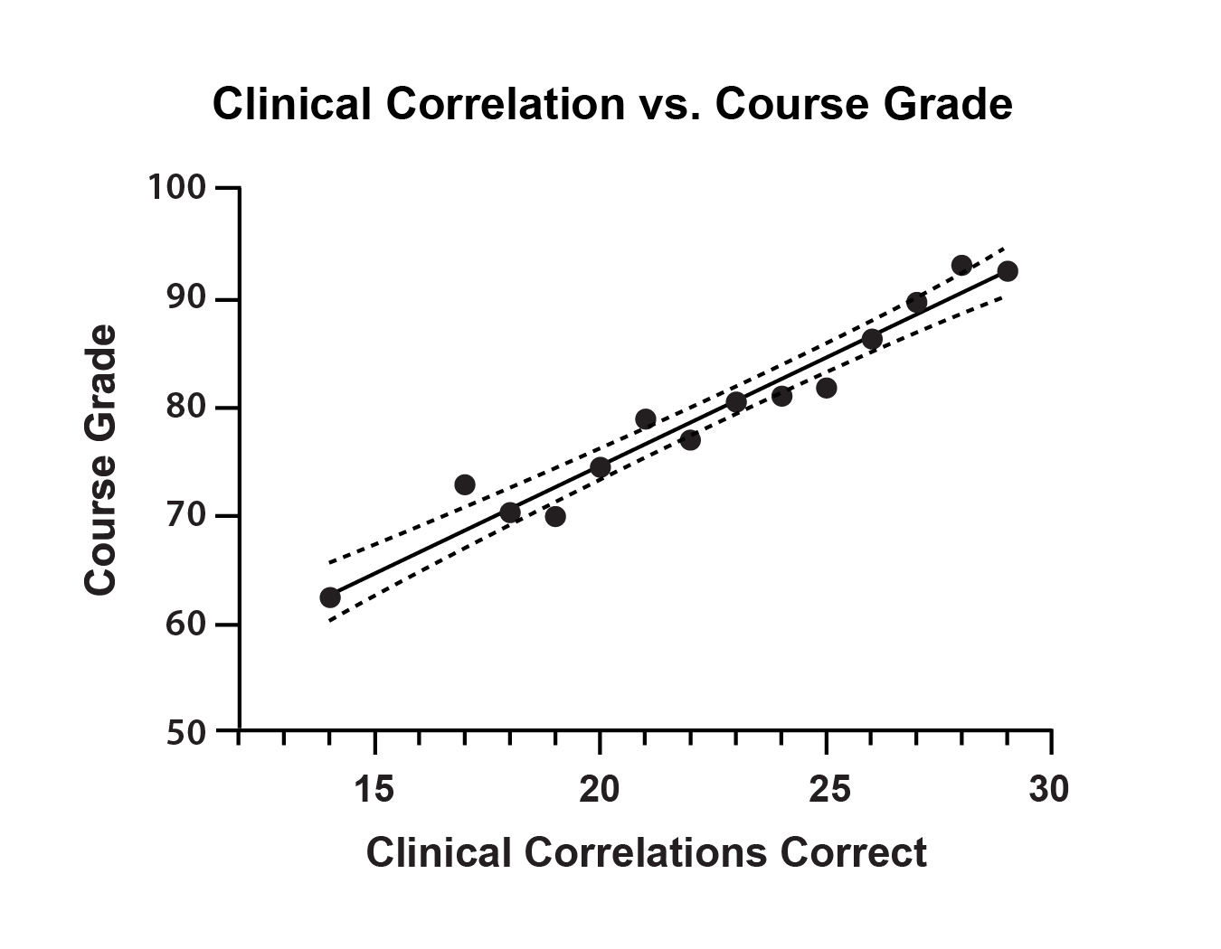
Increased clinical case understanding increased performance
29 of 120 case-based MCQs predicted success in the course

Slide 13
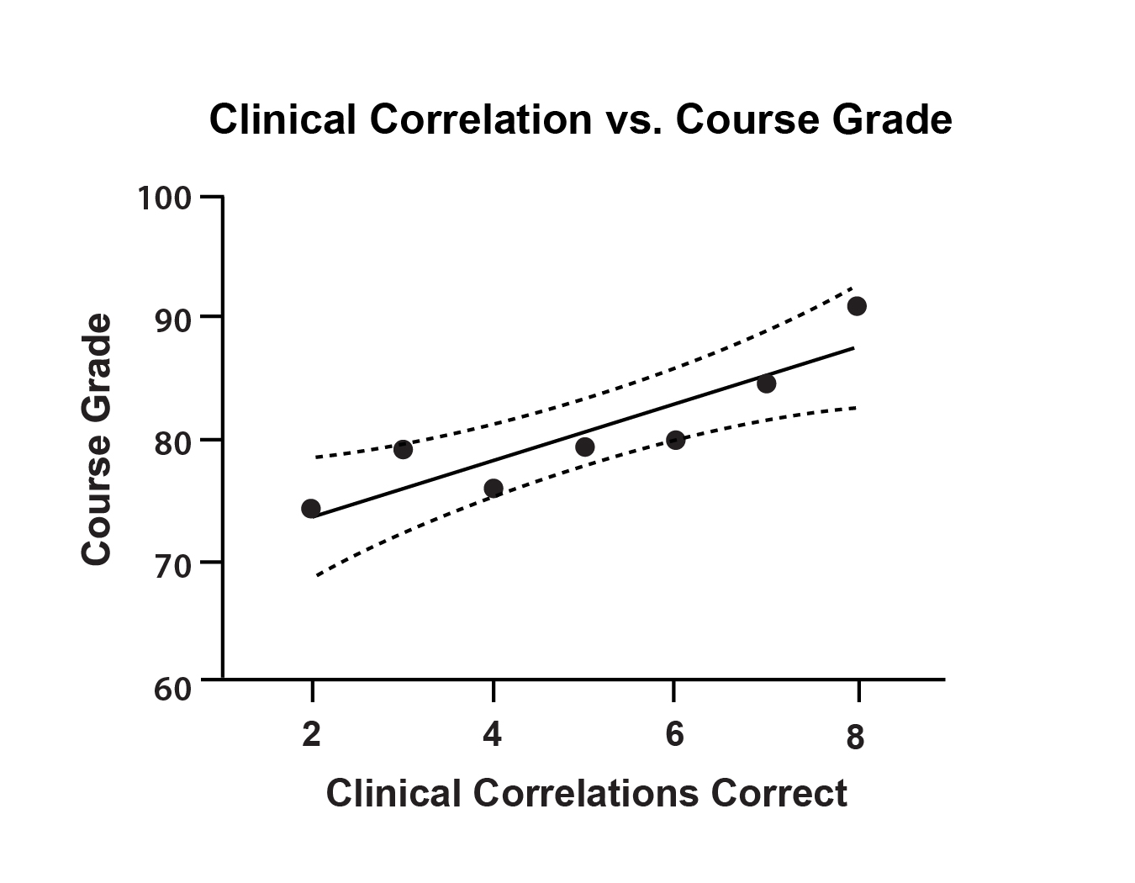
8 of 120 MCQs directly from the CCLs predicted success in the course

Slide 14
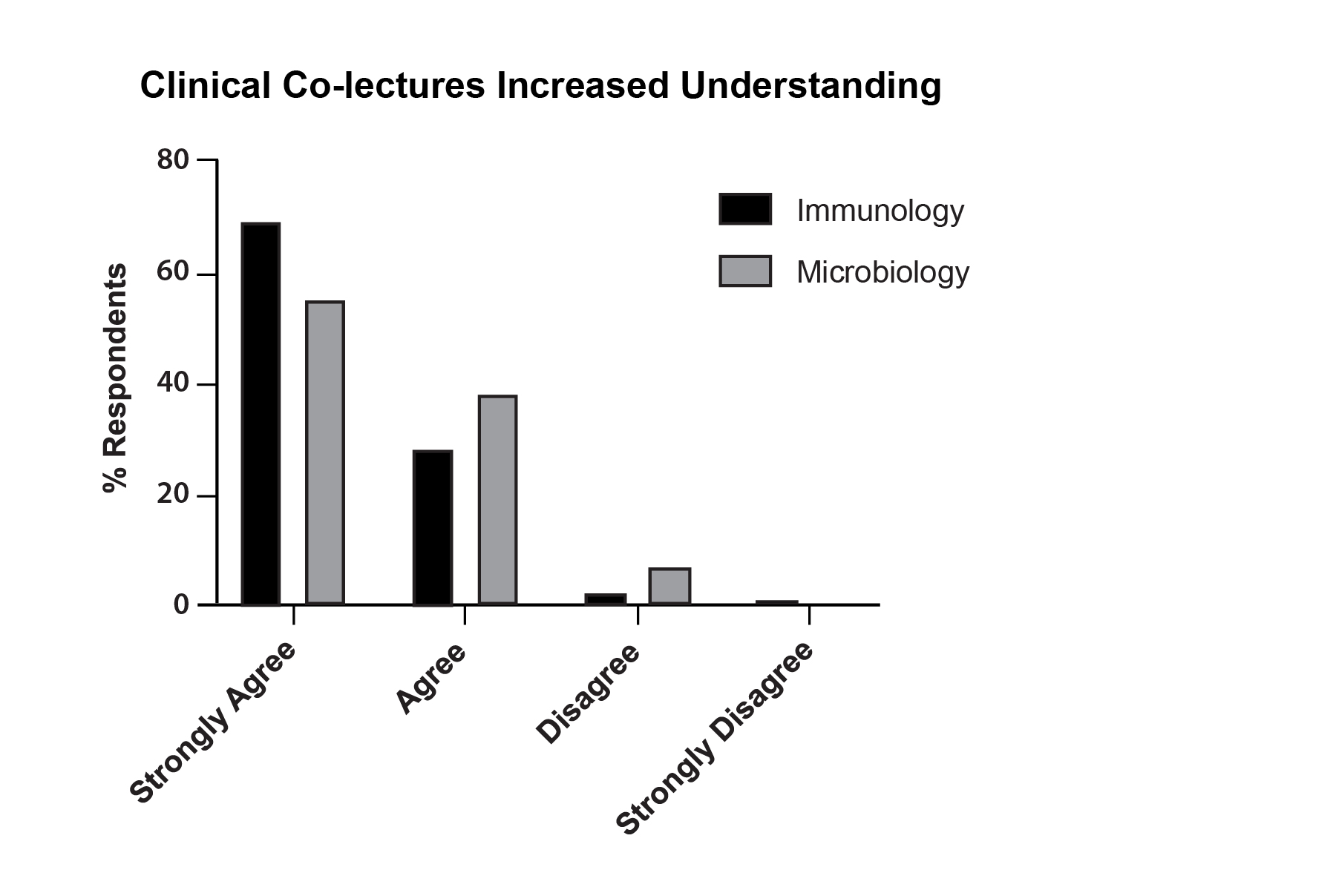
Student Perceptions

Slide 15
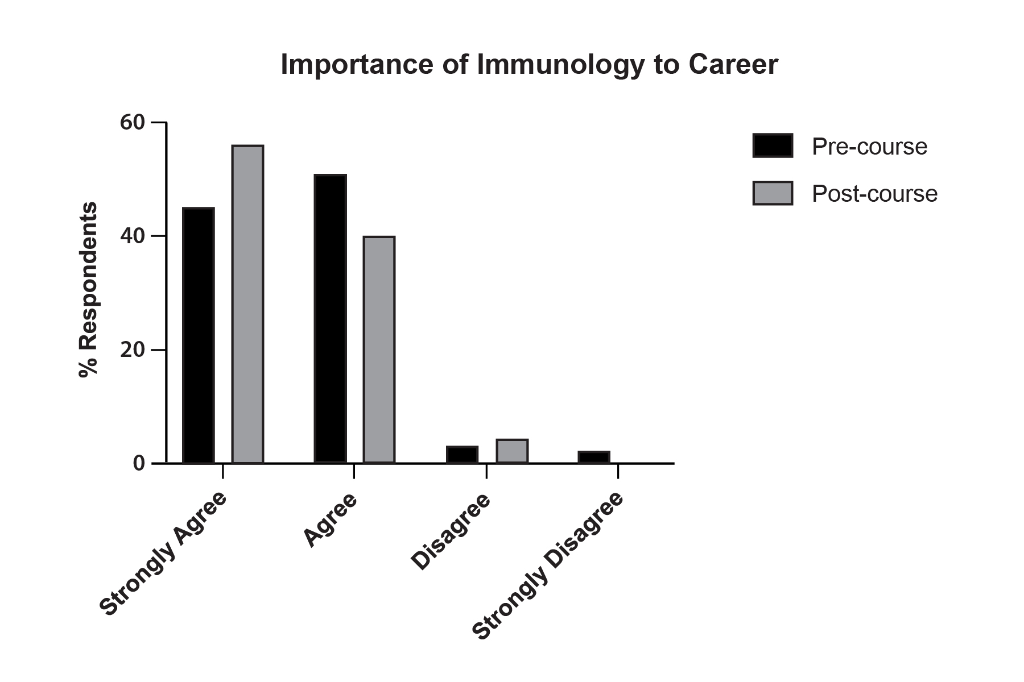
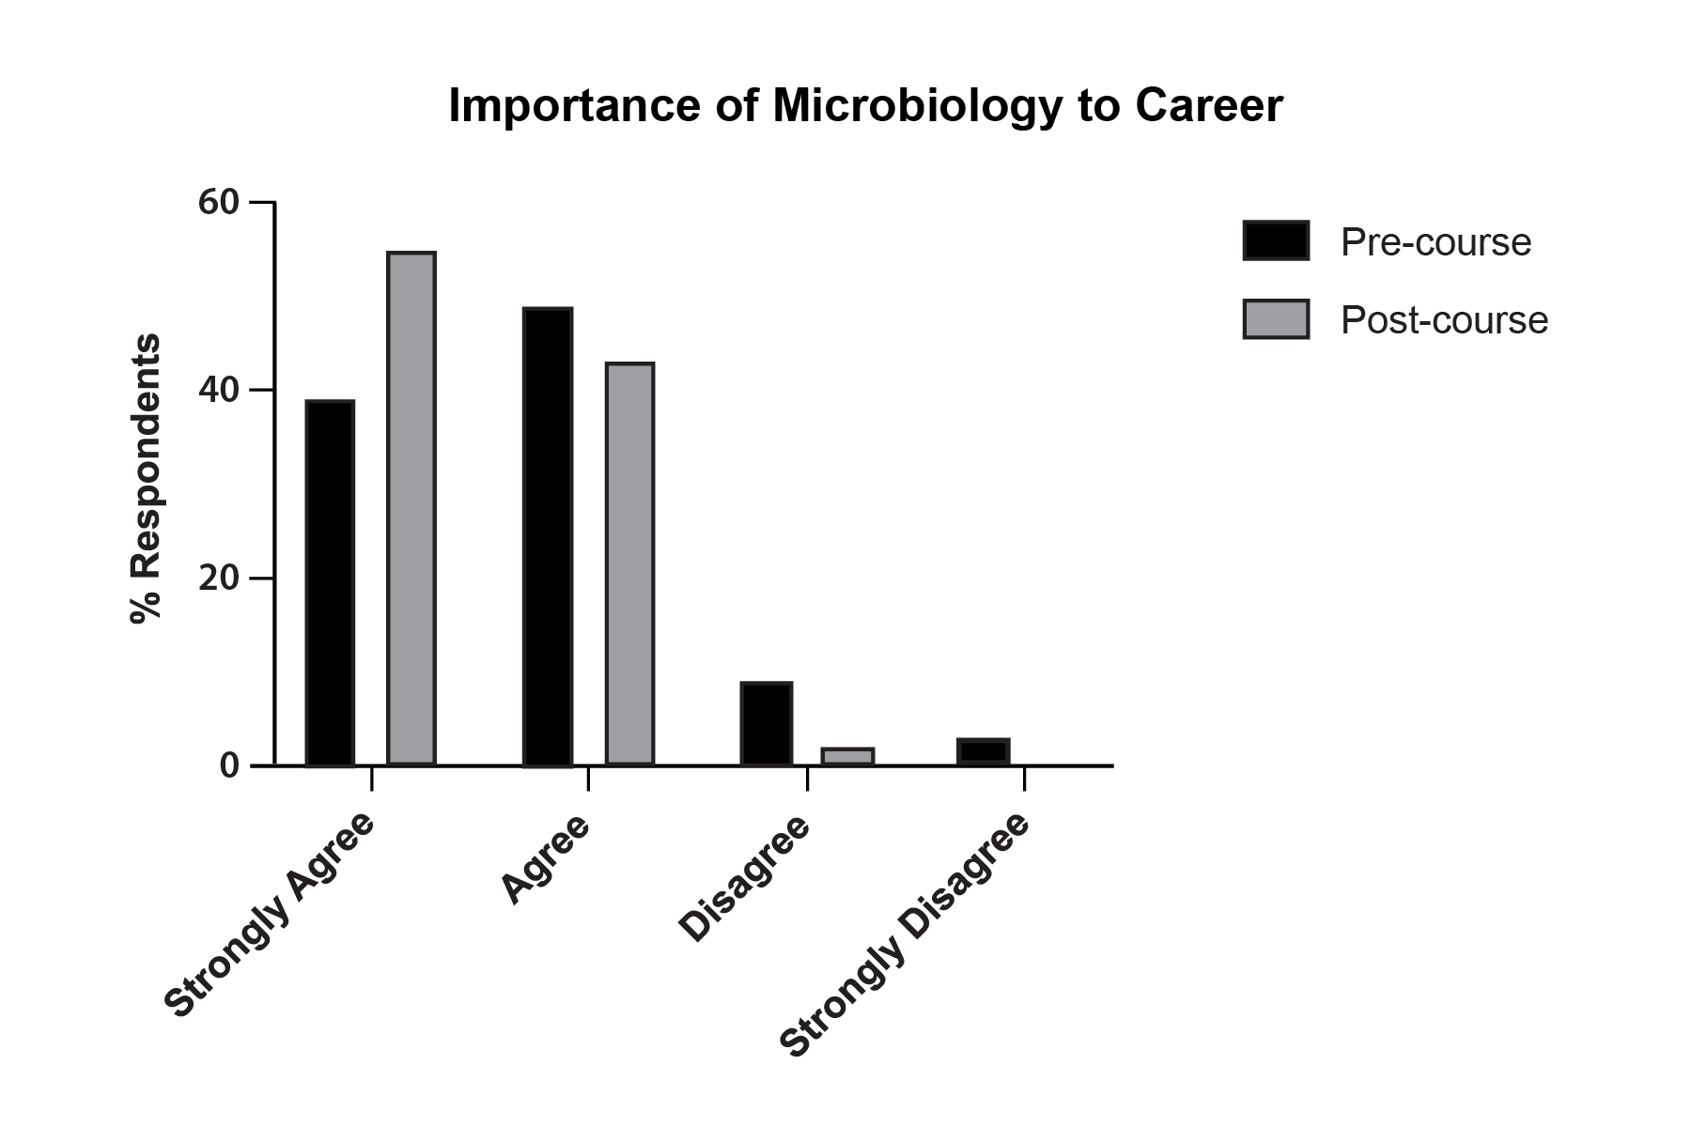
Student Perceptions

Slide 16
Conclusions
Most incoming NSU Optometry students had previous experience in Microbiology, but not Immunology
Students perceived the clinical co-lectures as helpful
Performance on clinically based MCQs correlated well with overall course performance
As few as 8 select MCQs accurately predicted overall course performance
The Microbiology & Immunology course tended to enhance the perception among students that the material was useful to their career.

Slide 17
Any questions?

Slide 18
References
Vidic B, Weitlauf HM. Horizontal and vertical integration of academic disciplines in the medical school curriculum. Clin Anat. 2002 May;15(3):233-5. doi: 10.1002/ca.10019.
Nehmad L, Appel J. The integrative track at SUNY State College of Optometry. Optometric Education. Summer 2011;36(3):146-151.
Rashima A, Krishnakumar R. Innovations in optometric education. Sci J Med & Vis Res Foun. 2016 Feb;34(1):11-14.
Armstrong RA. The microbiology of the eye. Ophthalmic Physiol Opt. 2000 Nov;20(6):429-41.
Twa MD. Optometry and biomedical sciences. Optom Vis Sci. 2018 Nov;95(11):975. doi: 10.1097/OPX.0000000000001313.
Ogu AN, Okereke JN, Ogwunga CC, Anyadoh-Nwadike S. Bacteria associated with ocular infections of out-patients visiting optical clinic in Owerri, Imo State, Nigeria. Res J Sci Technol. 2022;04(01):019-030. doi: https://doi.org/10.53022/oarjst.2022.4.1.0056.
Fernandes P, OYong K, Terashita D. Understanding infection prevention practices in optometry clinics. Optom Vis Sci. 2020 Jan;97(1):24-27. doi: 10.1097/OPX.0000000000001464.

