Slide 1
2011 Summer Conference – Academic Writing
By
Dr. David B. Ross
Abraham S. Fischler School of Education
Nova Southeastern University

Slide 2
This is a Doctoral Program
Academic Writing
Writing should be “scholarly”
Write for the specific reader
Read by “scholars”
Research and be familiar with your work
Read all of your cited references
Be able to defend your work at any given time
Research and read other “dissertations”
“Save” your work

Slide 3
When Should You Think “Scholarly”
Discussion topics (i.e., postings)
Blogs
Assignments
PowerPoints
Concept paper
Proposal
Dissertation

Slide 4
Annotated Outline
The word “annotation” refers to adding information: usually comments, explanations, or references
The organization and focus on the specifics of the paper insure that you concentrate on relevant material and exclude irrelevant material
Use in-text citations of resources
An outline in which you describe each section of the paper in complete sentences (an annotated outline is also sometimes referred to as a sentence outline)
Additional information is added (e.g., “key points,” also known as annotations)

Slide 5
Synthesize Your Research
Break into sections (level headings)
Look for connections between ideas and topics
Look at several observations and perspectives
Draw together particular themes or traits
Common sense thought and dialogue
Pull them together into some sort of harmony

Slide 6
EXAMPLE “A” Style I Style II
Leadership
Deming, W. E. (1986). Out of the crisis. Cambridge, MA: MIT CAES.
Deming observes that administrators must become empowering leaders by tapping the potential of an organization’s most important resource – its people. The people within the organization are not only important; they are unique and emotional beings, subject to cultural conditioning.
Garfield, C. (1992). Second to none: How our smartest companies put people first. Homewood, IL: Business One Irwin.
Garfield spoke with leaders of three companies to find out what they are facing and having to overcome in their future. The leader’s philosophy of empowering people helps build trust and respect between the leader and follower.
Leadership
Deming (1986) observes that administrators must become empowering leaders by tapping the potential of an organization’s most important resource – its people. The people within the organization are not only important; they are unique and emotional beings, subject to cultural conditioning.
Garfield (1992) spoke with leaders of three companies to find out what they are facing and having to overcome in their future. The leader’s philosophy of empowering people helps build trust and respect between the leader and follower.
References
Deming, W. E. (1986). Out of the crisis. Cambridge, MA: MIT CAES.
Garfield, C. (1992). Second to none: How our smartest companies put people first. Homewood, IL: Business One Irwin.
Notes:
As you can see, Style II will require that you provide at the end of your document the complete references

Slide 7
EXAMPLE “B” Style I Style II
Role of Perceptions
Fenwick, L. T., & Pierce, M. C. (2001). The principal shortage: Crisis or opportunity? Principal, 80(4), 24-32.
Fenwick and Pierce feel the qualities of an exemplary principal are having knowledge of all aspects of child development and curriculum implementation. They have knowledge of what to look for in a classroom and how to demonstrate teaching with a purpose.
Martin, E., Trigwell, K., Prosser, M., & Ramsden, P. (2003). Variation in the experience of leadership of teaching in higher education. Studies in Higher Education, 28(3), 247-259.
Martin, Trigwell, Prosser, and Ramsden suggest that teachers’ perceptions of leadership and their attitudes towards teaching affect the way in which teachers feel about their leadership. This is also an important precursor to the process of quality student learning and school setting outcomes.
Role of Perceptions
Fenwick and Pierce (2001) feel the qualities of an exemplary principal are having knowledge of all aspects of child development and curriculum implementation. They have knowledge of what to look for in a classroom and how to demonstrate teaching with a purpose.
Martin, Trigwell, Prosser, and Ramsden (2003) suggest that teachers’ perceptions of leadership and their attitudes towards teaching affect the way in which teachers feel about their leadership. This is also an important precursor to the process of quality student learning and school setting outcomes.
References:
Fenwick, L. T., & Pierce, M. C. (2001). The principal shortage: Crisis or opportunity? Principal, 80(4), 24-32.
Martin, E., Trigwell, K., Prosser, M., & Ramsden, P. (2003). Variation in the experience of leadership of teaching in higher education. Studies in Higher Education, 28(3), 247-259.
Notes:
Both styles have advantages and disadvantages (explain)
Style I will require that you provide at the end of your document the complete reference, while Style II will not

Slide 8
Structure Your Work
P.O.W.E.R.
Supporting ideas are much more complex in a doctoral level paper
Support
In-text citations
Paraphrase
Support from experts
Direct quotes
Use sparingly
Choose them carefully
Supporting paragraphs

Slide 9
According to Author (year). . .
Believed
Reported
Asked
Found
Contended
Concurred
Provided
Placed
Synthesized
Stated
Viewed
Mentioned
Recommended
Devoted
Examined
Discussed
Identified
Described
Used
Developed
Investigated
Echoed
Suggested
Expressed
Author’s 1998 study . . .
Bolman and Deal’s (1997) survey . . .

Slide 10
Dissertation Format
Title Page
Table of Contents
Acknowledgements
Abstract
Chapter 1 - Introduction
Chapter 2 – Review of the Literature
Chapter 3 - Methodology
Chapter 4 – Presentation and Findings of the Data
Chapter 5 – Conclusions, Discussion, and Recommendations
References
Appendices

Slide 13
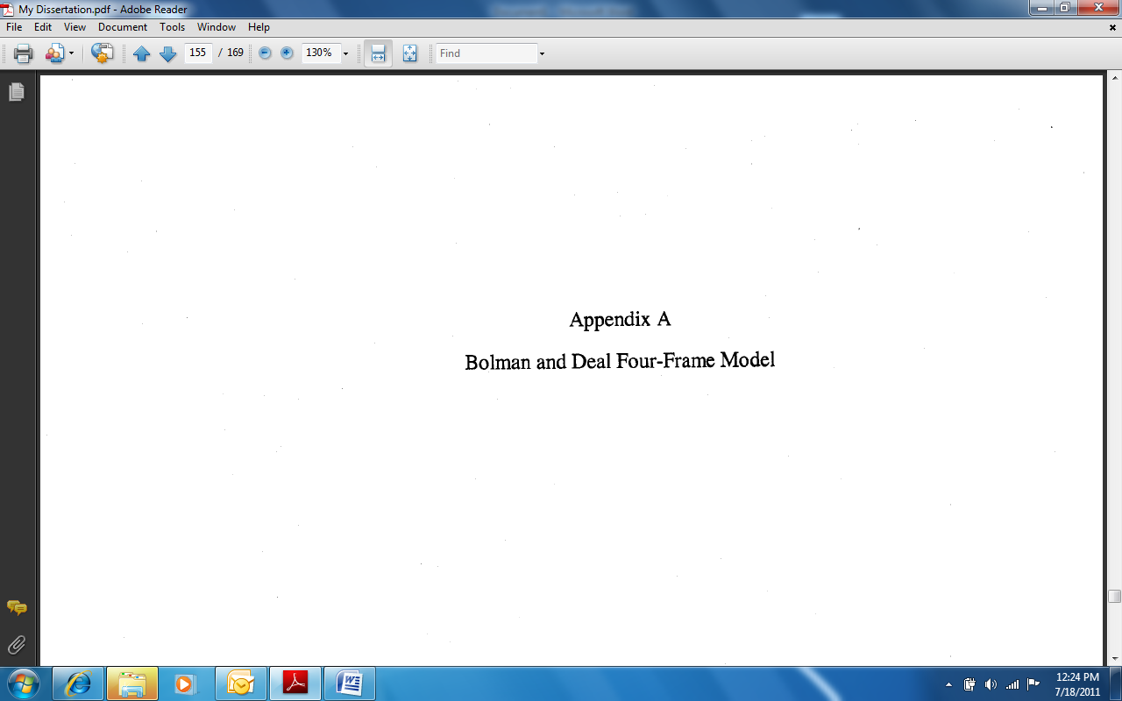

Slide 17
Paraphrasing versus Plagiarism
Read university policy on plagiarism
Read course syllabi regarding research and plagiarism
Write your own version of necessary information and ideas expressed by someone else – present your “own” analysis
Write a more detailed interpretation than a summary
Controls the temptation to quote too much
Balance thoughts of other scholars and your original ideas

Slide 18
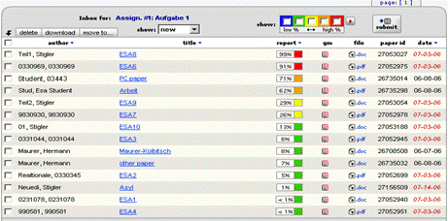
Notes:
Examples to discuss regarding the Turnitin procedures

Slide 19
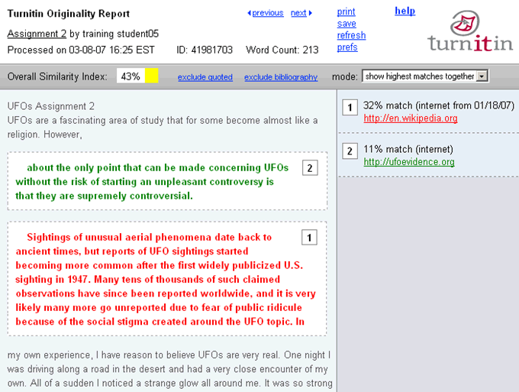
Notes:
Examples to discuss regarding the Turnitin procedures

Slide 20
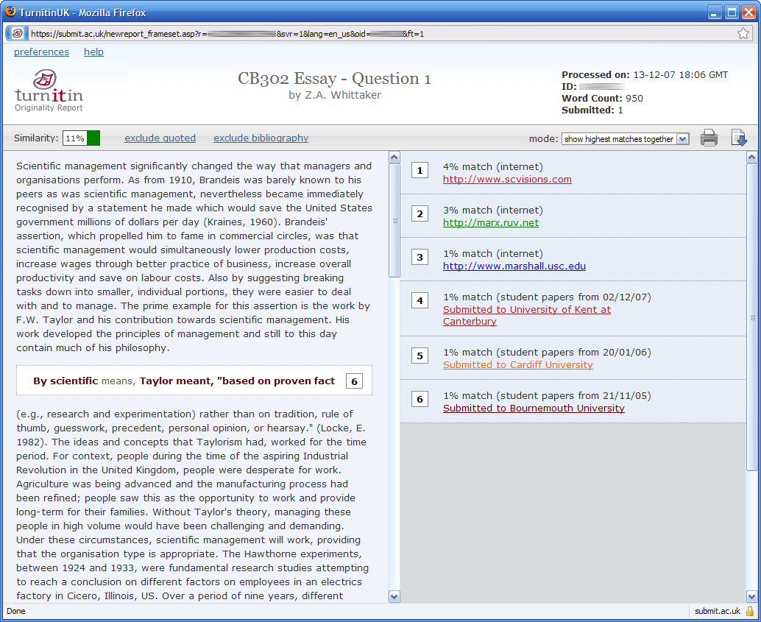
Notes:
Examples to discuss regarding the Turnitin procedures

Slide 21
American Psychological Association (APA)
First point – “BUY” and “READ” the 6th edition of the APA manual
Familiarization – like any text
Make tabs
Read APA Resources in Blackboard (Bb)
In-text Citations and References
Headings, tables, spacing, formatting
Page Numbers, seriation, punctuation

Slide 22
Themes Emerging from APA Errors
Grammar
Format
Hyphenation
Citing multiple authors
In-text citations
Numbers
Capitalization
Formality and clarity
Statistical copy
Punctuation
Tables and figures
Abbreviations
Quotations
Bias in language

Slide 23
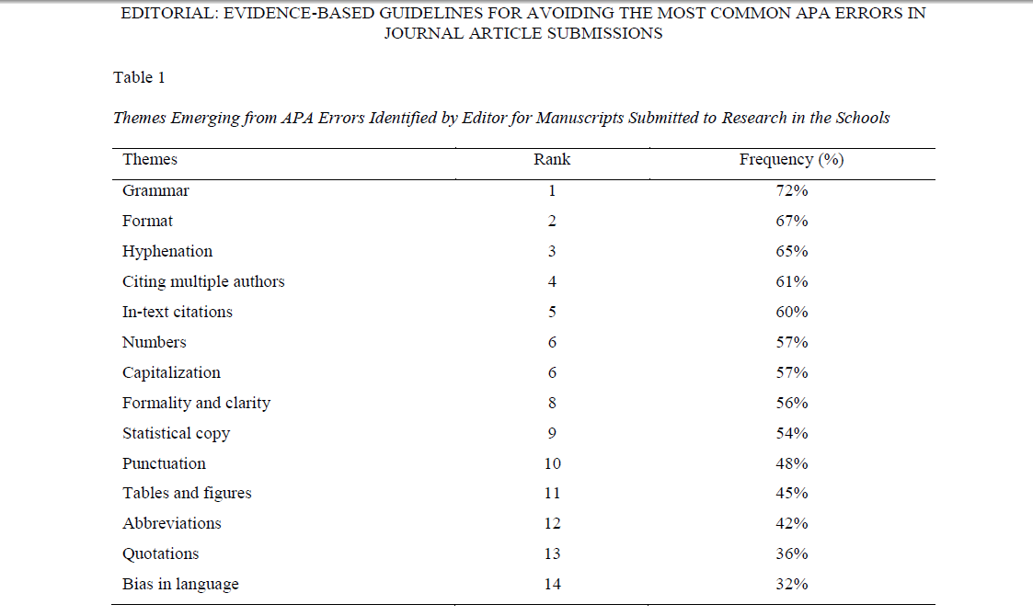

Slide 24
References
American Psychological Association. (2010). Publication manual of the American Psychological Association (6th ed.). Washington, DC: Author.
Galvan, J. L. (2009). Writing literature reviews (4th ed.). Glendale, CA: Pyrczak.
Harris, R. A. (2005). Using sources effectively (2nd ed.). Glendale, CA: Pyrczak.
Onwuegbuzie, A. J., Combs, J. P., Slate, J. R., & Frels, R. K. (2010). Editorial: Evidence-based guidelines for avoiding the most common APA errors in journal article submissions. Research in the Schools, ix-xxxvi.
Strunk, W. Jr., & White, E. B. (1999). The elements of style. New York, NY: Penguin Press.

Slide 26
Thank you for sharing your thoughts and experience Dr. David B. Ross daviross@nova.edu 954-262-8398

