Slide 1
Writing Your Dissertation: A Short Session on the Big Picture
David B. Ross, Ed.D.
Julie Ann Exposito, M.S.
Nova Southeastern University
2015 Summer Conference

Slide 2
Brief Disclaimer (yellow start)
We are reviewing a brief style for your dissertation
Numerous faculty philosophies (2 different chairs…different styles; not matched; common interests, topics, communication, time frame. Also teaching styles
(#of faculty) Courses, dissertation chair, and dissertation committee member
Various writing styles (Me: complement, wrote 3 articles/David diff faculty grading/1st vs this writer
We teach only APA 6th edition & NSU style guide format (david format) (Discuss programs, citation machines)
Different philosophies of hiring an editor
Be careful . . . Do your homework

Slide 3
Saving Your Work (by date, time stamp, email, Adriana, save edited ones but not overwrite it, writing process, create separate docs for sections to go back to.
. . . Very simple . . . Save it in numerous areas

Slide 4
Content
In order to be good, it must sound good and look good
Organization and structure
Level headings (APA manual & NSU Style Guide)
Organization of the Study
Chapter Summaries
Use direct quotes sparingly (a book of quotes, paraphrase and synthesize); plagiarism & unintentional plagiarism (discuss)
Theoretical & Conceptual Frameworks
Limitations of the Study
Delimitations of the Study
Suggestions for Future Research
Scholarly Resources

Slide 5
Examples of Literature Review Headings
Chapter 2: Literature Review
Introduction
Theoretical Framework
Reading Performance in a Title 1 School
Students With Special Education Needs
Interactive Read-Aloud
Five Components of Reading
Fountas and Pinnell Benchmark System 1
Research Questions
Chapter 2: Literature Review
Introduction
Theoretical Framework
Professional Development
Varied Approaches
Evaluation
Transfer of Knowledge
Professionalism
Conclusion
Research Questions

Slide 6
Examples of Literature Review Headings
Historical Context (Bring copy)
Contextualization of the Setting (Level 3 not in Table; headings and why; lit led me, read from this page)
Student Learner Styles and Preferences Across Cultures
Interaction Between Local and International Students
The Culture Engagement of Student and Teacher
Cultural Competency of Educators
International Student Adjustment
Academic Performance
Conclusion
Research Questions

Slide 7
Theoretical & Conceptual Frameworks
Focuses on time tested theories that embody the findings of numerous investigations
Provides a general representation of relationships between things in a given phenomenon
Specifies the theory used as a basis for the study
Mentions the theorists; historical & current
Cites the main points emphasized in the theory
A theoretical framework is based on ONE theory
The term conceptual framework crosses many large and small theories
See examples in following slides . . .

Slide 8
Theoretical versus Conceptual
These terms are used interchangeably
As stated in the previous slide
Theoretical is one theory
Conceptual is a combination
Literature can have them mislabeled
At the end of the day, you have to answer which theory works for my study
If you are studying satisfaction, then use any theory related to this topic
Satisfaction: assimilation theory (Lewin); contrast theory (Hovland, Harvey, & Sherif); assimilation-contrast theory (Sherif & Hovland); negative theory (Anderson)

Slide 9
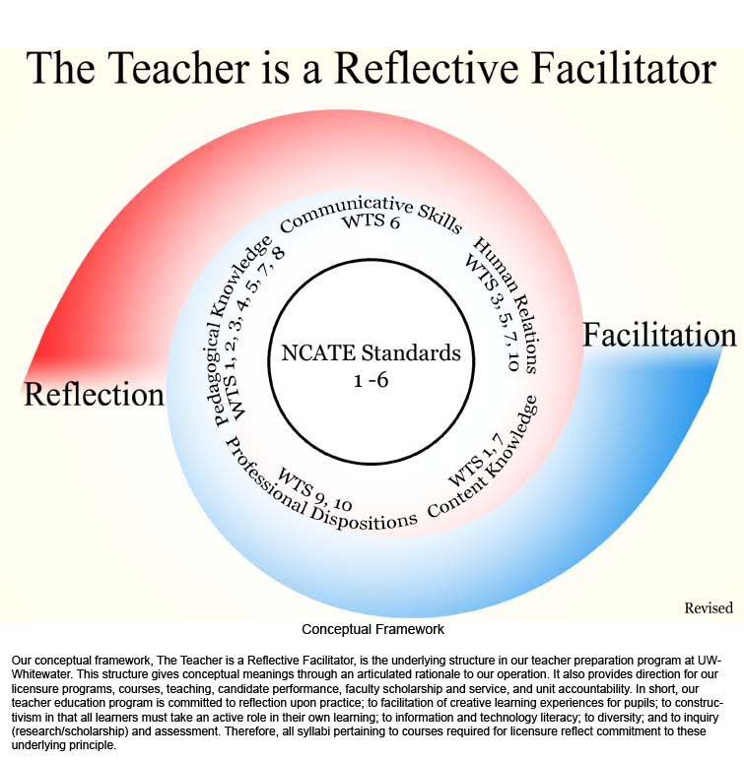
Conceptual Framework

Slide 10
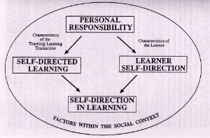
A Conceptual Framework: Self-Direction in Adult Learning
Self-Direction in Adult Learning (1991), Ralph G. Brockett and Roger Hiemstra argue that self-direction in learning refers to two distinct but related dimensions: as an instructional process where a learner assumes primary responsibility for the learning process; and as a personality characteristic centering on a learner's desire or preference for assuming responsibility for learning.

Slide 11
Some Theoretical & Conceptual Frameworks From Other Disciplines
Social learning theory: Bandura,1986; Rotter, 1954
Adult learning theory: Knowles, 1980
Role theory: Mead, 1934
State-Trait Anxiety: Spielberger, Gorsuch, & Lushene, 1972
Stress: Cannon, 1929; Lindemann, 1944; Selye, 1976
Helplessness: Seligman, 1975
Cognitive dissonance: Festinger, 1957
Developmental theory: Erickson, 1950; Freud, 1938; Havighurst, 1952; Piaget, 1926

Slide 12
Some Theoretical & Conceptual Frameworks From Other Disciplines
Motivation: Maslow, 1970
Crisis: Caplan, 1964
Relaxation: Benson, 1975
Pain: Melzak & Wall, 1983
Body Image: Schilder, 1952
Job satisfaction: Herzberg, 1966
Satisfaction: assimilation theory (Lewin); contrast theory (Hovland, Harvey, & Sherif); assimilation-contrast theory (Sherif & Hovland); negative theory (Anderson)

Slide 13
Some Theoretical & Conceptual Frameworks From Other Disciplines
Moral reasoning: Kohlberg, 1978
Change theory: Lewin, 1951
Health behaviors: Becker, 1985
Health Belief: Becker, 1955
Attitudes: Fishbein & Ajzen, 1975
Gate control: Melzak & Wall, 1983
Political systems: Michels, 1911; Mosca, 1939
Family theory: Duvall, 1977; Minuchin, 1974
Family communication: Satir, 1967
Coping: Lazarus & Folkman, 1984

Slide 14
Some Theoretical Frameworks From Nursing
Uncertainty: Mishel, 1988
Interpersonal theory: Peplau, 1988
Health promotion: Pender, 1987
Goal attainment: King, 1981
Interaction model of client behavior: Cox, 1982
Self-care deficit theory: Orem, 1991
Unitary person: Rogers, 1970
Adaptation: Roy, 1984
Systems model: Neuman, 1972

Slide 15
Andragogy and Malcolm Knowles
The theory based on the need to improve teacher professional development is grounded in the andragogy learning theory. This theory was advanced by Dr. Malcolm Knowles in the 1970s and was primarily used to study adult learning pedagogy. The theory of andragogy indicates that there are distinct characteristics of adult learning, which includes (a) self-directedness, (b) need to know, (c) use of experience in learning, (d) readiness to learn, (e) orientation to learning, and (f) internal motivation (Chan, 2010).
Zepeda (2012) affirms that “professional development that honors the adult learner has follow up to ensure transfer of new knowledge into the land of practice” (p. 49). Thus, adult learning theories guide professional development for effectiveness and transfer of new knowledge to classroom practice.

Slide 16
Social Psychology & Cultural Differences (moi)
According to Hofstede (2010), the school experience reinforces the cultural values that have already been experienced within the family setting. The theory based on the experience of the international student is grounded in the cultural dimensions theory, originally developed by Hofstede (1980) describing individualism-collectivism, uncertainty avoidance, poser distance, and masculinity-femininity. His original theory was revised to include a fifth dimension called long term orientation and a sixth dimension called indulgence versus restraint (Hofstede, 2010).

Slide 17
Social, Political, & Economic Issues
The social, political, and economic movements spanning the colonial period until today have impacted higher education in America in terms of accessibility, curriculum, and types of institutions. There is a shift to a universal student access to higher education, including all students of diverse ethnic, religious, socioeconomic, and academic levels (Noftsinger & Newbold, 2007). Furthermore, more than 3 million students prefer to study outside their home country (Rienties, Beausaert, Grohnert, Niemantsverdriet, & Kommers, 2012; Russell, Rosenthal, & Thomson, 2010).

Slide 18
Vygotskian Theory & Lev Vygotsky
In the Vygotskian theory, students are provided intellectual interaction through scaffolding approach that enhances learning more quickly than they could without the intervention (Vygotsky, 1978). This intervention, defined as best practices in education today, guides learning through modeling and cognitive development, while building repertoire of knowledge and understanding in students.
Flint (2010) introduced the Vygotskian and transactional reading theories; two approaches that promote literacy and learning. Flint reported that social interactions between teacher-student, student-student, and literary transactions combined with interactive read-aloud and buddy reading, promoted literacy.

Slide 19
Differentiated Instruction
This study is grounded in differentiated instruction approach that parallels the principles of the Sternner and Smith’s (1982) Lexile framework, Vygotsky’s social constructivist (SC) theory (1978), Vygotsky’s theory of zone of proximal development (Vygotsky, 1978), Bruner’s scaffolding approach (Bruner, 1962), and Krashen’s second language acquisition theory including Affective filter hypothesis and input hypothesis (1981). Based on the idea that all students differ in a way they receive, process information, and learn, the responsibility of providing students with multiple avenues for absorbing and internalizing of knowledge is shifted to an educator (Tomlinson, 2001).

Slide 20
Ineffective Co-Teaching Practices
The problem of ineffective co-teaching practices in the classroom is grounded in the distributed leadership theory and sociocultural theory’s more knowledgeable other. The distributed leadership theory was originally developed by James Spillane in 2004 and was primarily used to study leadership and management within the school. This theory was applied in both elementary and middle school leadership projects "designed to explore and understand leadership as a practice of instructional improvement and to examine the relations between leadership practice and teachers’ classroom work" (Northwestern University, 2010, para. 7).
The theory of distributed leadership indicates that individuals develop a reciprocal interdependence on one another (Spillane, 2005), where situations and activities require input from both individuals, as well as pooled interdependence on one another (Spillane & Sherer, 2004), where individuals work independently, but for a common purpose.

Slide 21
Limitations of the Study
Limitations refer to the restriction in the study over which the researcher has no control. The major limitation of the study is as follows:
1. The study was based on one first-grade class within an elementary school. Since the collection of data was limited to this one first-grade classroom out of six first-grade classrooms.
2. Since students were taught from different kindergarten and first-grade teachers, fidelity was questionable regarding the instruction of the interactive read-aloud.
3. Students’ data collection from the Fountas and Pinnell Benchmark System 1 was administered without fidelity.
4. The outcomes of this study would be hindered by the students’ challenge with expressive language.

Slide 22
Limitations of the Study
The study was based on voluntary participation of secondary school teachers who are employed with The XYZ School District. Since the collection of data was limited to the secondary school teachers of The XYZ School District, the generalization of the results of this study to other groups should be done only with caution and after extensive analysis and comparison.
Outcomes of this study are based on the responses to a survey, and therefore are limited by (a) the reliability and validity of the assessment instrument, (b) the ability of the respondents to read and understand the questions, and (c) the respondents’ honesty in answering the questions.

Slide 23
Limitations of the Study
The major limitations in the study will be found in the accessibility to the target audience and the scope of the study itself. In reference to the accessibility to the targeted audience, the survey has been designed to be completed by current police chiefs only, which may ultimately limit the number of survey responses to those police chiefs who will take the time to personally complete the survey. In addition, accessibility to the targeted audience will be restricted to the number of police chiefs who are listed on the available professional organizations’ email distribution lists. (my limitations are …)

Slide 24
Delimitations of the Study
This study was limited to the population of language impaired students in an elementary first-grade classroom. The researcher did not choose the general education student population of the same classroom of the four language impaired students. Due to the researcher’s professional experience while working with these language impaired students, a trend was recognized based upon how language impaired students learn to read; in addition, how they are consistently struggling with comprehension of written text across genres. This has a direct impact concerning performance on the FCAT 2.0 as well as the school grade. The researcher also did not select any of the other first-grade students from the other classes. This decision was based on convenience to focus on a specific group of students where fidelity of instruction would not be problematic.

Slide 25
Delimitations of the Study
Delimitations of this study was not to use perception data from high school co-teaching teams and not to conduct focused walkthroughs in order to identify effective co-teaching practices. The decision not to use perception data from high school co-teaching teams stems from the abundance of research on co-teaching practices at the high school level (Casale-Giannola, 2012; Clark, Dyson, Millward, & Robson, 1999). Additionally, due to constraints within the organization being researched, focused walkthroughs in order to identify effective co-teaching practices was not advantageous as this would be a conflict with the researcher’s current contract of employment. (what are my demiliations. What did I want to do but didnot-I did not do this because)

Slide 26
Suggested Future Research
The findings of this study supported the following recommendations for future research of the Fountas and Pinnell Benchmark System 1, to include the Leveled Literacy Intervention: (a) provide teachers with professional development and training on the implementation and analysis of using the Fountas and Pinnell Benchmark System 1 and the Leveled Literacy Intervention, (b) conduct a phenomenological study and interview teachers to gain the lived experiences on utilizing the Fountas and Pinnell Benchmark System 1 and 2, and (c) conduct a mixed study using quantitative and qualitative data to gain a better understanding to improve reading comprehension of language impaired students.

Slide 27
Suggested Future Research
In contemplating the limitations to the study, future studies may expand this study by (a) including sheriffs as part of the target population; (b) incorporating an additional perspective into the study, such as the city manager perspective, which could focus on how the politics variable may be impacting the police chief role as an emerging trend; (c) targeting the study to examine the impact of other emerging trends; (d) narrowing the scope of the research to examine the impact of the emerging trends on a certain state or region; and (e) conducting a mixed methods approach to include personally interviewing police chiefs and governmental officials regarding how the emerging trends are impacting the police chief role and influencing the KSAOs needed to perform the police chief role. (What do I want to research further? You can expand from a previous study. Contact other authors, may help direct in particular area)

Slide 28
Scholarly Resources
Written or edited by a scholar
Articles in a journal published by a college or university
Articles in a journal published by a scholarly group
Peer reviewed or published in a scholarly source
Recognized academic publishers or university presses
Sources are cited and listed references
Documented research claims
Conclusions based on evidence provided
The length of the source and higher level language

Slide 29
NOT a Scholarly Source
No author or no publisher listed
Not magazines
Not newspapers
Textbook written for classroom use as it is a teaching tool
Classical works
Has no review process; material meant for a wider audience
Wikipedia
Lots of pictures

