Slide 1
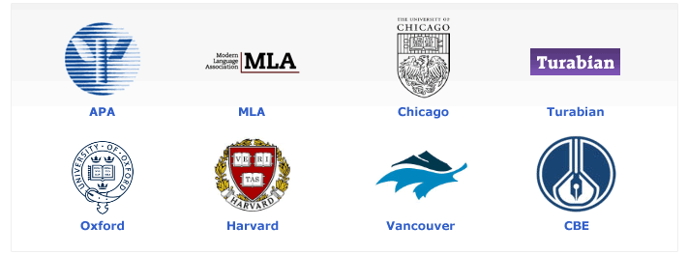
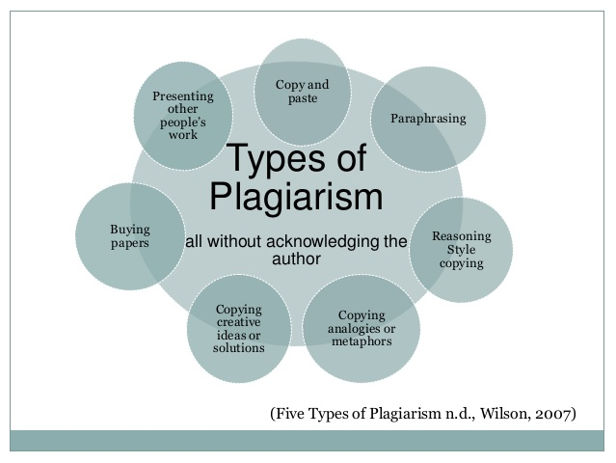
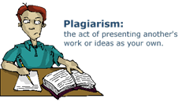
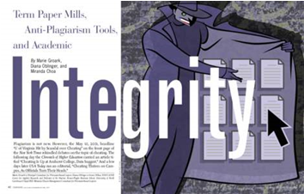
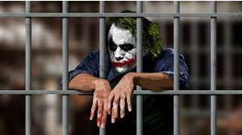
Academic Integrity: Corruption and the Demise of the Educational System
Julie A. Exposito & Dr. David B. Ross, Florida, USA
Abraham S. Fischler College of Education, Nova Southeastern University and Broward College
Academic Integrity
The Need for Institutional Policy
Fraud
Federal Fraud Code and Crimes
Academic Dishonesty
Academic dishonesty is a phenomenon witnessed in higher education where the decision to cheat is a deliberate choice for students (Seals, Hammons, & Mamiseishvili, 2014). Although this is prevalent in higher education, it is also a disturbing phenomenon witnessed at all educational levels.
Preserving academic integrity is a topic for all stakeholders that has been challenged by the onset of new technology and changed viewpoints of the millennial generation (Dyer, 2010). The increase of technology usage has increased violations of academic integrity: an increased connectivity, collaboration, and social networking (Dyer, 2010; Jiang, Emmerton, & McKauge, 2013; Marsh, 2011).
Cultural Perspective of Academic Integrity
Blum (2009) admonished there must be communication about plagiarism between students and faculty, and international students must be cognizant of institutional policy on academic integrity. Cultural differences can be misinterpreted with negative consequences for international students (Cohen, 2007).
Honor Codes
In drafting a hypothetical model code for academic integrity, Pavela (2013) delineated four stages of institutional development at different institutions of higher education.
The primitive stage: includes schools without policy or procedures and a lack of standard procedure for handling academic misconduct.
The radar screen: characterized by initial policies set by administration due to fear of litigation. There is an inconsistent response to academic dishonesty.
The mature stage: where policies are known but not completely followed; the policies are utilized more by faculty.
The honor code: where students take a responsibility in implementing academic integrity.
Academic integrity and commitment to honor codes (Dix, Emery, & Le, 2014)
Biswas (2013) contended student development plays an integral role in adherence to a code of conduct. Institutions should not only develop policy to implement academic honor pledges, but there is a need in raising awareness and increased training of academic integrity (Gullifer & Tyson, 2014; Jiang, Emmerton, & McKauge, 2013). When a policy is in place, it protects the institution, the faculty, and students; it is the responsibility of the faculty to set expectations, guidelines, and scoring rubrics for assignments and coursework.
A wide spectrum of secondary and postsecondary institutions were selected to represent the diversity of different institutions ranging in geographic location, population, student demographics, initiatives, mission statement, and vision. Institutional plagiarism policies, which were found on their websites, contain many terminologies that are illustrated in Table 1.
Institutional Academic Policy
It is important for institutions to implement and maintain a policy on academic integrity. Equally important is a systematic approach to ensure faculty, domestic students, and international students understand the definition of plagiarism and the policy on academic integrity (Gillespie, 2012; Gullifer & Tyson, 2014).
Gullifer and Tyson (2014) found that both students and faculty have inconsistent notions about plagiarism, which contributed to inconsistencies among students, faculty, and institutions. Gullifer and Tyson contended a standard definition of plagiarism does not exist, and there is no standard among staff in recognizing and managing plagiarism. Table 2 illustrates some definitions by other writing styles.
Table 2
Academic Policies for Various Discipline Styles
____________________________________________________________________________
APA Policy - Authors do not present the work of another as if it were their own work.
MLA Policy - Taking another person's language or thoughts and putting them in your own paper without acknowledging they came from another source.
The St. Martin’s Guide - A writer may represent someone else’s thought or idea as his own by including direct quotations without attribution, or, in some cases, a writer may obtain an entire paper from another source and turn it in as her own (St. Martin’s Tutorial, n.d., para. 4).
Chicago Manual Policy - Whether permission is needed or not, researchers should develop good practices at all times to avoid any possible charge of plagiarism; credit any sources used.
____________________________________________________________________________
Academic Misconduct
Contract cheating. Contract cheating is the process of bidding between independent contractors for assignments that have been uploaded to a website. The client selects an author based on the lowest bidding price, and services are paid through PayPal (Weber-Wulff, 2014).
Falsifying data. Falsifying data is the manipulation of data to meet personal agendas in biased research. In a qualitative study, researchers have to write sections on ethical considerations, trustworthiness, and potential research bias.
Ghostwriting. Ghostwriting is the process where an author does not receive acknowledgment for writing assignments. Companies hire ghostwriters to write custom-written papers. Because the company acts as an intermediary, the ghostwriter remains anonymous. There is no contact between the client and the ghostwriter (Weber-Wulff, 2014).
Honorary authorship. This is an issue to determine which researchers should gain credit for their contributions to a specific study.
Paper mills. A paper mill maintains papers collected with an author’s permission in a large database. The customer purchases access to this database under the pretense of learning to structure the paper.
Plagiarism. Weber-Wulff (2014) classified ten types of plagiarism:
copy and paste,
translations,
disguised plagiarism,
shake and paste collections,
clause quilts,
structural plagiarism,
pawn sacrifice,
cut and slide,
self-plagiarism,
other dimensions like collusion.
Unknown ghostwriters. Weber-Wulff (2014) described an “unwitting ghostwriter” to be a thesis writer with archived work on a compact disk with a digital version at the university library. Students access these digital versions to modify, use, and claim ownership to the thesis.
Fraud
Academic dishonesty is a concern for institutions of higher education as the increase in technology provides a path to new ways of committing academic fraud and electronic dishonesty (Wallace & Newton, 2014). Even though students accept the terms of the honor code, students are risking the consequences of cheating (e.g., failing grade, suspension, expulsion).
There are few acts that seem to the draw the attention of society over others when discussing ethics and integrity. Society has an expectation that colleges remain neutral and inspire critical thinking; furthermore, it is expected that institutions will raise the bar on ethics, excellence, and integrity through various standards. However, there are far too many examples of clever schemes to defraud and cheat various entities and stakeholders.
Cheating has plagued our educational system and permeated the workforce; in fact, a significant body of open source reporting suggested cheating an epidemic in America. There are serious flaws within our educational system, exemplified in the ease of committing academic fraud. This phenomenon has become an almost instinctive impulse to achieve goals with little consideration for ethics and integrity.
The conduct of cheating violates both federal and state felony statutes-law(s) and a person(s) or institution can be criminally charged-convicted individually or in a conspiracy case. Double jeopardy does not imply if charged or convicted in both the federal and state courts based on the same conduct in the defense argument.
The Federal False Claims Act is a tool that can reign in unethical conduct and encourages the reporting of unethical conduct and violations of federal law. Many states have adopted the provisions of the Federal False Claims Act; any person or institution can be dually charged with violations of federal-state False Claims Act offenses arising from the same conduct.
Any person or institution having personal knowledge of any conduct and other activities defined by statute as illegal conduct can lead to the felony prosecution of persons and or institutions that fail to report any conduct which is illegal.
This provision of the law includes any (overt acts) or attempt(s) to do an act in violation of a crime; the crime is punishable under the same provisions as if the act had been completed. Under the theory of a conspiracy, any person-business in the conspiracy is liable for the acts of others whether they know the others involved and the statements of others are attributable to others.
Any proceeds or property acquired by means of academic cheating are subject to either federal or state administrative-criminal asset forfeiture proceeding. Thus, there is an added disincentive for engaging in the conduct presented in this paper.
Paper mills must operate using means to communicate. Under the federal mail and wire act, any person-business or other entity involved in a scheme to defraud (attempts are included) using the mail or wire systems are crimes.
It is likely the paper mill services under report and or fail to report earnings to federal and state taxing authorities which also become crimes.
A national investigative-enforcement strategy could prevent-control this problem. Adding enhanced crimes, such as false statements or causing/keeping false records: (a) student grades and educational reports (18 USC § 1001), (b) theft (18 USC § 666), (c) the Racketeer Influenced and Corrupt Organizations (RICO) Act (18 USC § 1961-1968) and (d) financial institution fraud crimes (18 USC § 1344) can be applied as countermeasures and investigative tools. Each carries additional criminal sentences and asset forfeiture penalties (18 USC § 1956).
18 USC § 4 Misprison of a Felony
Steps in the Fraud Case
18 USC § 371 Law of Conspiracy
Concepts of cheating/shared work may be considered acceptable
Considered honorable to help the community
May not be an issue of honesty, character, and integrity.
Cheating may not considered unethical (Smithee, 2009)
Hypothetical Case Study
The Process
A student receives an assignment with the professor’s criteria, expectations, rubric, scoring guide, and format rules
a quick online search of paper mills, plagiarism mills, or essay mills produces several results
selects one based on various factors
The client includes payment information and then posts the topic on the paper mill board
ghostwriter contacts the client directly to discuss the specifics of the paper based on the guidelines
client’s credit card is charged and then the contracted writer begins working on the paper
By entering into an agreement, both parties agree to accept the resulting obligations and consequences
ghostwriter then sends a final copy via email
student only has to write his or her name on the title page of the paper and submit it to the professor, usually by email
the professor grades it; the student has now stolen a grade which is something of value
Conduct can be defined as theft and fraud because something of value (e.g., academic grade) was stolen
potential crimes could include; (a) false statements, (b) wire fraud, (c) mail fraud, (d) conspiracy, (e) RICO, (f) money laundering, and (g) financial institution fraud (e.g., banks, PELL, VA, financial aid), and (h) theft
Consequences
Everyone involved in the paper mill companies, e.g. owners, ghostwriters, institutions, and students, committed numerous violations of law and may be involved in an ongoing conspiracy.
Fraudulent scholarly work is reported, maintained, and transmitted to federal and state departments of education (and related administrative and regulatory agencies); yhis represents false record-keeping (18 USC § 1001)
Assets/monies are subject to asset seizure and forfeiture; added incentive to initiate criminal investigation into these organized schemes to defraud (18 USC § 1001)
Failure to report it is a violation of the US Code 18 Section 4 (Misprison of a felony)
Recommendations
Plagiarism policies need to be developed by training students and teachers, establishing a transparent policy
Policy makers in universities and colleges, including the K-12 system, should have a policy in place that detects possible plagiarism-unintentional plagiarism
Public policy of plagiarism, editing services, contract cheating, and use of ghostwriting need to be implemented
Implementation of a flowchart would help professors and students understand the due process to determine consequences of the documentation in question
The Center for Academic Integrity (1999) developed seven recommendations for every institution of higher education:
1. Have clear statements, policies, and procedures that are implemented.
2. Inform and educate the community about academic integrity
3. Practice these procedures from top down. Follow and uphold them.
4. Have an equitable system to adjudicate violations.
5. Develop programs to promote integrity.
6. Watch trends in technology that affects campus integrity
7. Assess efficacy of policies and improve upon existing ones.
18 USC § 1956 Forfeiture
Forms of academic misconduct:
contract cheating,
falsifying data,
ghostwriting,
honorary authorship,
paper mills,
plagiarism,
unknown ghostwriters (Weber-Wulff, 2014)
18 USC § 1341 and 1343 Mail and Wire Fraud
26 USC § 7201 Attempt to Evade Tax
The global concept of honor codes should be introduced at K-12 international schools
There is a need for honor codes in American institutions of higher education
Possibilities for Actions
Table 1
Terminology of Institutions’ Relevant Terms Involving Plagiarism Policy
______________________
___________________________________________
Academic Dishonesty
Academic Integrity
Academic Misconduct
Accountability
Cheating
-
Deception
Fraud
-
Fabrication
Electronic Dishonesty
Plagiarism
Unintentional Plagiarism
_____________
__________________________________________________

