Slide 1
It’s a Process: Mentally Preparing for Iterative Manuscript Development
Karen Wilson Scott, TQR Co-Editor

Slide 2

Submitting a manuscript to a peer-reviewed journal . . .

Slide 3
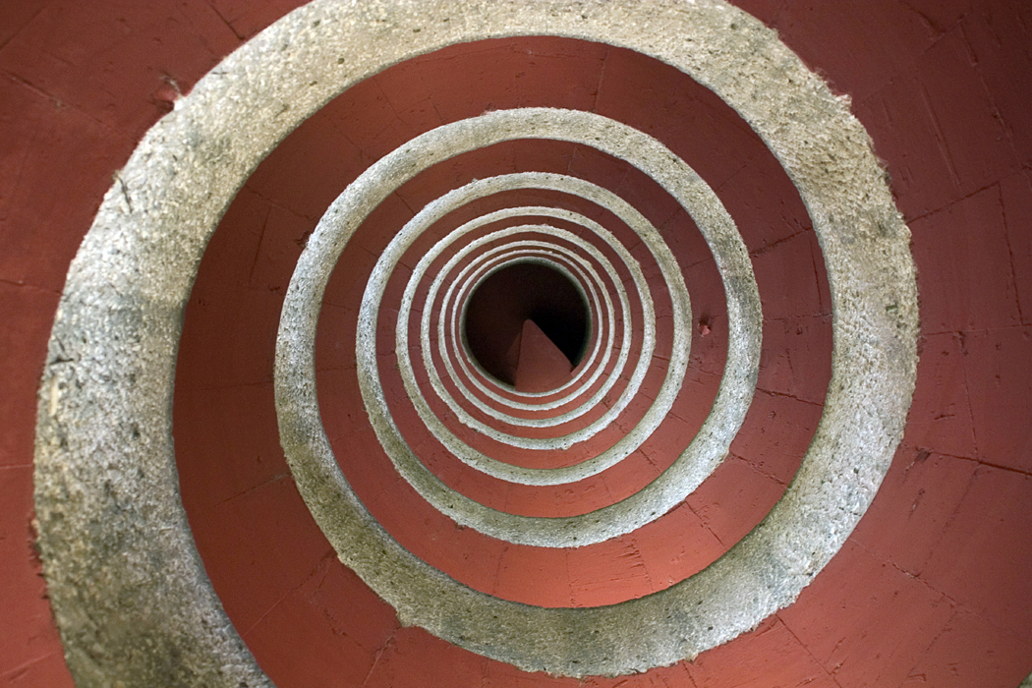
Sometimes, feels like this . . .

Slide 4
TQR wants it to feel like this . . .
Your Manuscript
Your Work
Your Publication
In TQR
TQR Work

Slide 5

We’re in this together . . .
Plan on partnership, not grading

Slide 6


Broadening perception. . .
There is no such thing as immaculate perception. What you see depends upon what thought before you looked.
There is no such thing as an immaculate manuscript. What you submit depends upon what you thought before you wrote.

Slide 7

Read this …

Slide 8
How many “F’s”?
FINISHED FILES ARE THE RE
SULT OF YEARS OF SCIENTI
FIC STUDY COMBINED WITH
THE EXPERIENCE OF YEARS
How many “F’s” did you find?

Slide 9
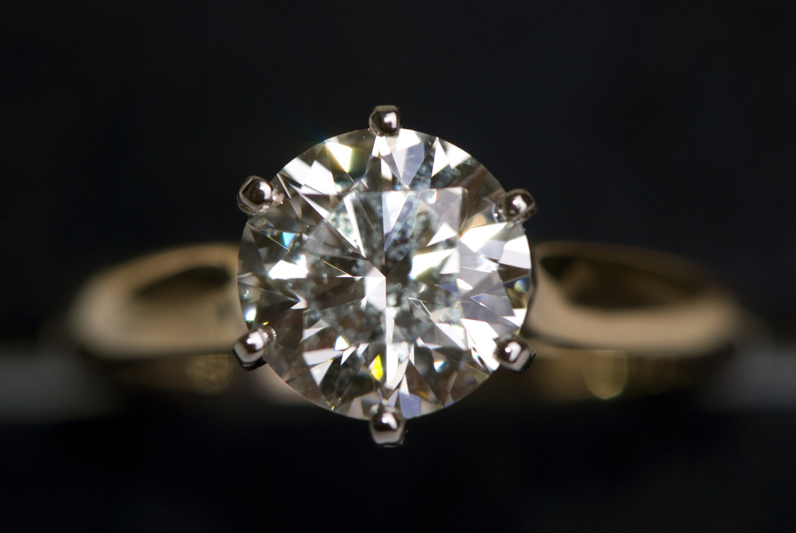
Creating a Masterpiece
“Right the first time” – possible, but unlikely
Do well – but don’t expect perfection

Slide 10

Creating a Manuscript
Work on your manuscript until you have it ready, then let it go…
TQR accepts manuscripts willing to partner with authors; mentor authors along the way.

Slide 11

Be open to suggestion . . .
Collaborating with researchers
TQR offers suggestions, new perspectives, additional resources
Chance to “go to coffee” virtually

Slide 12

Persevere . . .
Few things are impossible to diligence and skill. Great works are performed not by strength, but by perseverance.
Samuel Johnson (1709-1784)
Thoughts?

