Slide 1
Library
Tips
Getting
Your Paper
Published
Susan Berkman
Faculty Fest
October 28, 2014

Slide 2
Publishing articles
Finding the right journal
READ the manuscript submission guidelines
Submit
Editorial Board reviews and notifies
Accept/Reject/Revise
Revision process
Accept and publish
Notes:
Look at journal’s scope; is it empirical research, review paper, thought piece, book review? Are they accepting those? Reputation?
Guidelines: Right reference style? Word limit? Prepared for blind review? Stuck to academic writing style? Permission for copyright of articles cited?

Slide 3
Cabell’s

Slide 4
Finding Call for Papers
Journals
Associations
Conferences
Publishers
Societies

Slide 5
Assessing scholarly publications
Ulrichsweb—for peer-reviewed and scholarly
Journal Citation Reports (JCR)—calculates citations, Impact Factor, Immediacy Index, and more
Eigenfactor score—number of incoming citations to the journal and the total importance of the journal to the academic community
SCImago Journal & Country Rank database--journal rank indicators, also known as SJRs, are similar to the Eigenfactor scores but come from Elsevier’s Scopus database
Notes:
http://thomsonreuters.com/journal-citation-reports/
http://www.eigenfactor.org/
http://www.scimagojr.com/journalrank.php?country=US scientific

Slide 6
Resources
Predatory Publishers (http://scholarlyoa.com/publishers/)
Emerald Guide to Getting Published
(http://www.emeraldgrouppublishing.com/authors/workshops/)
Education Arena -- Taylor & Francis (http://www.educationarena.com/cfp.asp)
H-Net (http://www.h-net.org/)
Sage’s How to Get Published (http://www.sagepub.com/upm-data/63382_how_to_get_published.pdf)
Notes:
H-Net is an international interdisciplinary organization of scholars and teachers dedicated to developing the enormous educational potential of the Internet and the World Wide Web. Our edited lists and web sites publish peer reviewed essays, multimedia materials, and discussion for colleagues and the interested public.
SCImago's journal rank indicators, also known as SJRs, are similar to the Eigenfactor scores. The major difference is that the SJRs are based on information obtained from Elsevier's Scopus database which includes more than 17,000 titles from 5,000 publishers.

Slide 7
General tips
Read and review the professional literature
Become a good writer
Look at professional development activities
Know your audience; know journal’s audience
Collaborate
Have others review your manuscript
If rejected, ask for comments of manuscript reviewers
DO NOT GIVE UP!!!!
Notes:
Write book review; revisit papers from academic past; read new publications; review journal manuscripts and conference papers (be considered for a reviewer);
PD—poster sessions, panel discussion, volunteer op can be framework for developing an article; attend “how to get published” discussions

Slide 8
?????????

Slide 9
Contact us
Susan Berkman
Subject Specialist—Business
sberkman@nova.edu refdesk@nova.edu
954-262-4573 954-262-4613

Slide 10
Photo by arbyreed - Creative Commons Attribution-NonCommercial-ShareAlike License https://www.flickr.com/photos/19779889@N00
Created with Haiku Deck

Slide 11
Photo by djking - Creative Commons Attribution-NonCommercial-ShareAlike License https://www.flickr.com/photos/60368684@N00
Created with Haiku Deck

Slide 12
Photo by włodi - Creative Commons Attribution-ShareAlike License https://www.flickr.com/photos/19716902@N00
Created with Haiku Deck

Slide 13
Photo by ginnerobot - Creative Commons Attribution-ShareAlike License https://www.flickr.com/photos/78011127@N00
Created with Haiku Deck

Slide 14
Photo by Holly Norval - Creative Commons Attribution License https://www.flickr.com/photos/63833161@N05
Created with Haiku Deck

Slide 15
Photo by nickwheeleroz - Creative Commons Attribution-NonCommercial-ShareAlike License https://www.flickr.com/photos/7762644@N04
Created with Haiku Deck

Slide 16
Photo by cplong11 - Creative Commons Attribution-NonCommercial-ShareAlike License https://www.flickr.com/photos/45298653@N00
Created with Haiku Deck

Slide 17
Photo by Holy455 - Creative Commons Attribution-NonCommercial-ShareAlike License https://www.flickr.com/photos/37254526@N04
Created with Haiku Deck

Slide 18
Photo by payayita - Creative Commons Attribution-ShareAlike License https://www.flickr.com/photos/73669120@N00
Created with Haiku Deck

Slide 19
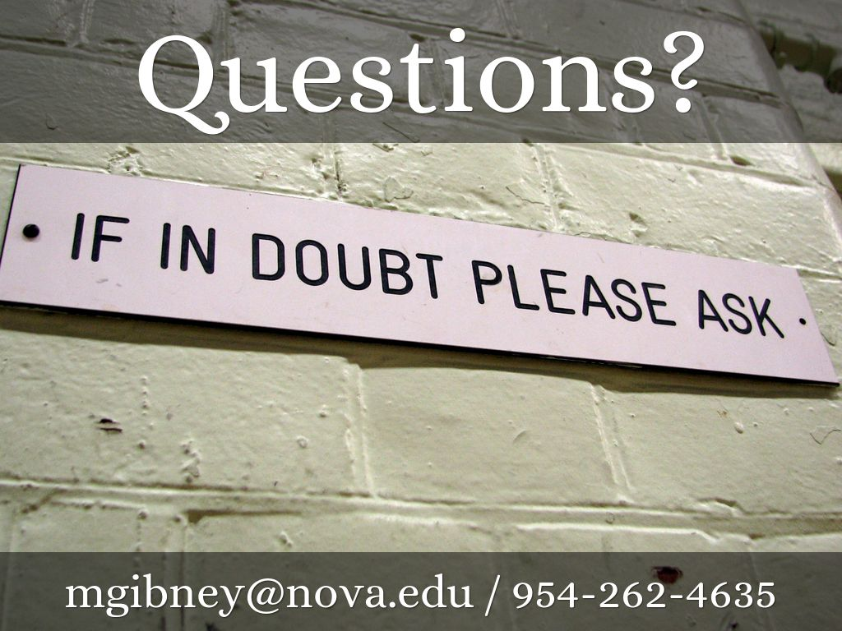
Photo by Roo Reynolds - Creative Commons Attribution-NonCommercial License https://www.flickr.com/photos/85429509@N00
Created with Haiku Deck

